Slide 1
Học máy trong phân tích kinh doanh
Bài Học
MySQL Interaction
Giảng viên:
TS. Trần Duy Thanh
Email: thanhtd@uel.edu.vn
Blog: https://tranduythanh.com

Slide 2
Mục tiêu bài học
Cài đặt được MYSQL
Sử dụng được MYSQL Workbench
Lập trình được Flash Python với MYSQL

Slide 3
Outlines
Cài đặt MYSQL
Sử dụng MYSQL Workbench
Lập trình Flash Python với MYSQL

Slide 4
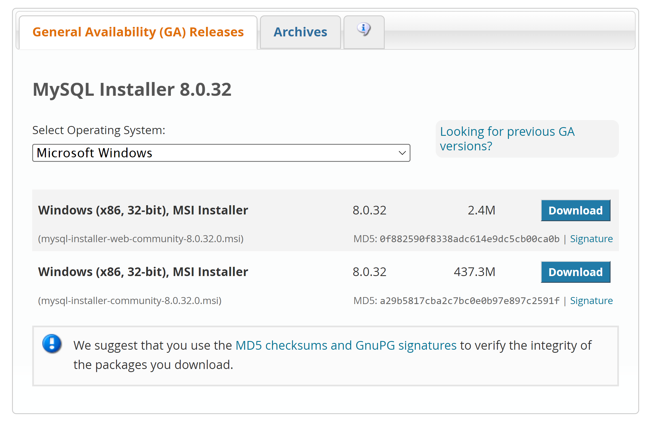
Cài đặt MYSQL
https://dev.mysql.com/downloads/installer/

Slide 5
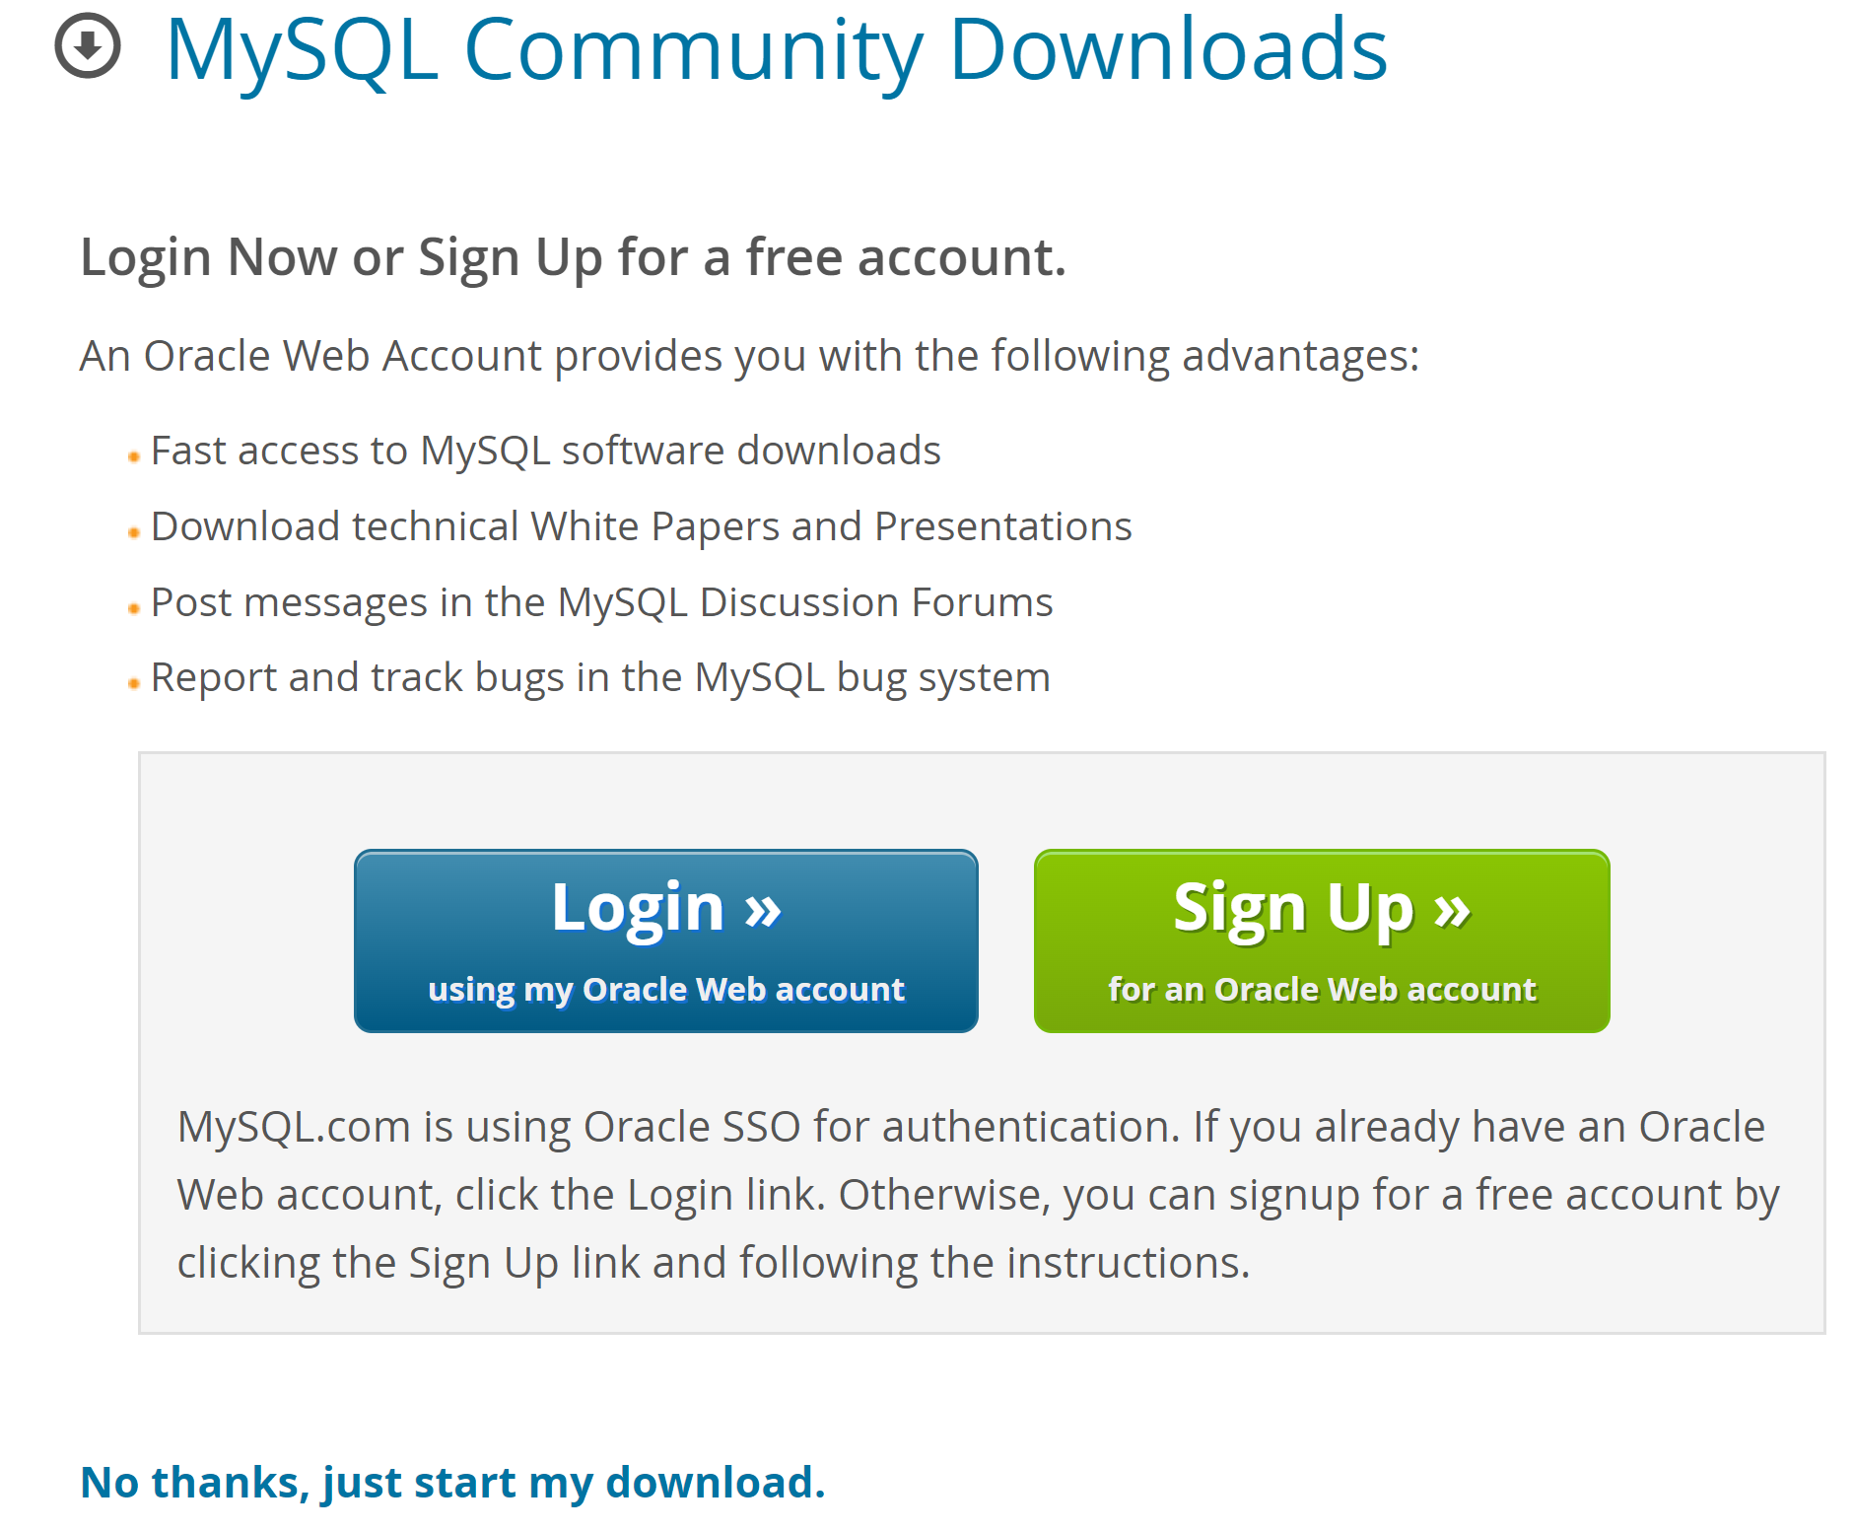
Cài đặt MYSQL

Slide 6
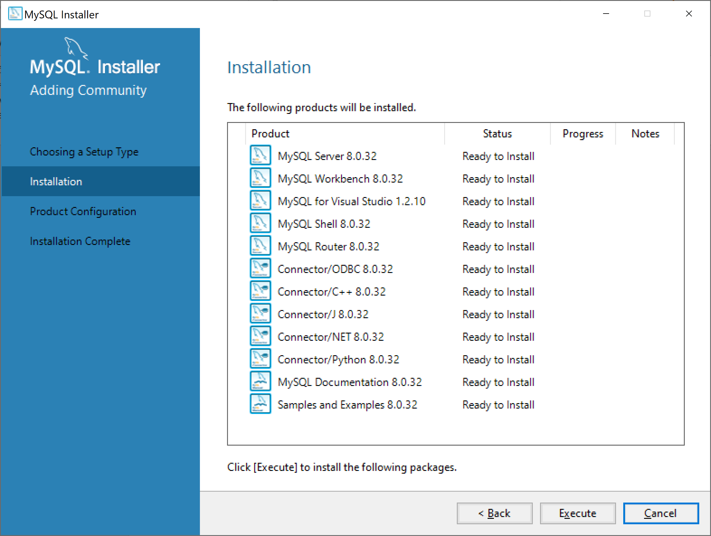
Cài đặt MYSQL
Installing MySQL Server:
mysql-installer-community-8.0.32.0

Slide 7
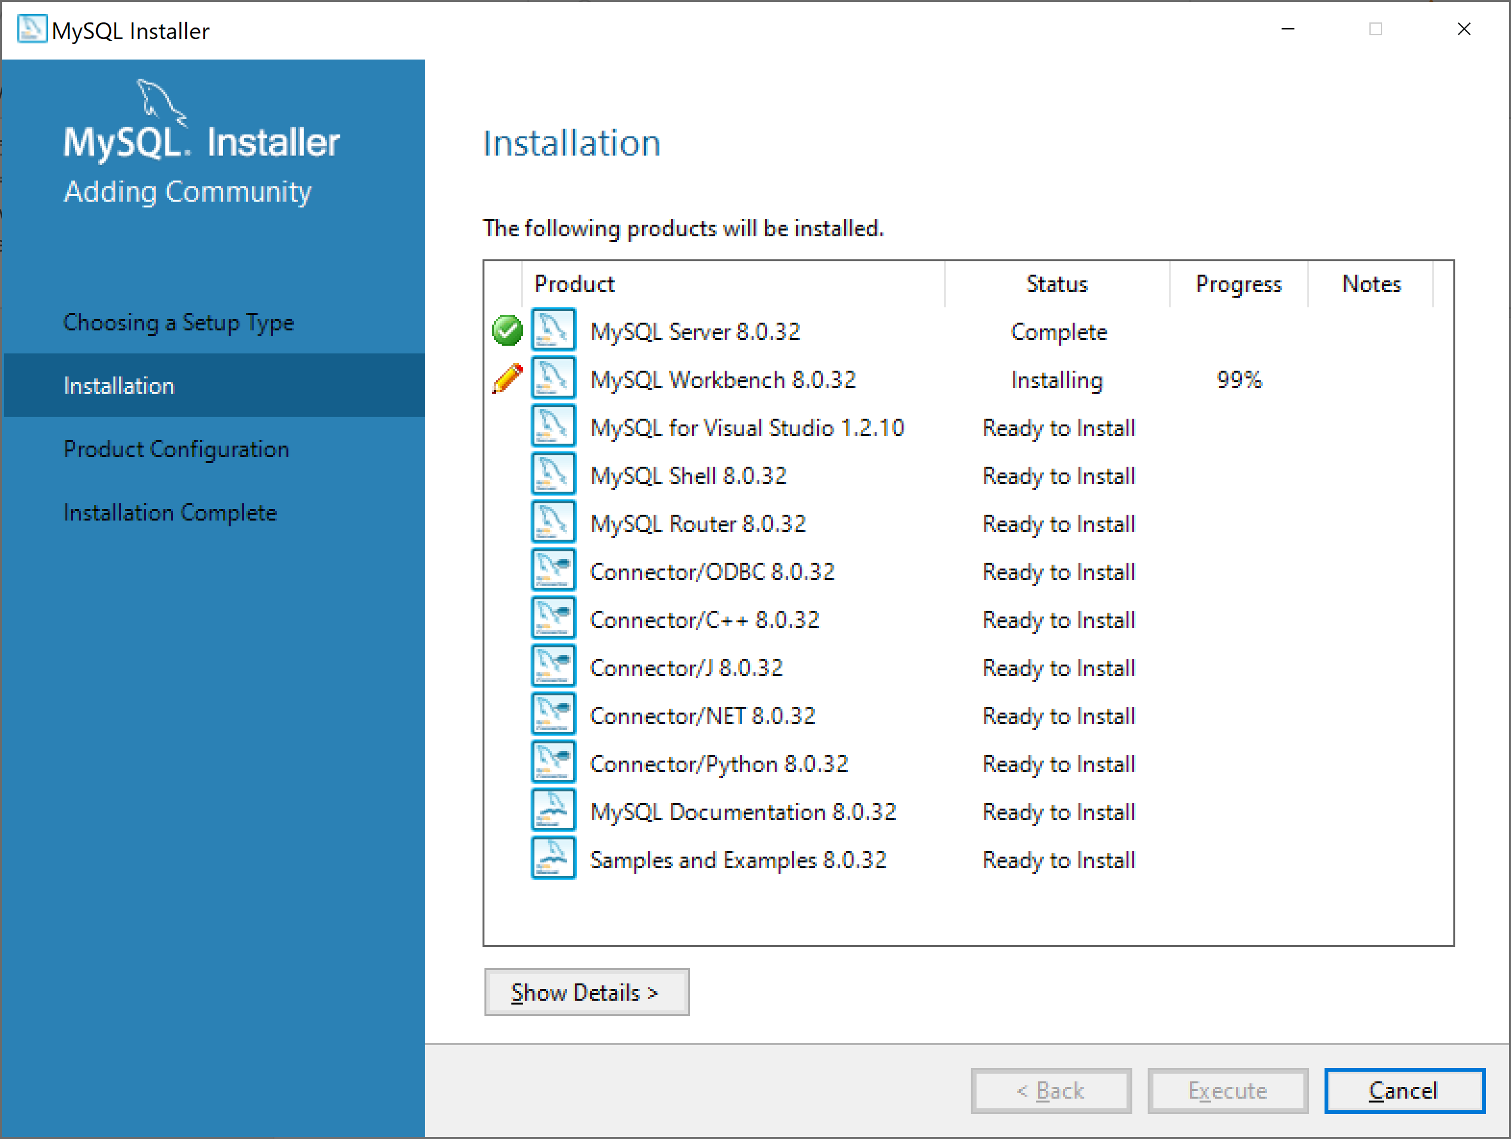
Cài đặt MYSQL

Slide 8
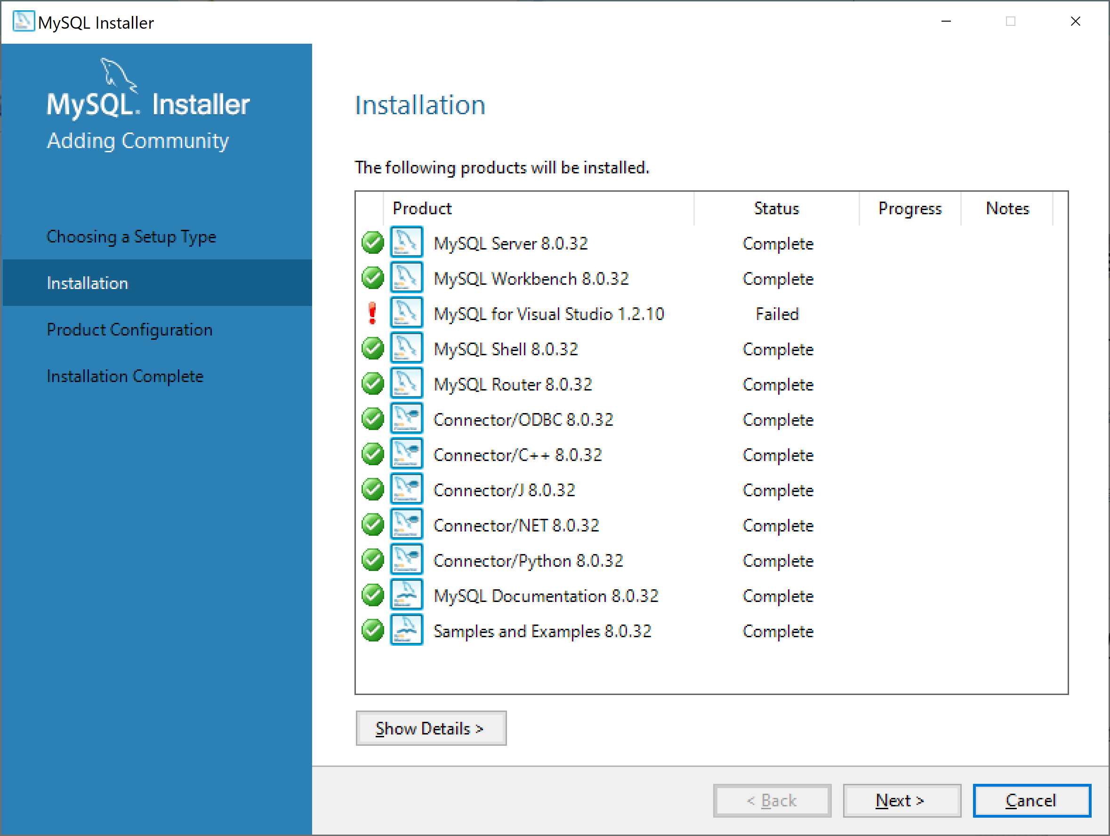
Cài đặt MYSQL

Slide 9
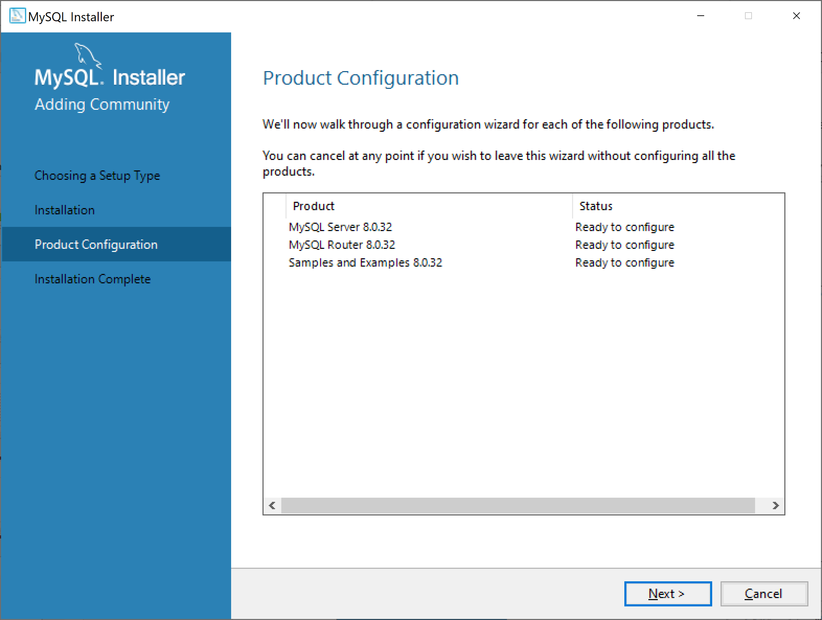
Cài đặt MYSQL

Slide 10
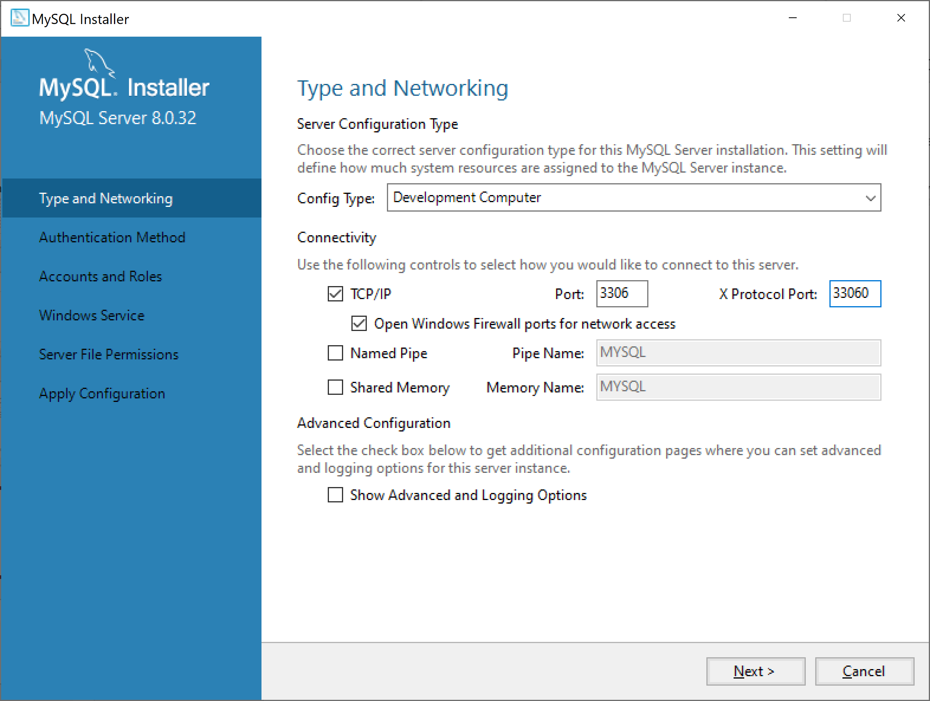
Cài đặt MYSQL

Slide 11
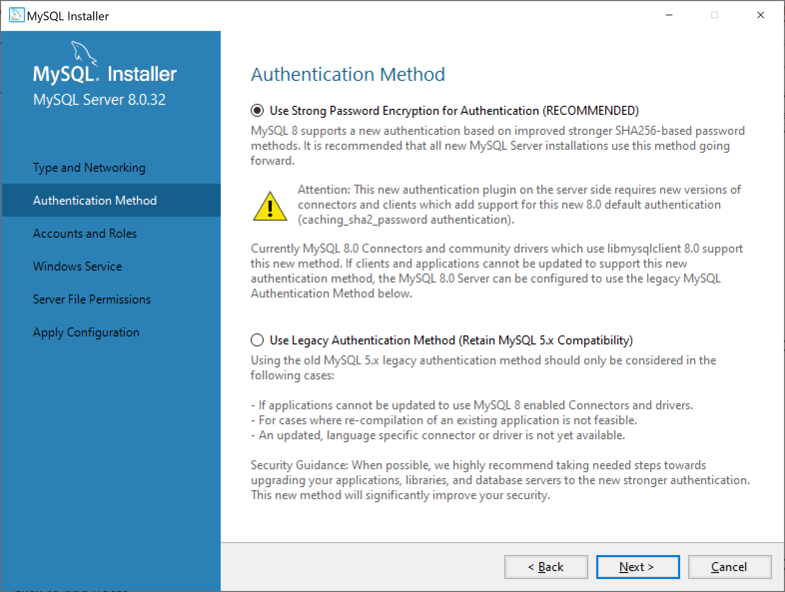
Cài đặt MYSQL

Slide 12
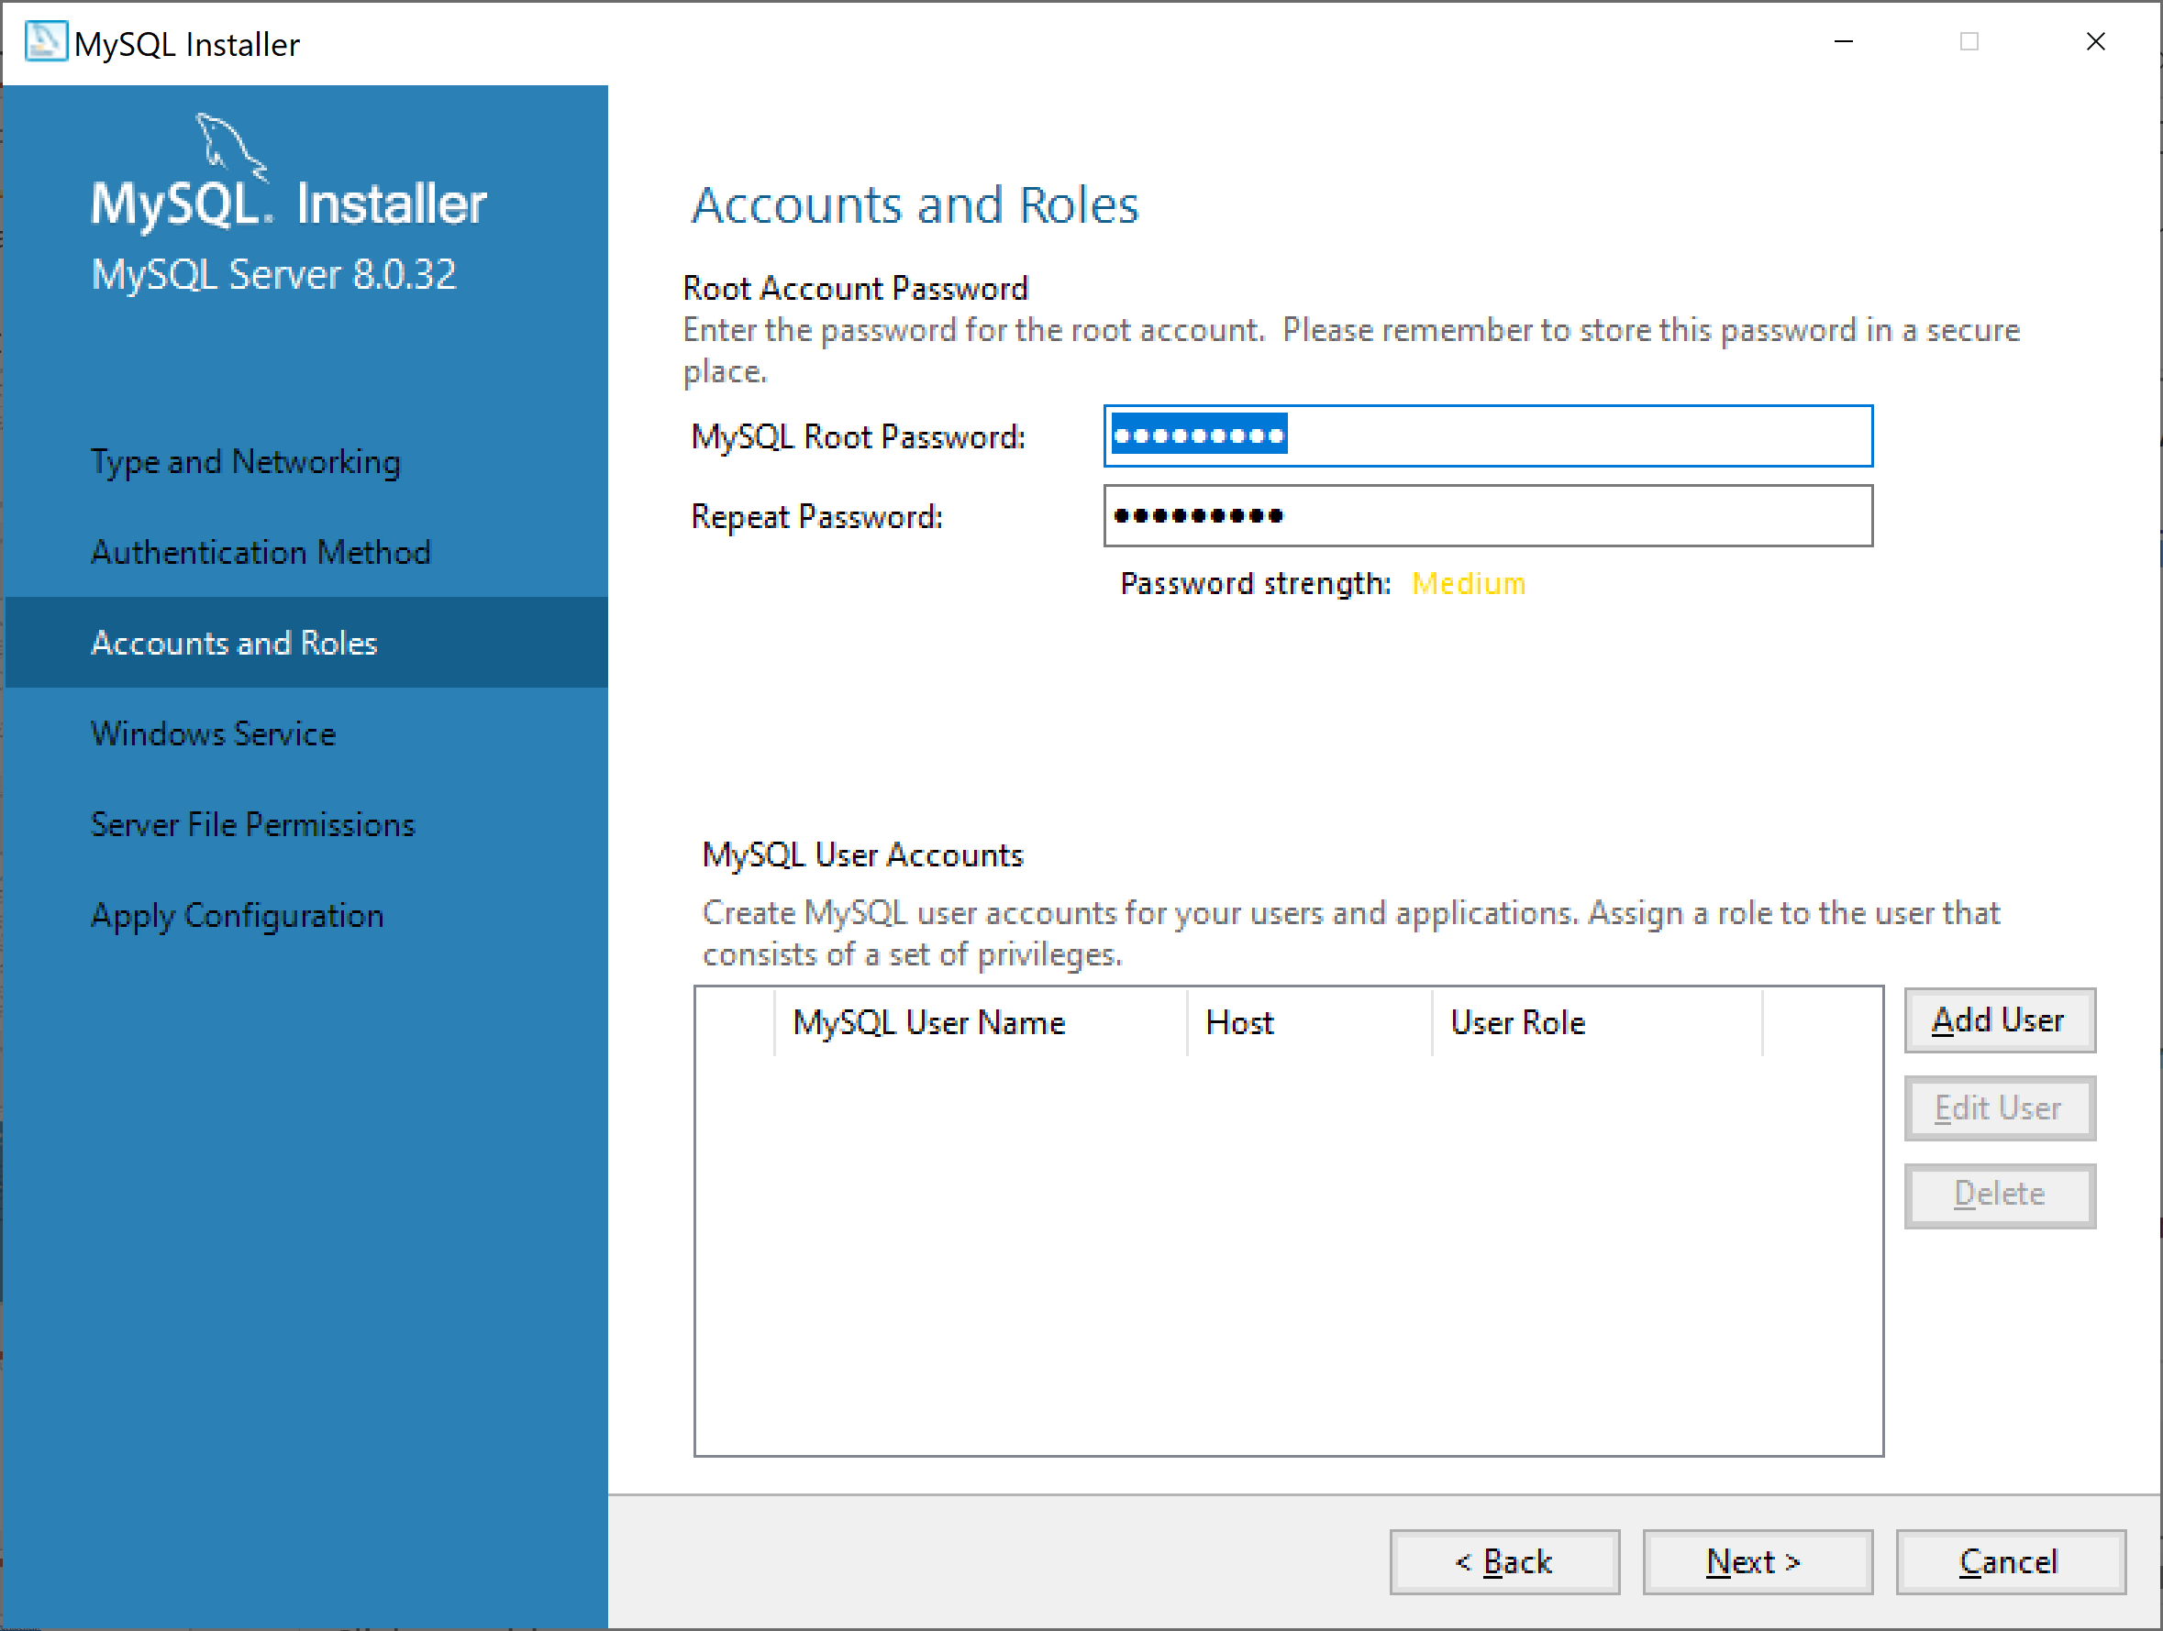
Cài đặt MYSQL
Root account:
root
Password:
@Obama123

Slide 13
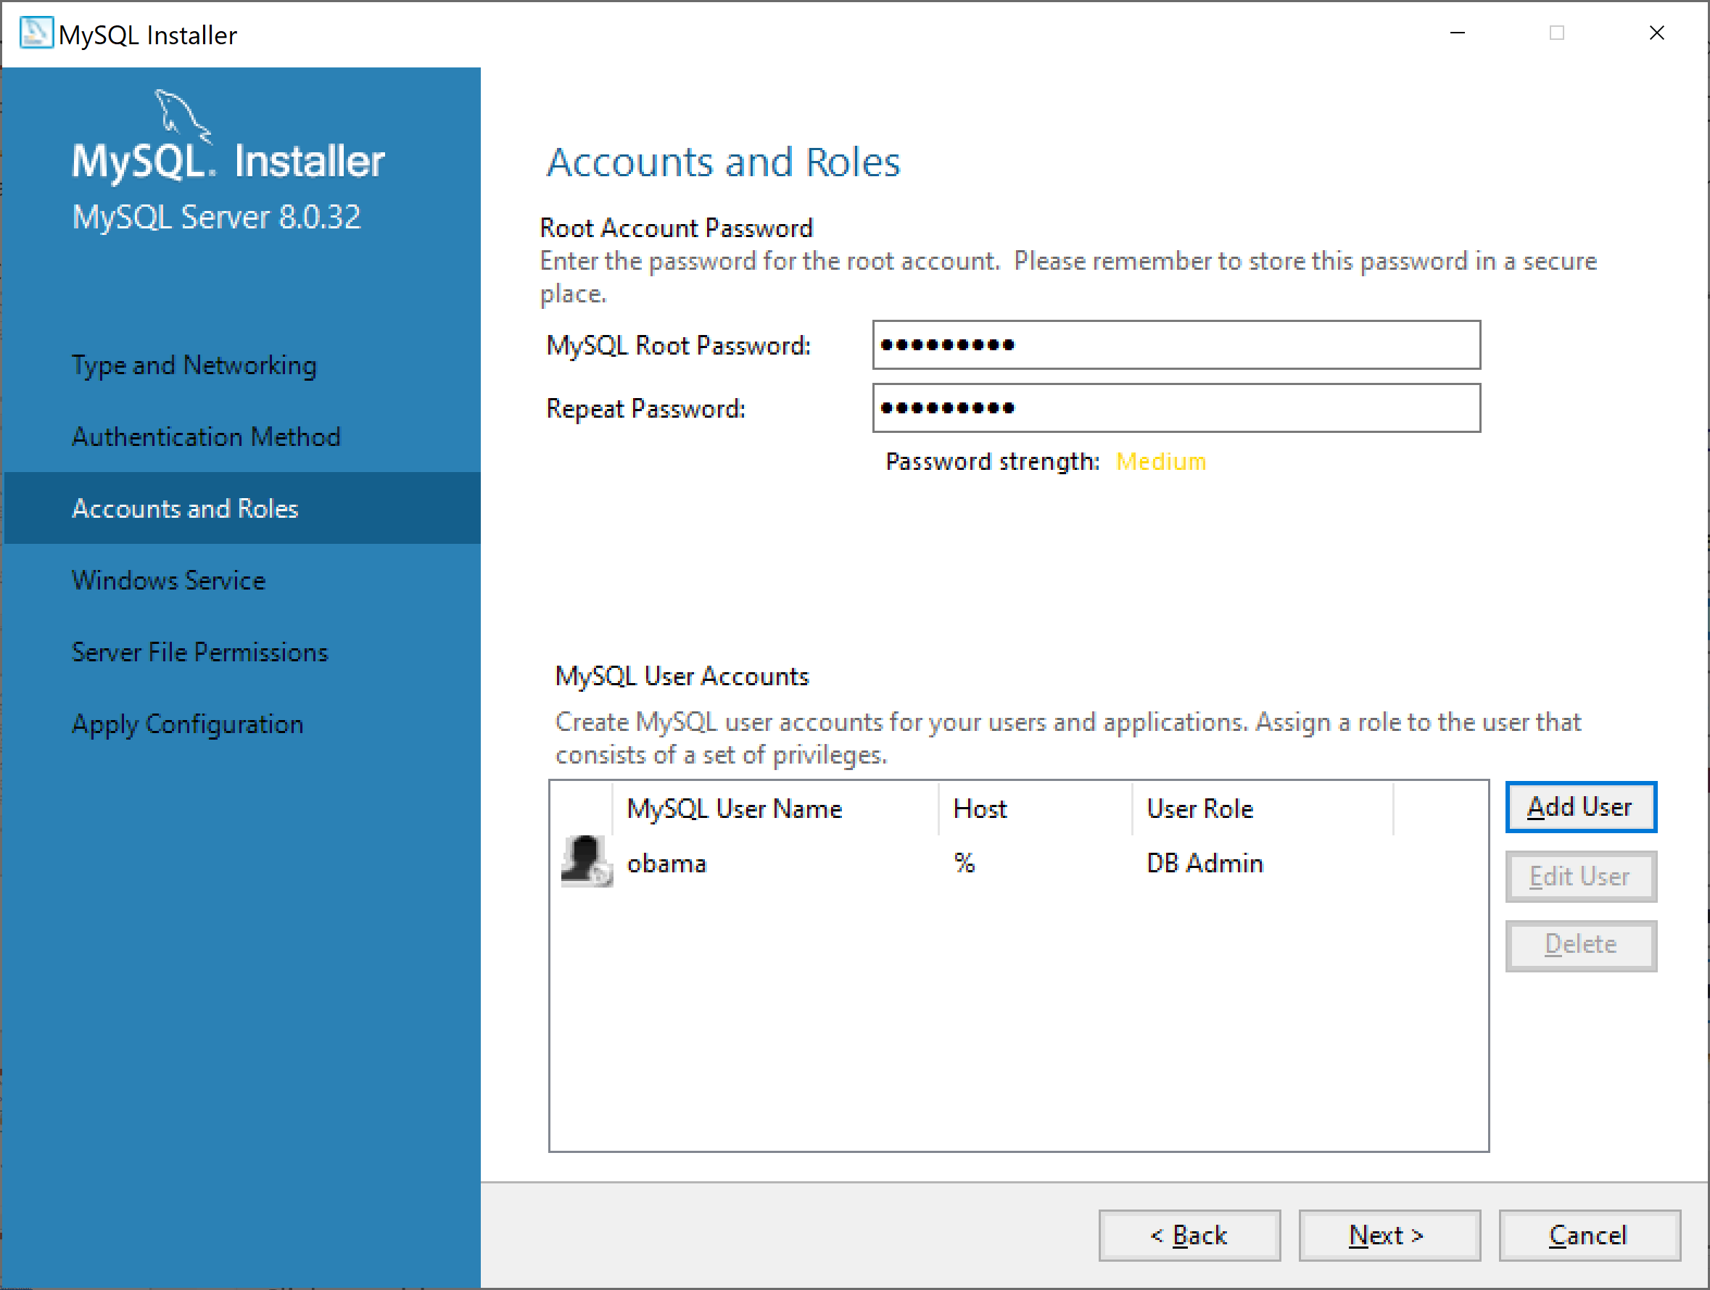
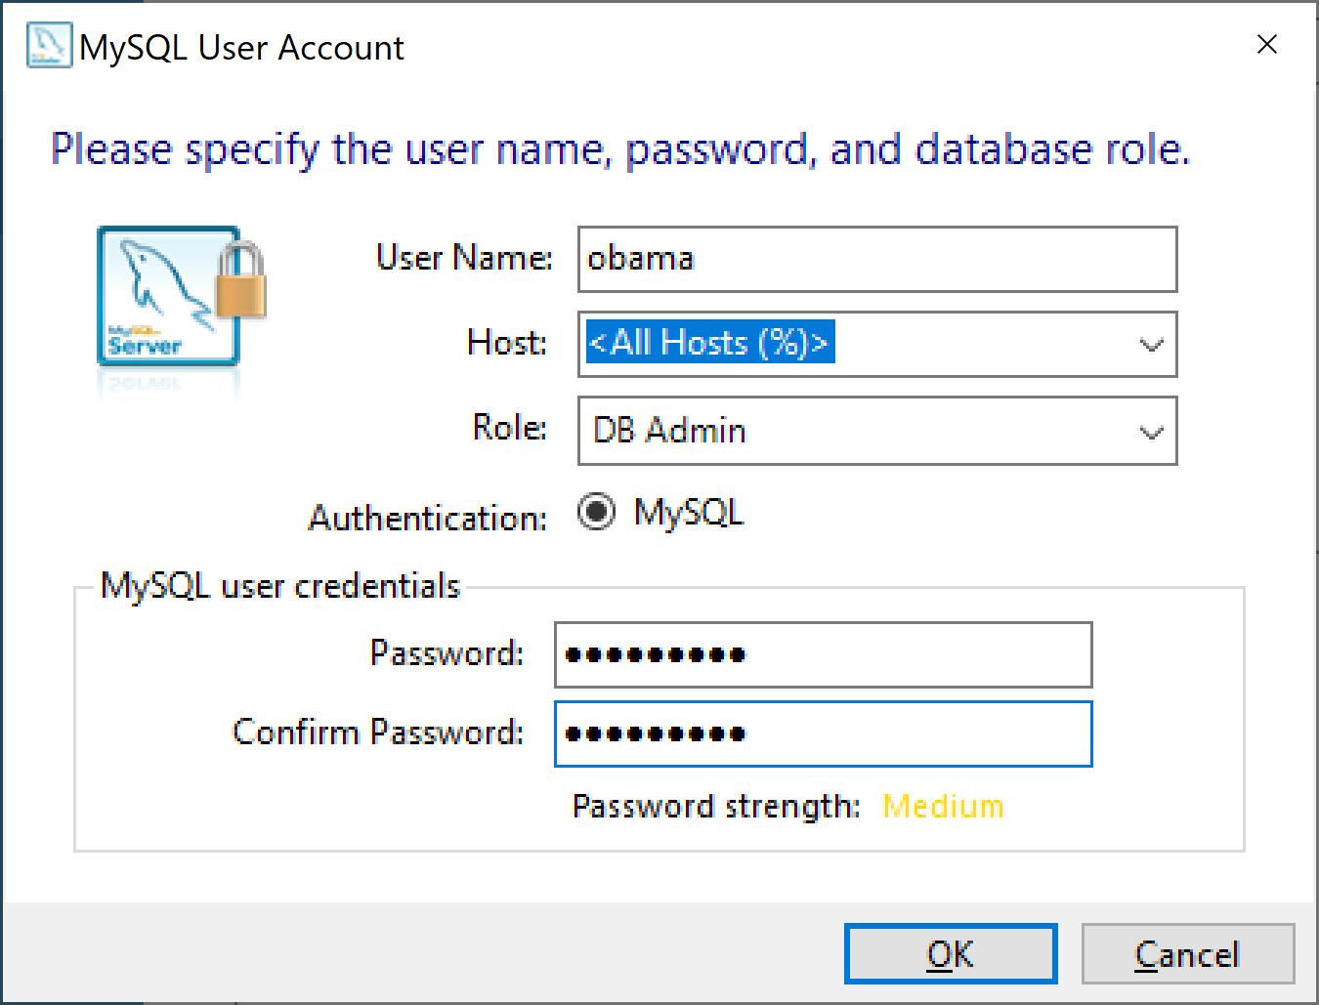
Cài đặt MYSQL
Root account:
root
Password:
@Obama123

Slide 14

Cài đặt MYSQL

Slide 15
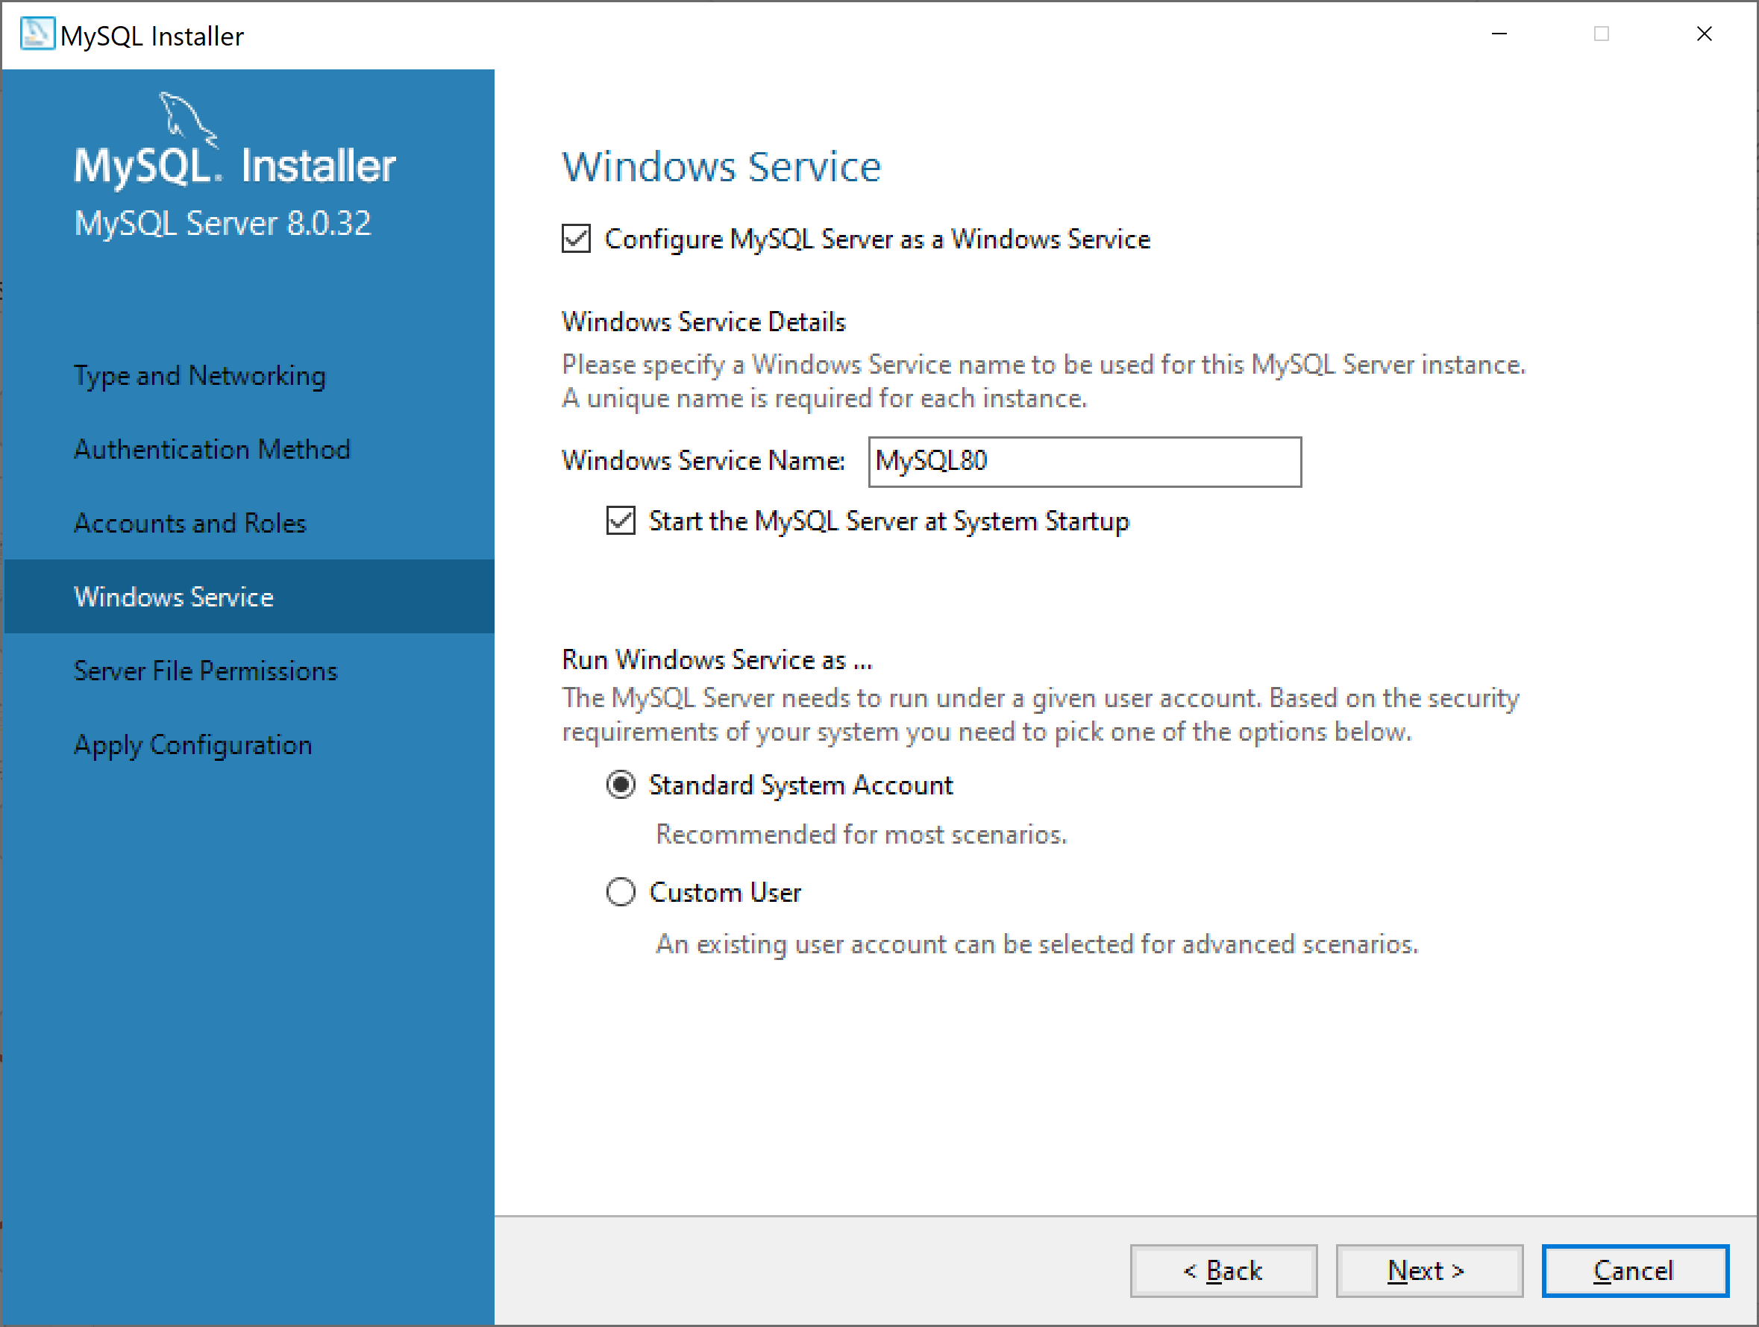
Cài đặt MYSQL

Slide 16
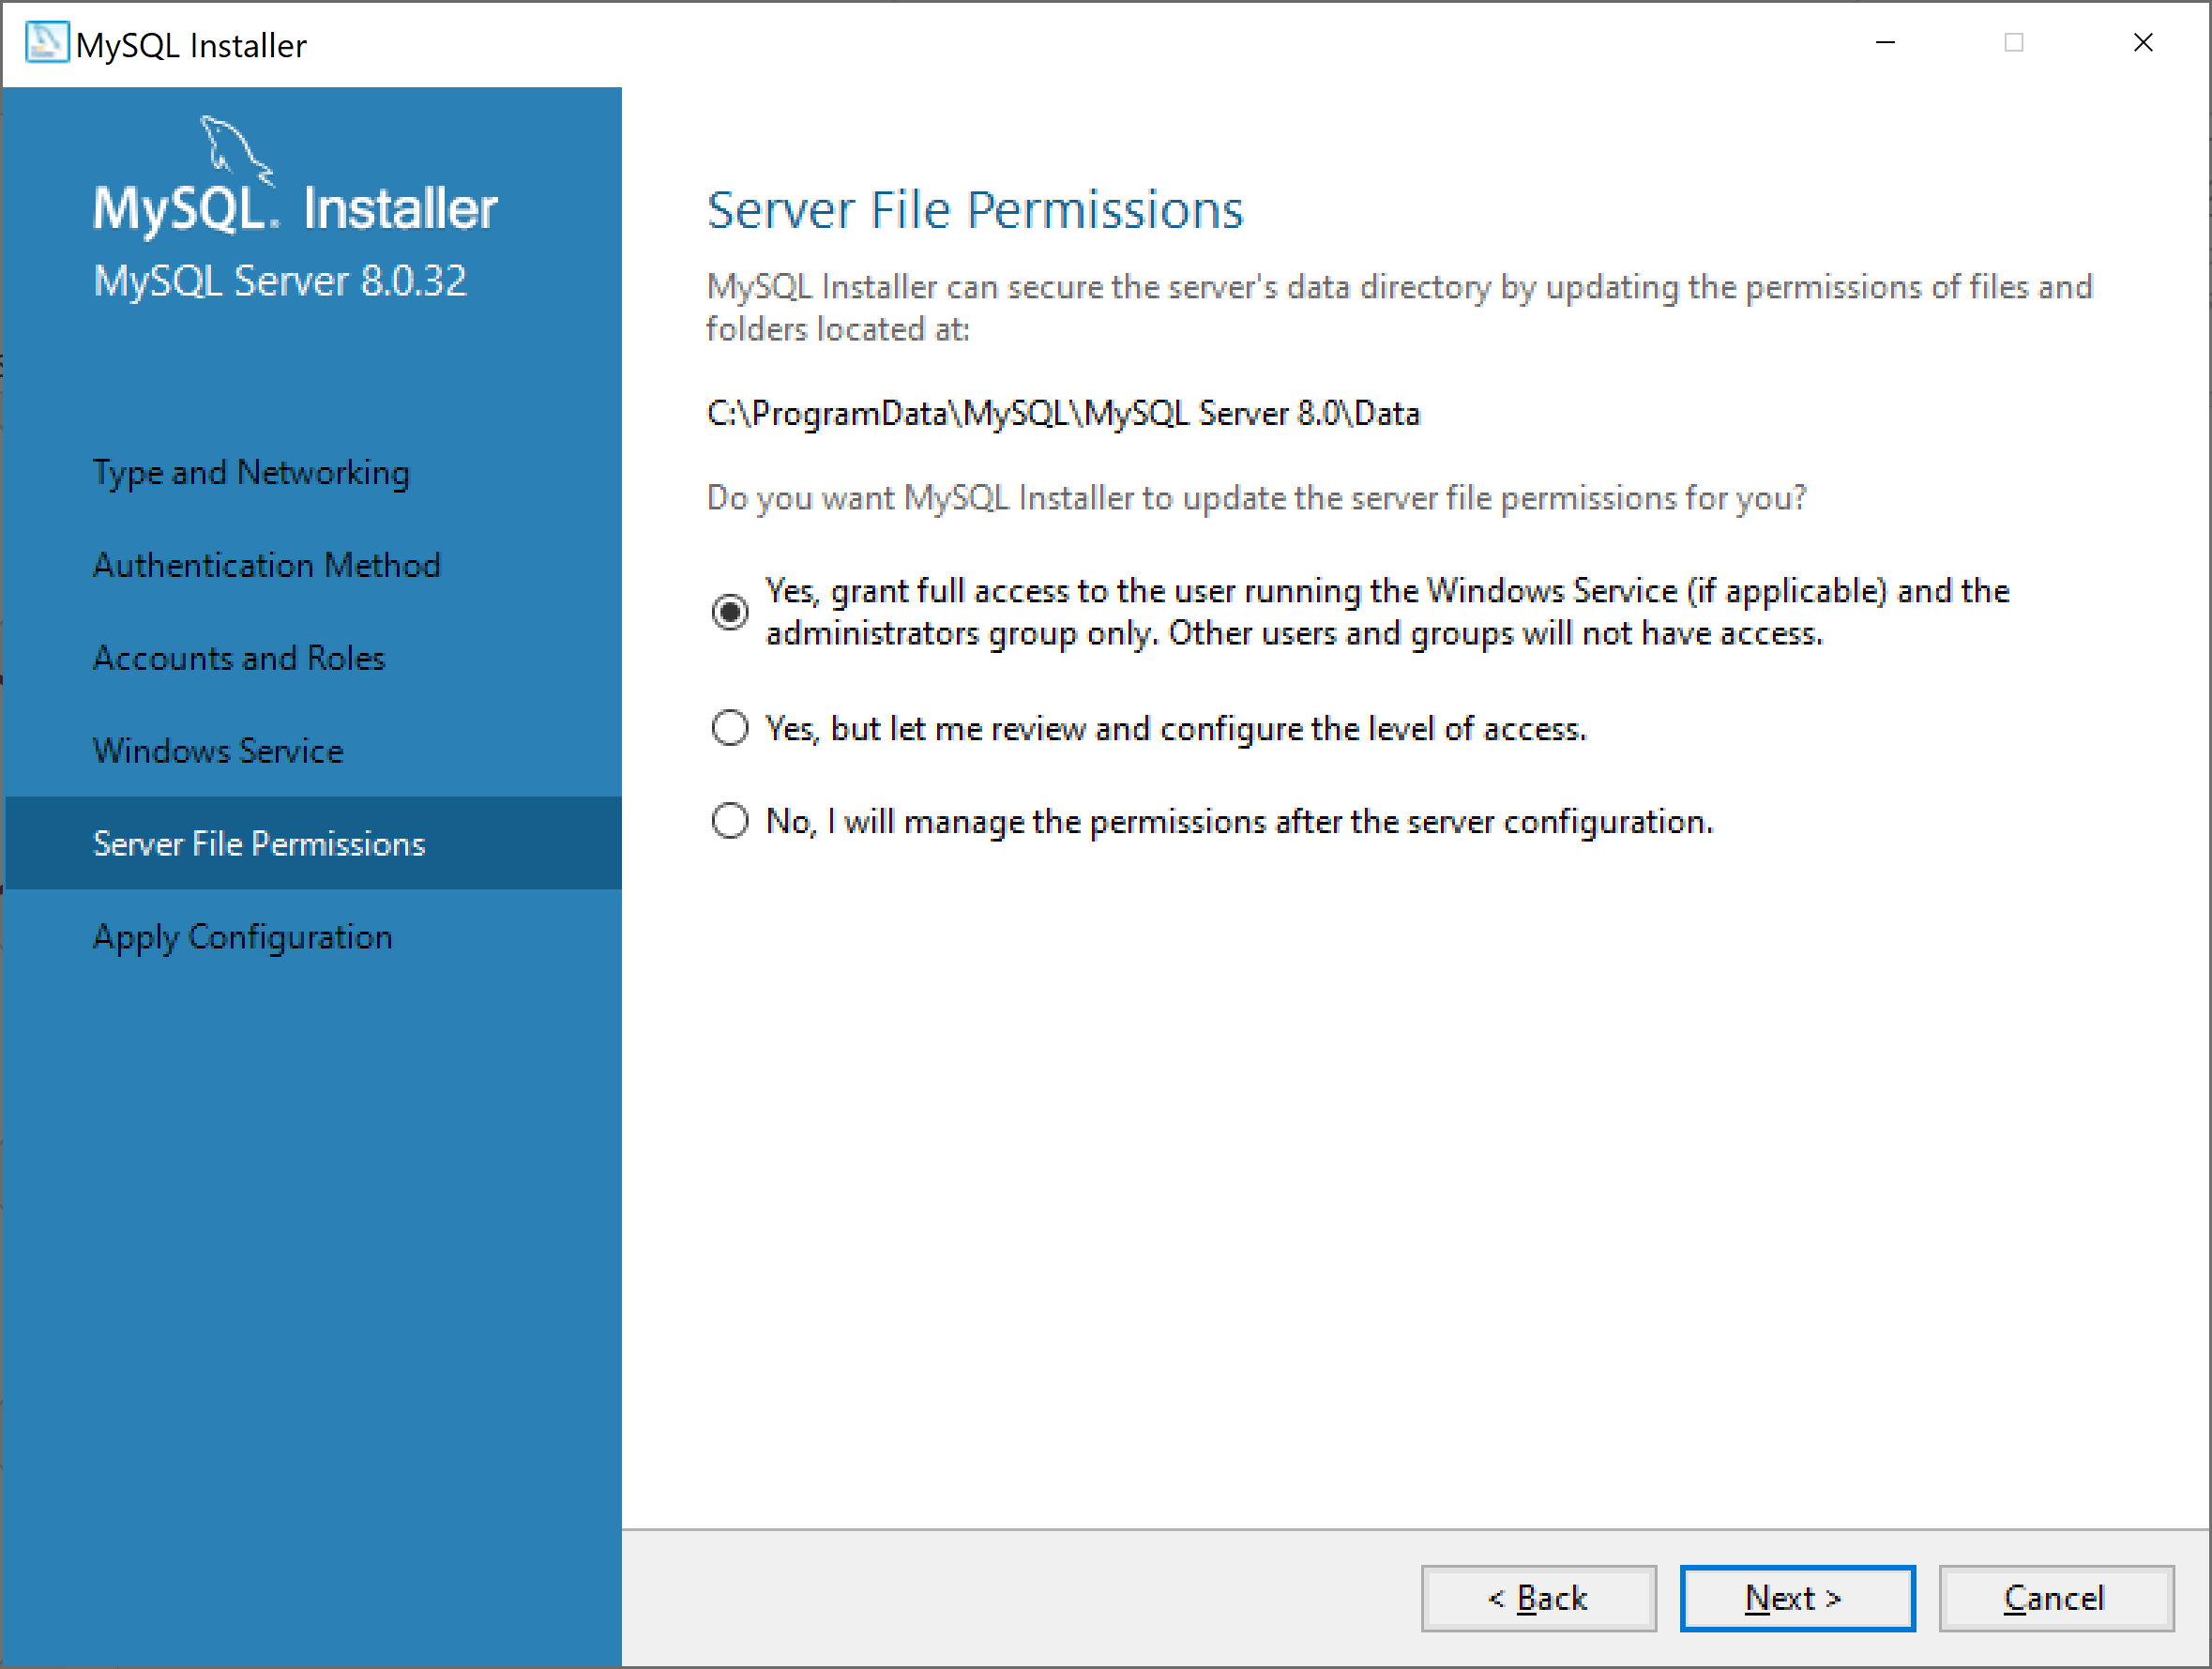
Cài đặt MYSQL

Slide 17
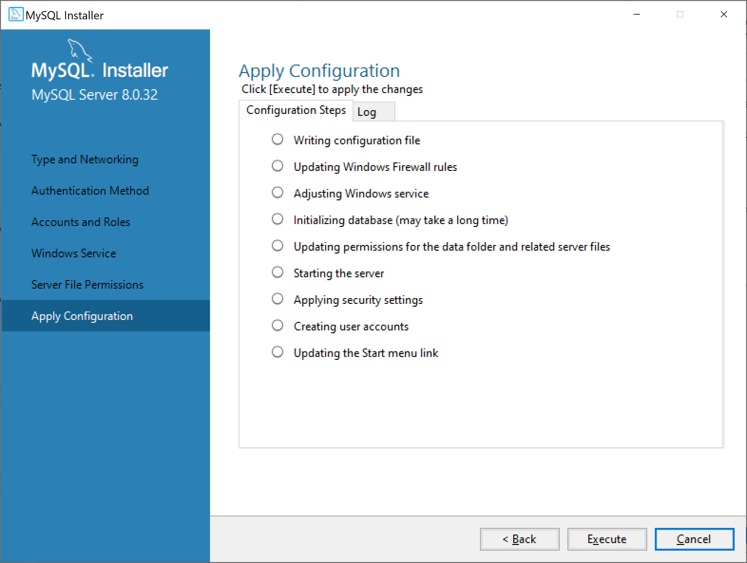
Cài đặt MYSQL

Slide 18
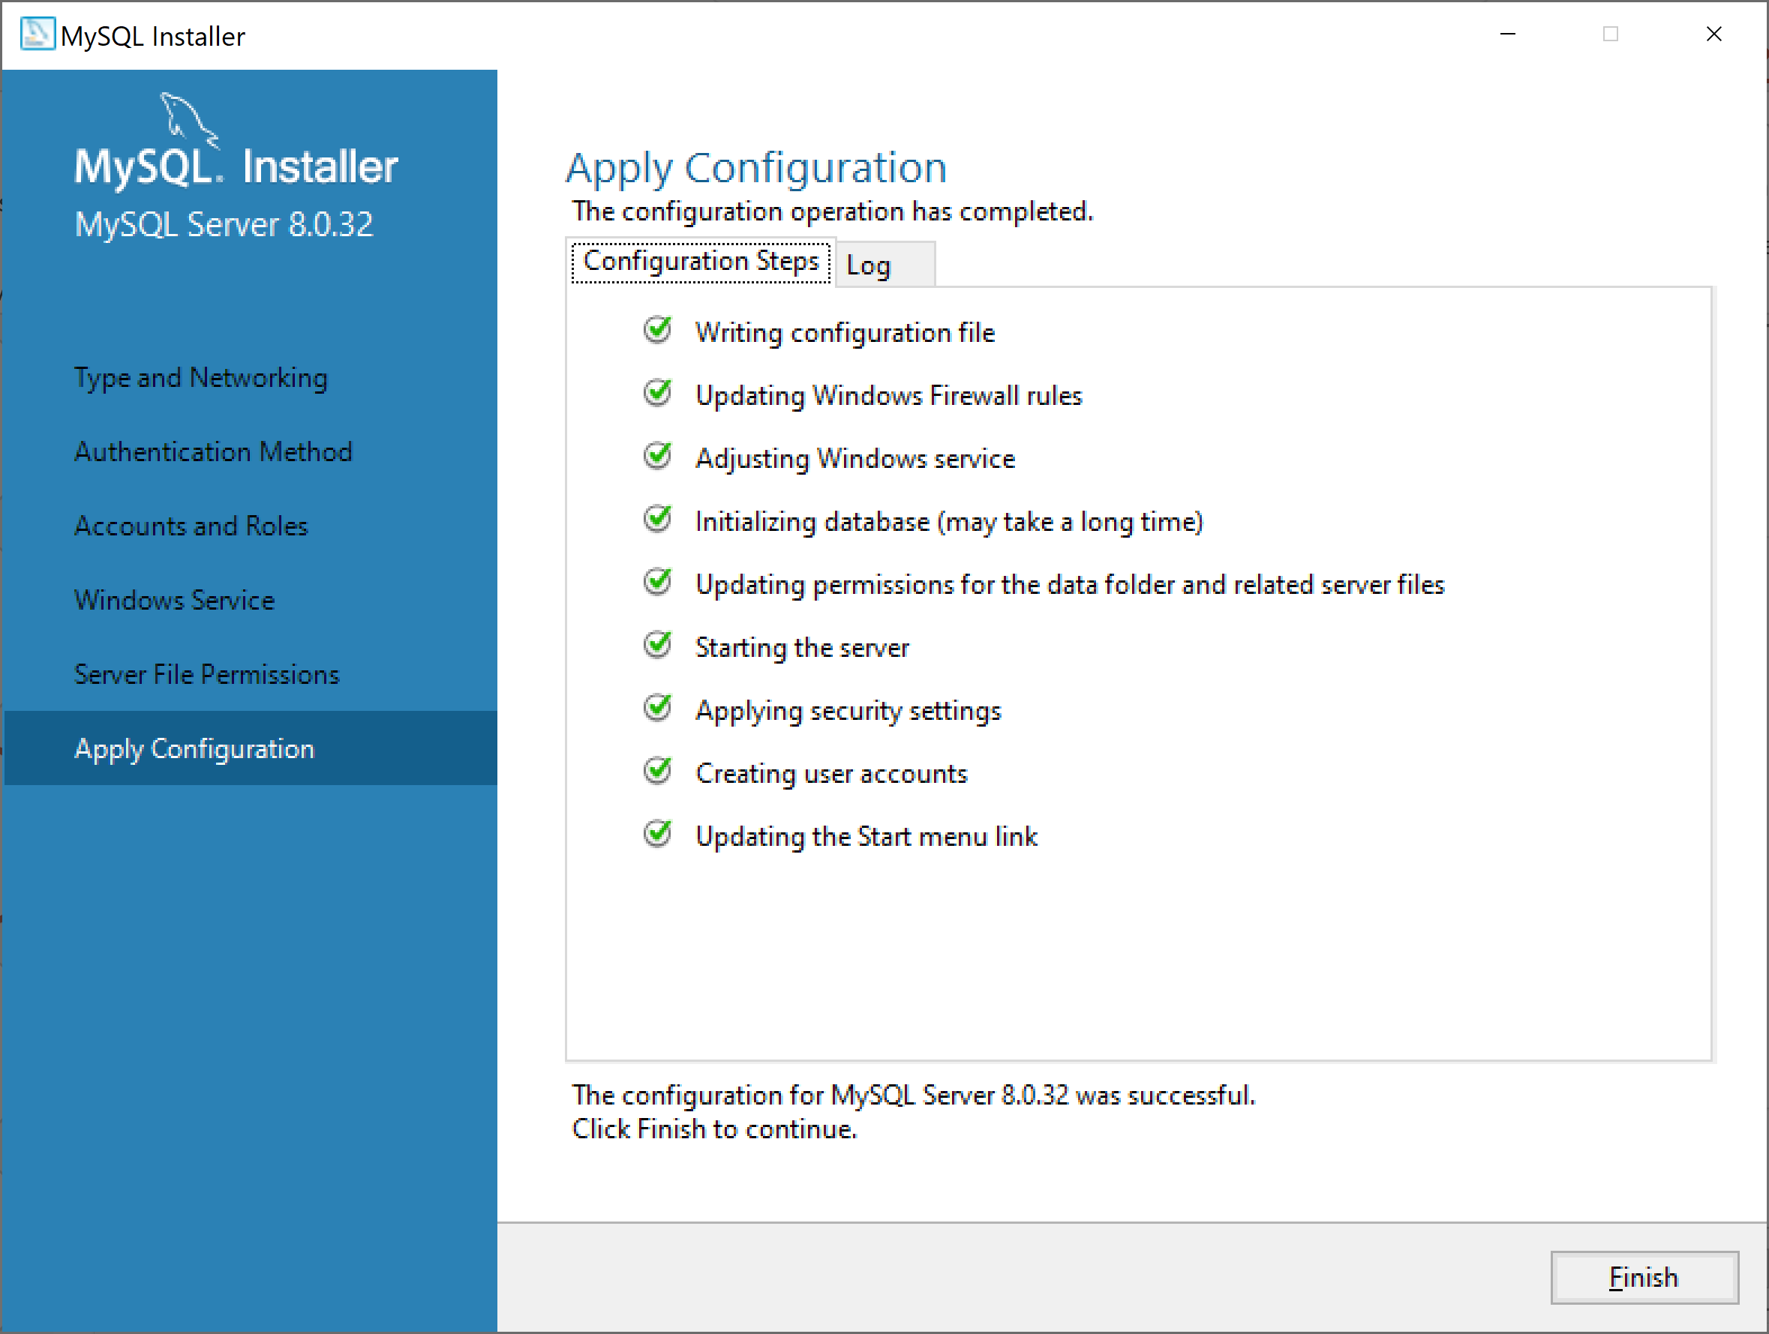
Cài đặt MYSQL

Slide 19

Cài đặt MYSQL

Slide 20
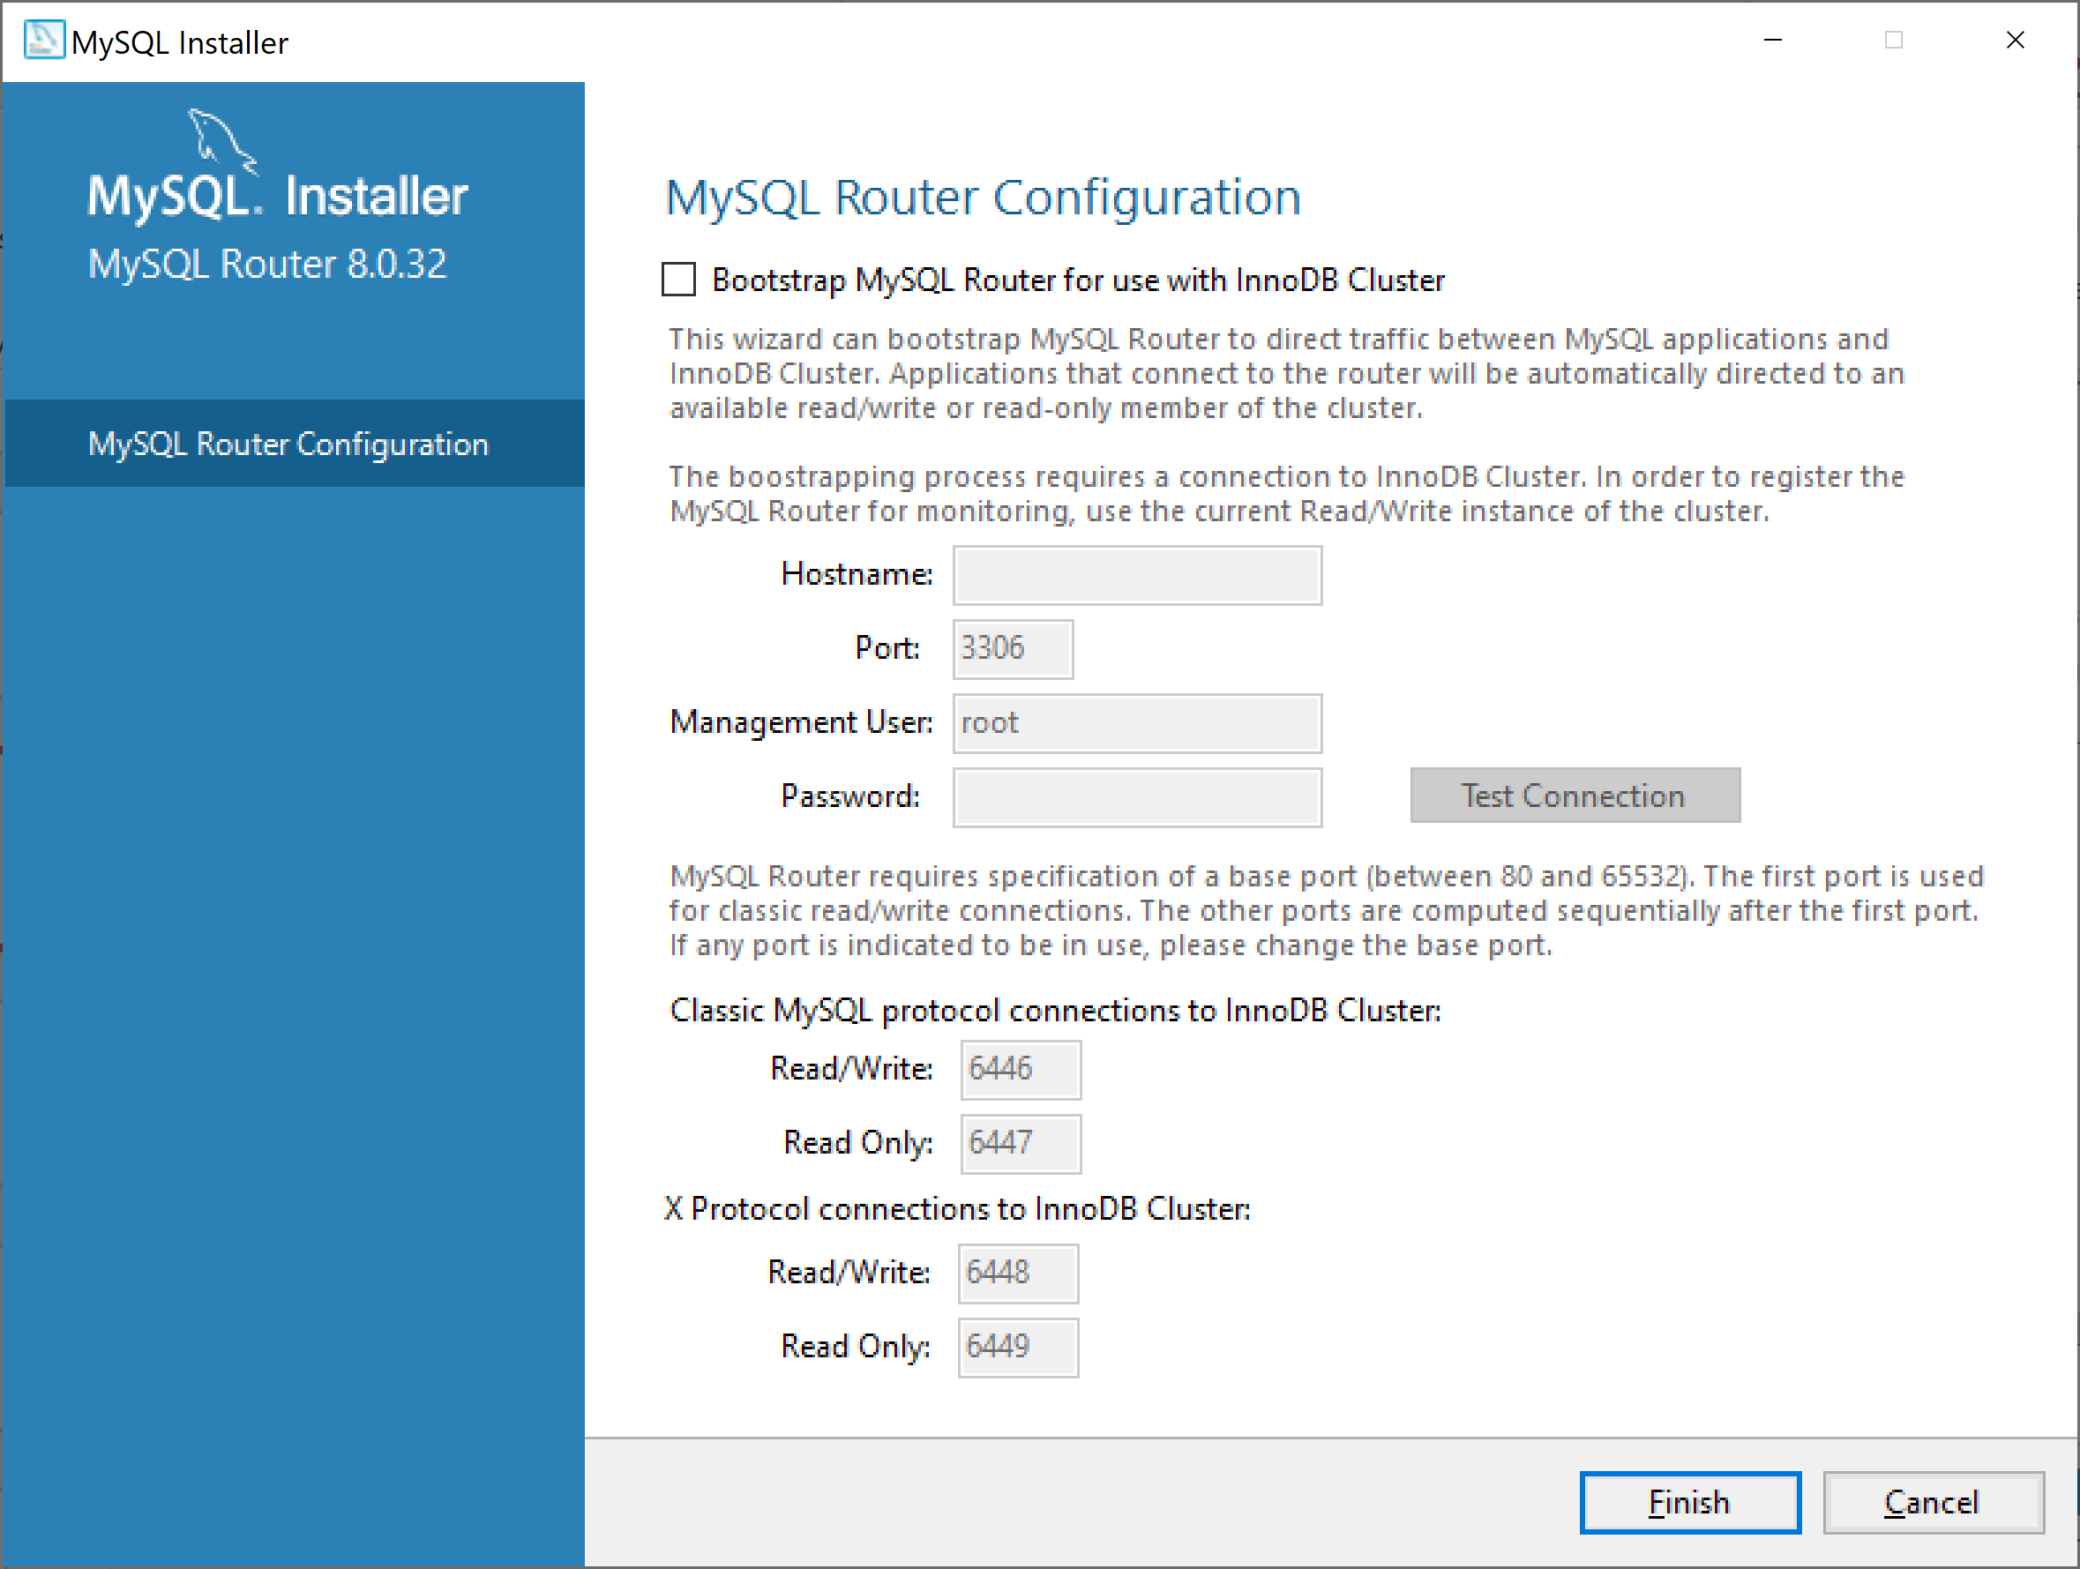
Cài đặt MYSQL

Slide 21

Cài đặt MYSQL

Slide 22
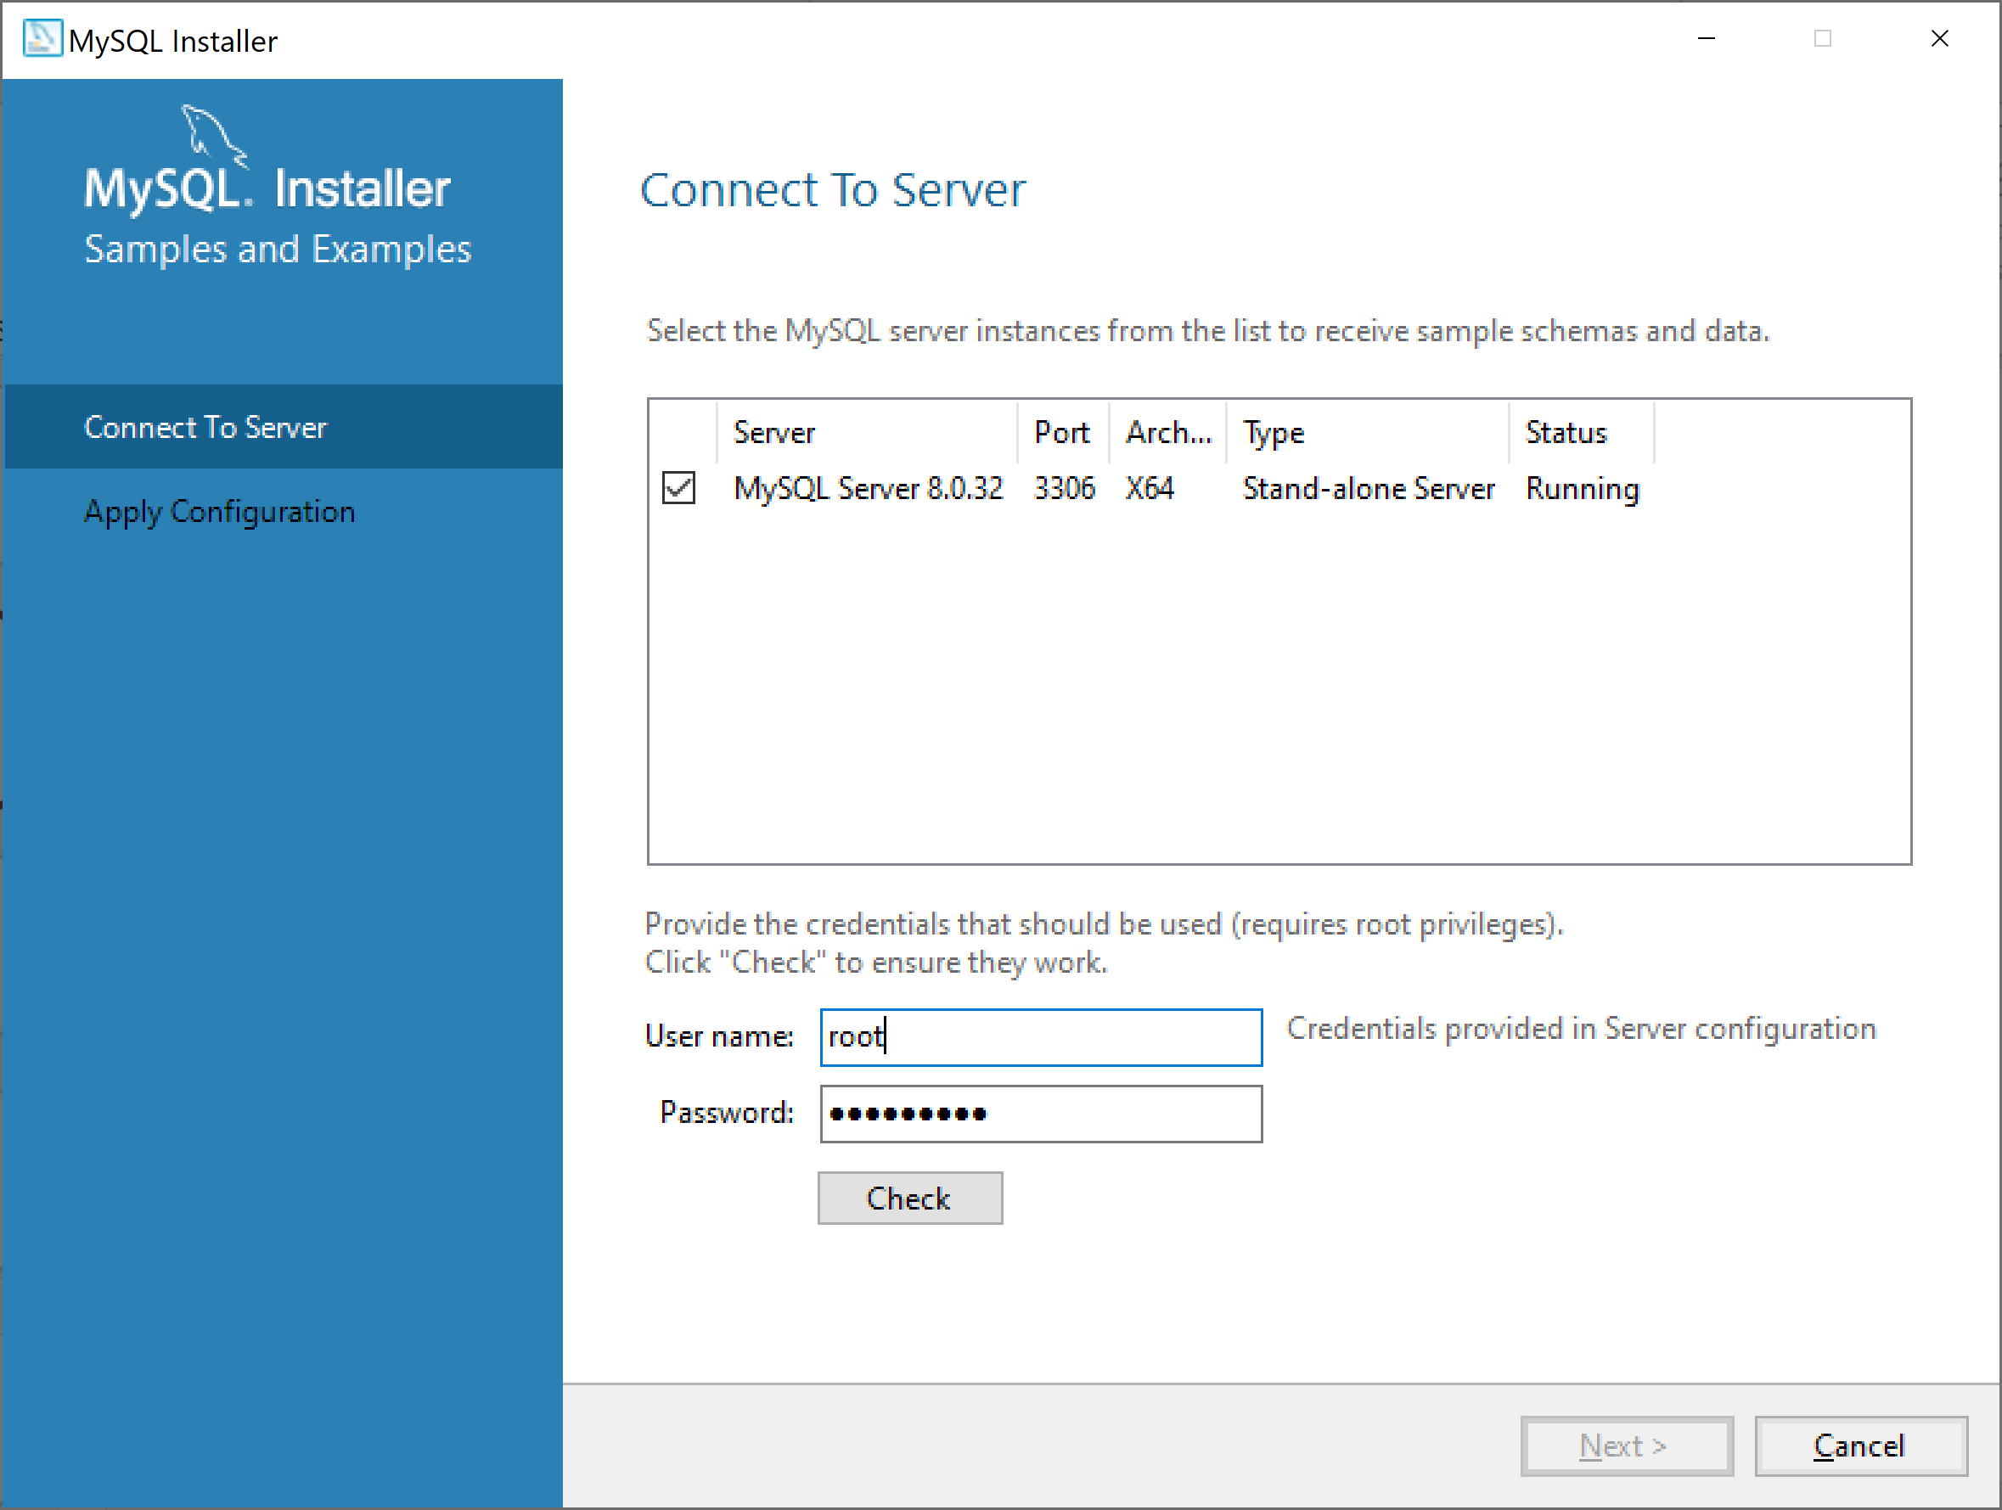
Cài đặt MYSQL

Slide 23
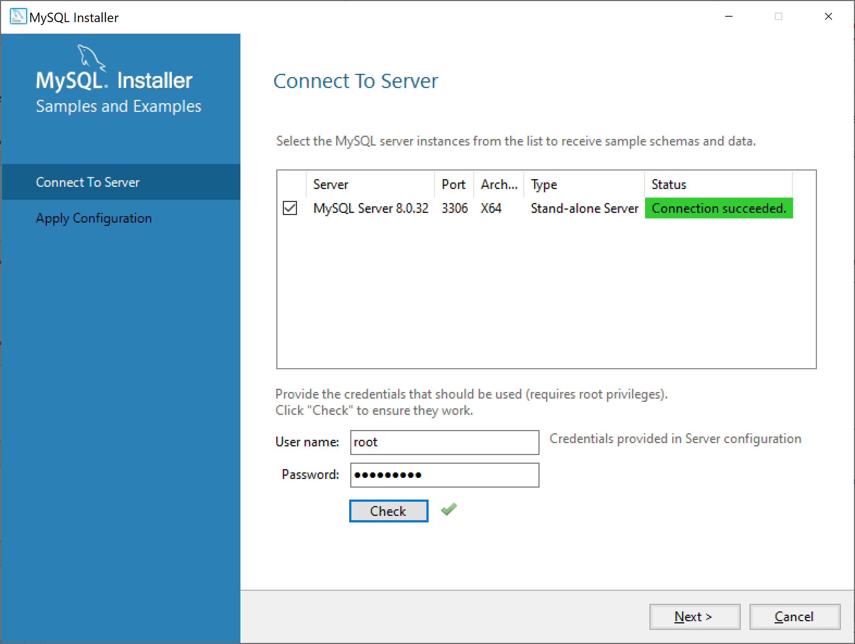
Cài đặt MYSQL

Slide 24
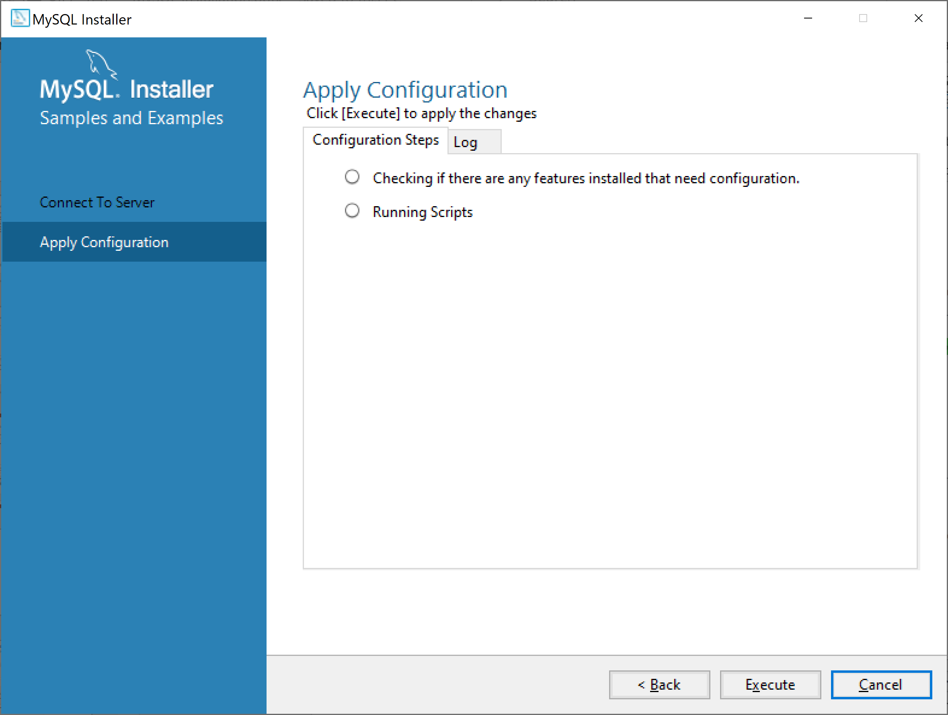
Cài đặt MYSQL

Slide 25
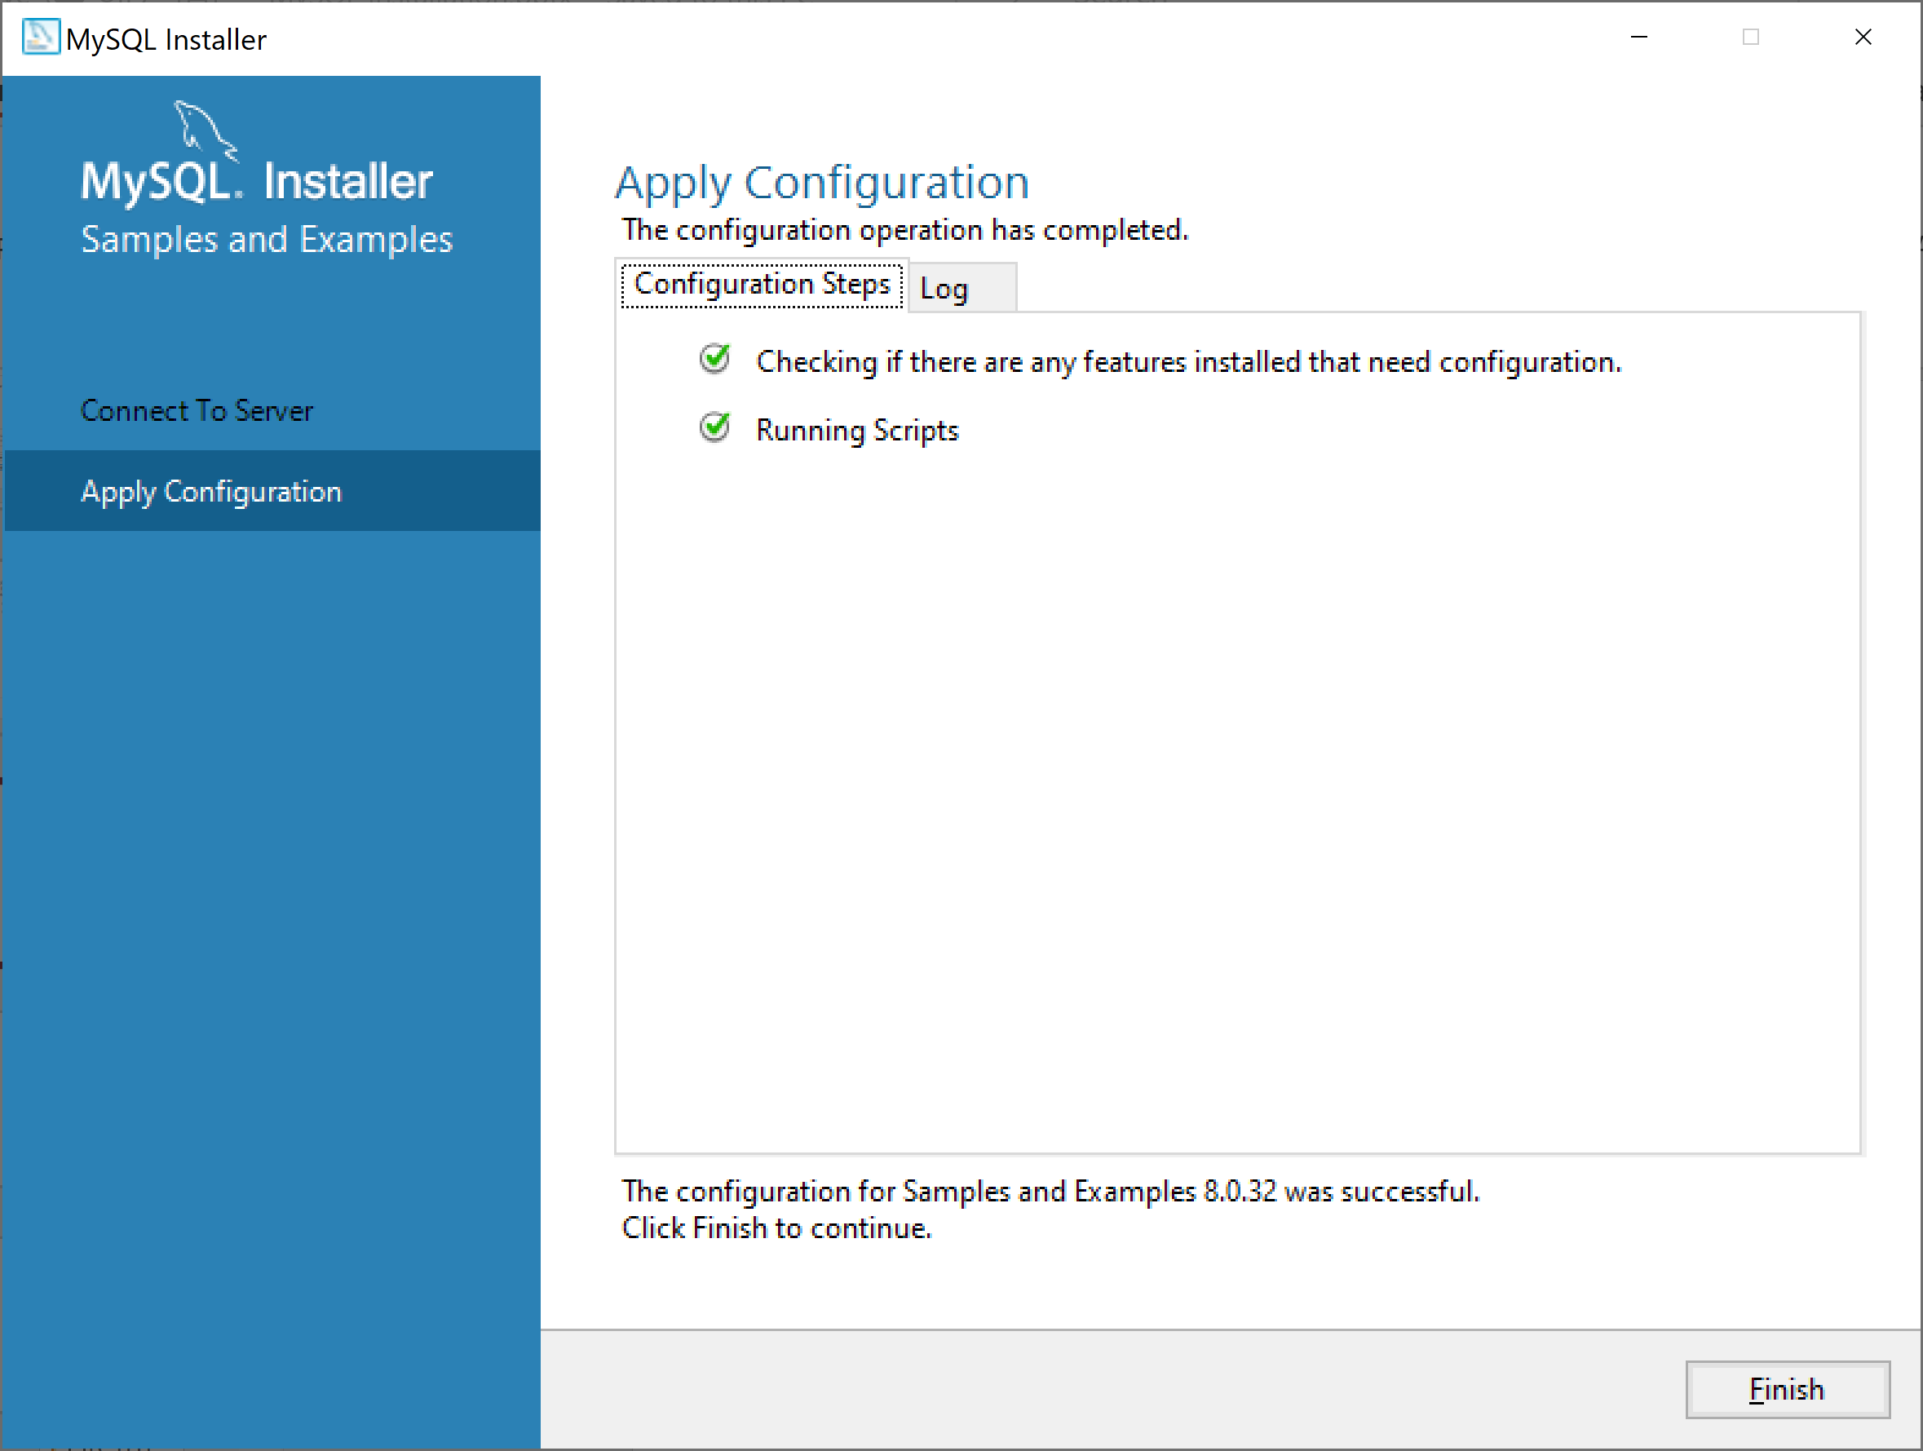
Cài đặt MYSQL

Slide 26

Cài đặt MYSQL

Slide 27
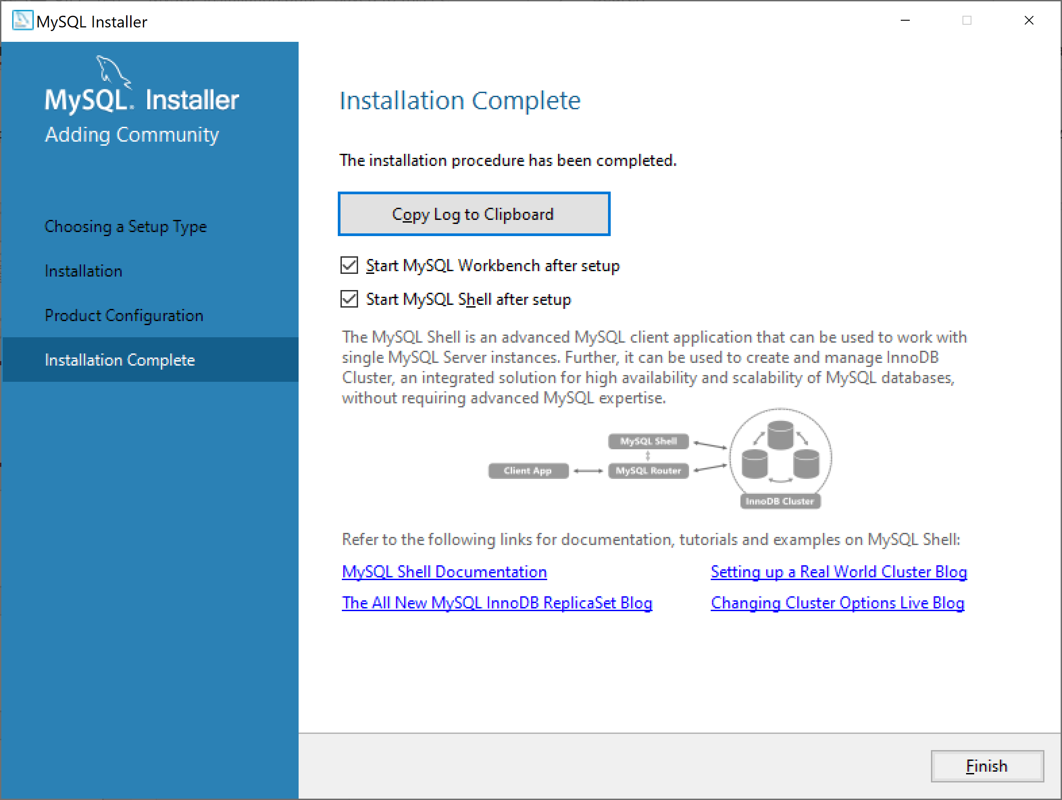
Cài đặt MYSQL

Slide 28
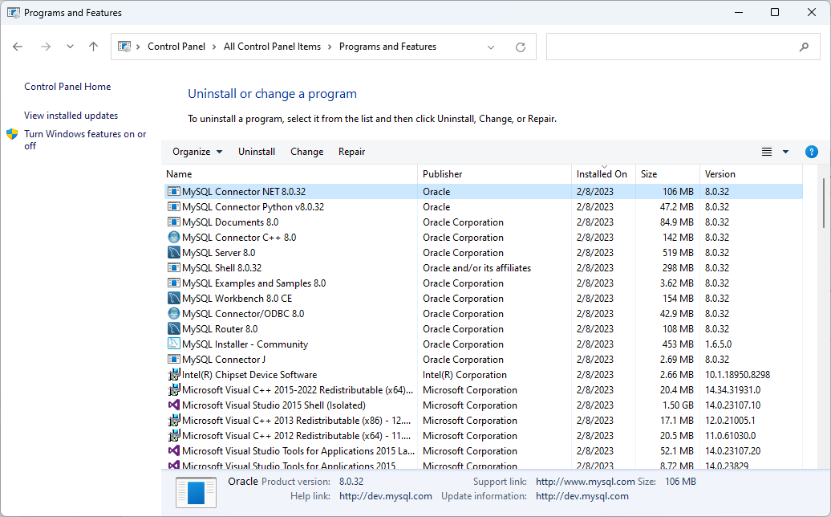
Cài đặt MYSQL

Slide 29
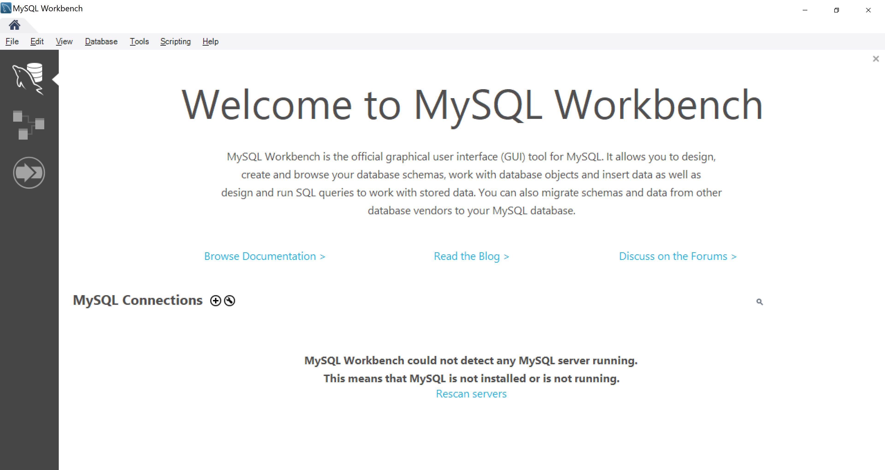
Sử dụng MySQL Workbench

Slide 30
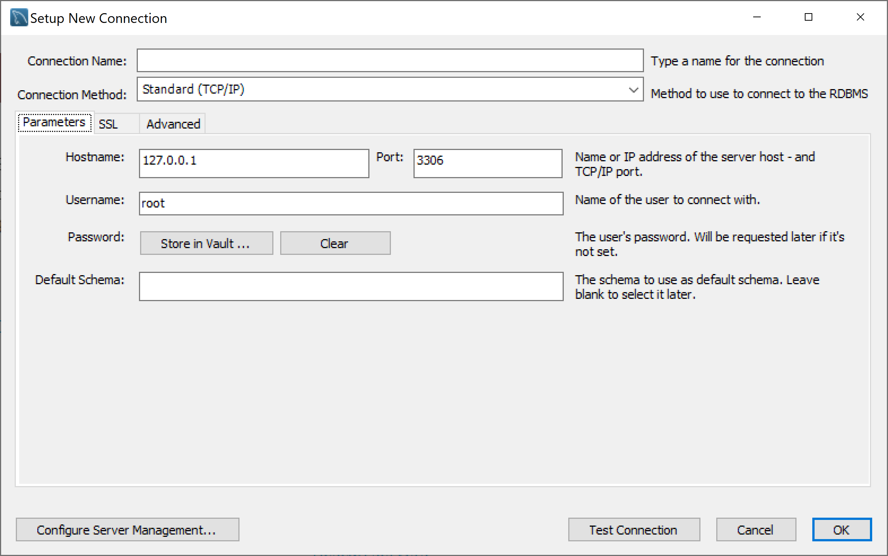
Sử dụng MySQL Workbench

Slide 31
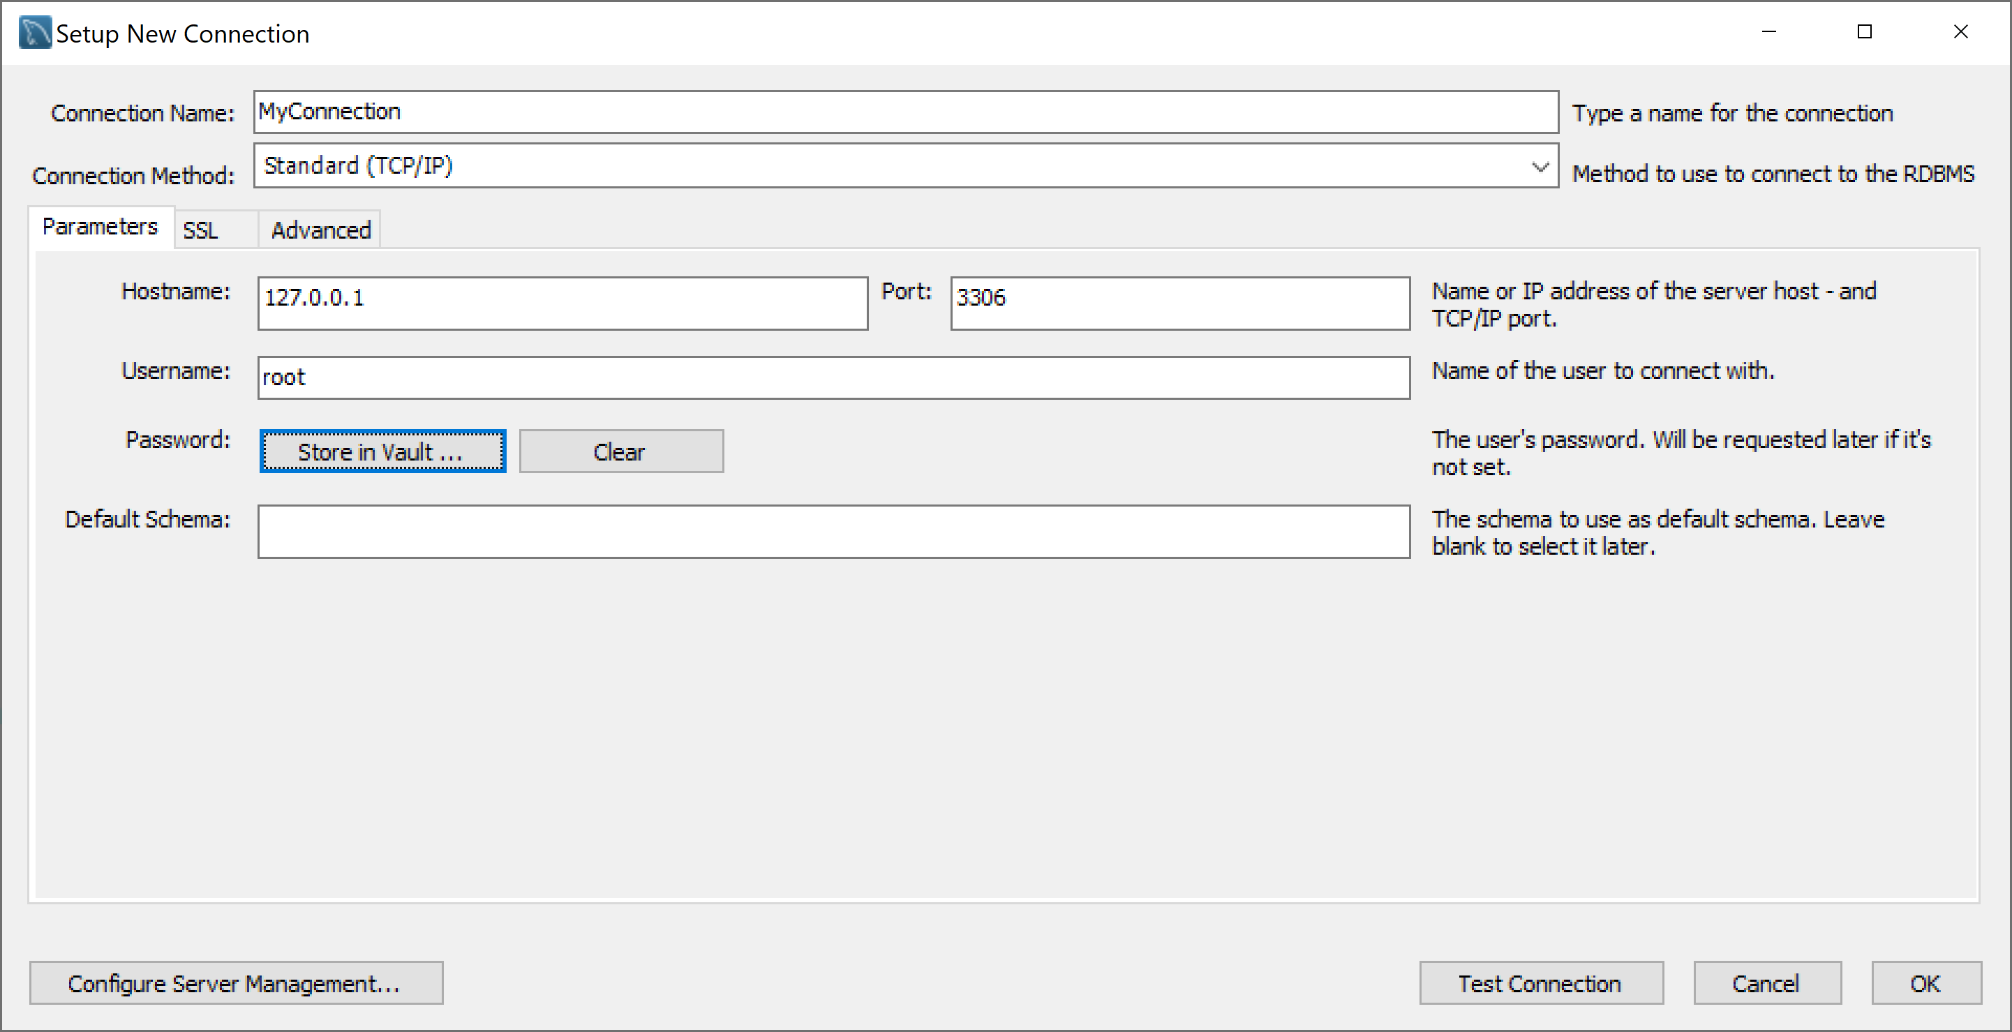
Sử dụng MySQL Workbench

Slide 32
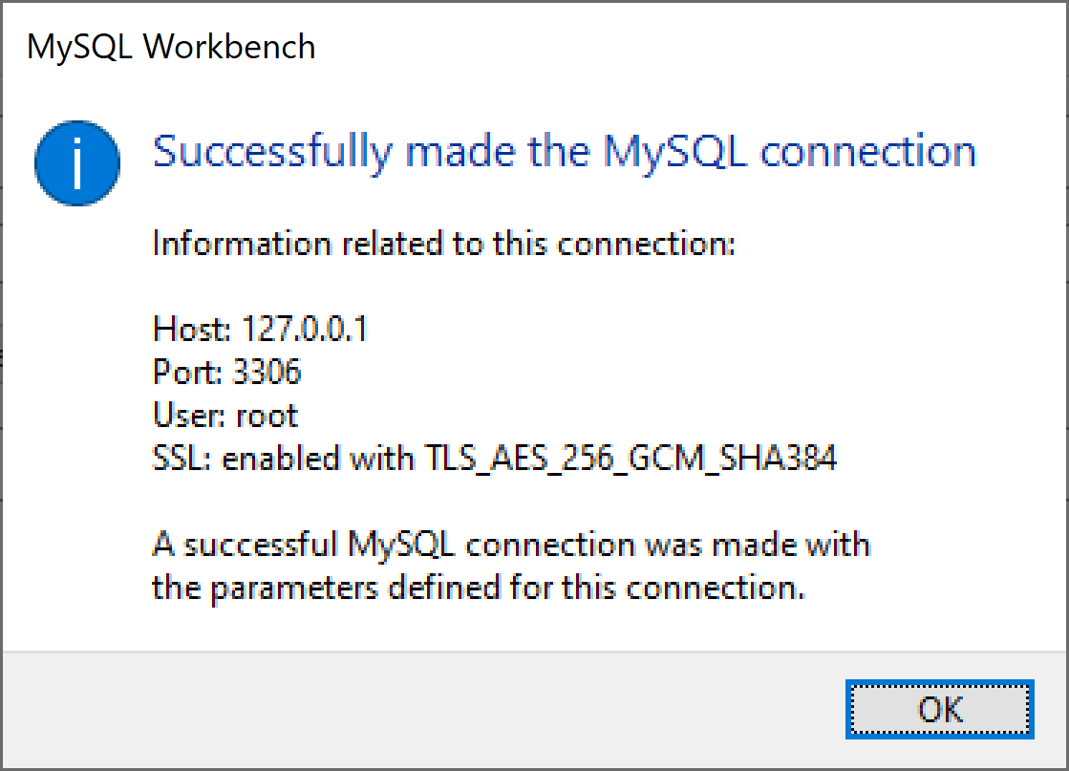
Sử dụng MySQL Workbench

Slide 33
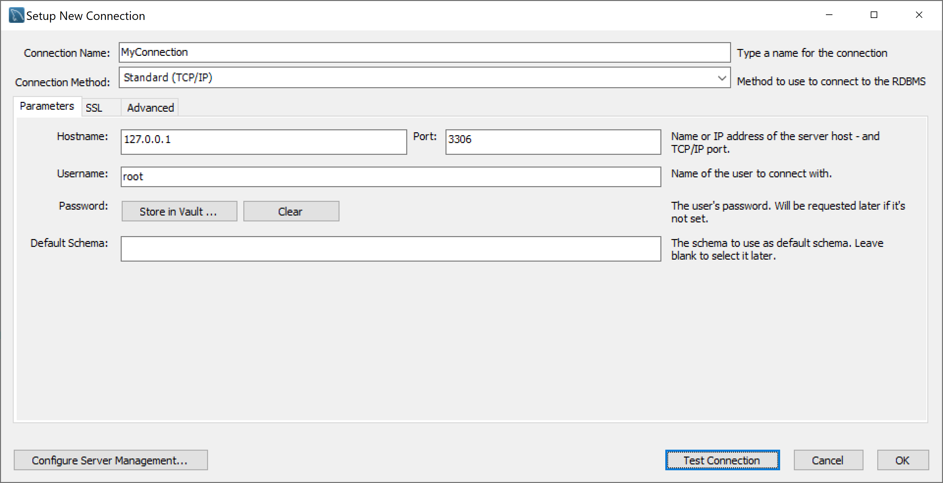
Sử dụng MySQL Workbench

Slide 34
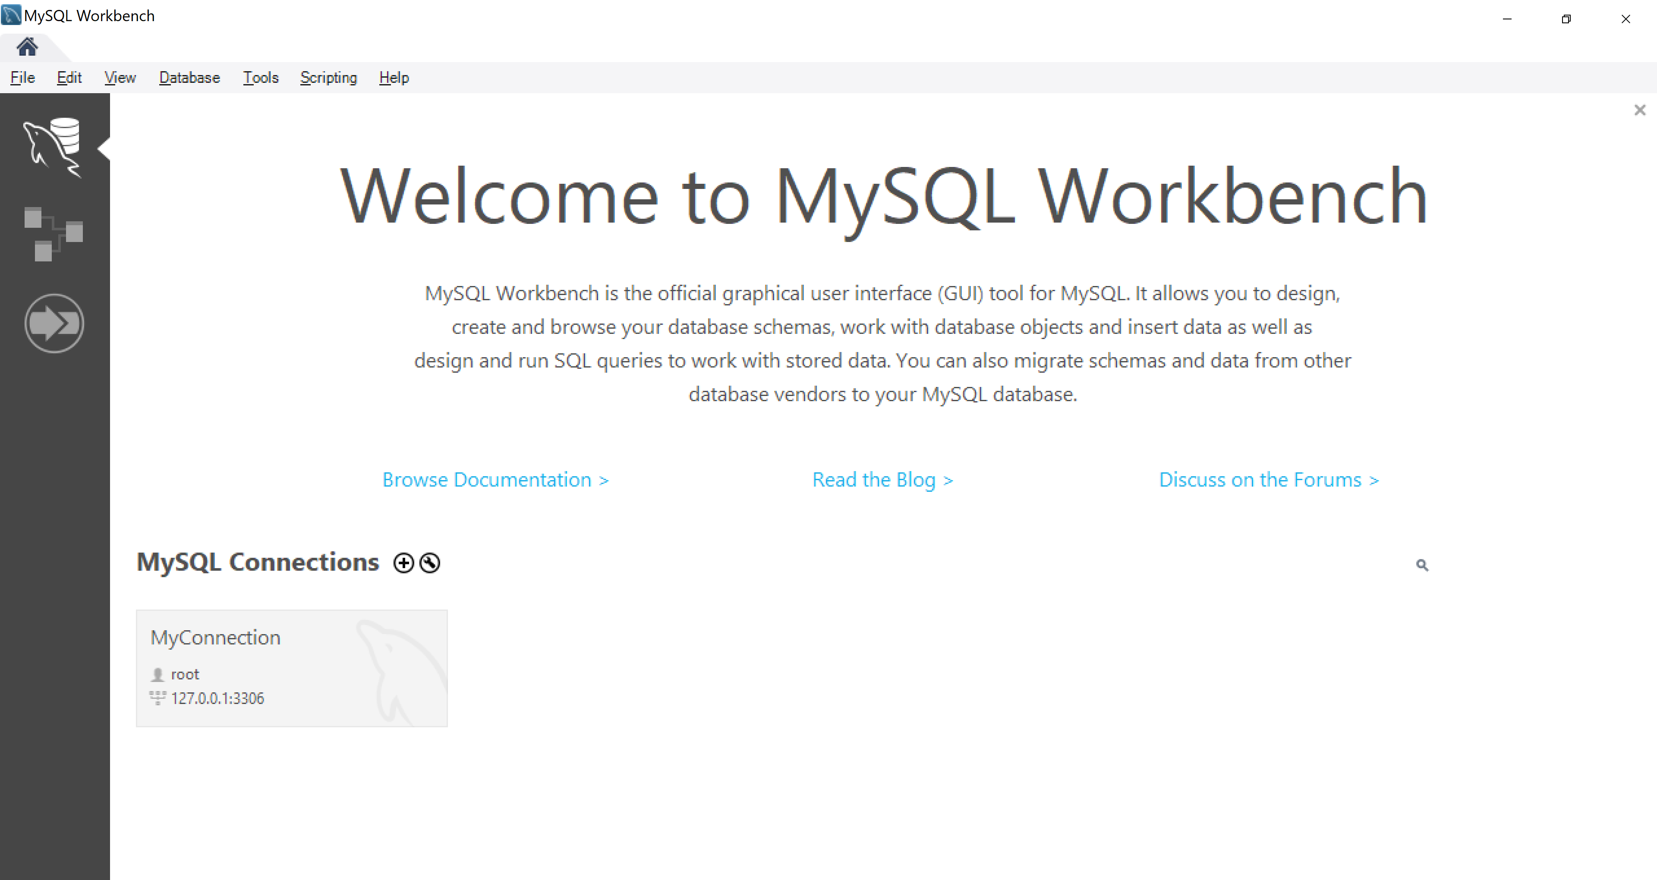
Sử dụng MySQL Workbench

Slide 35
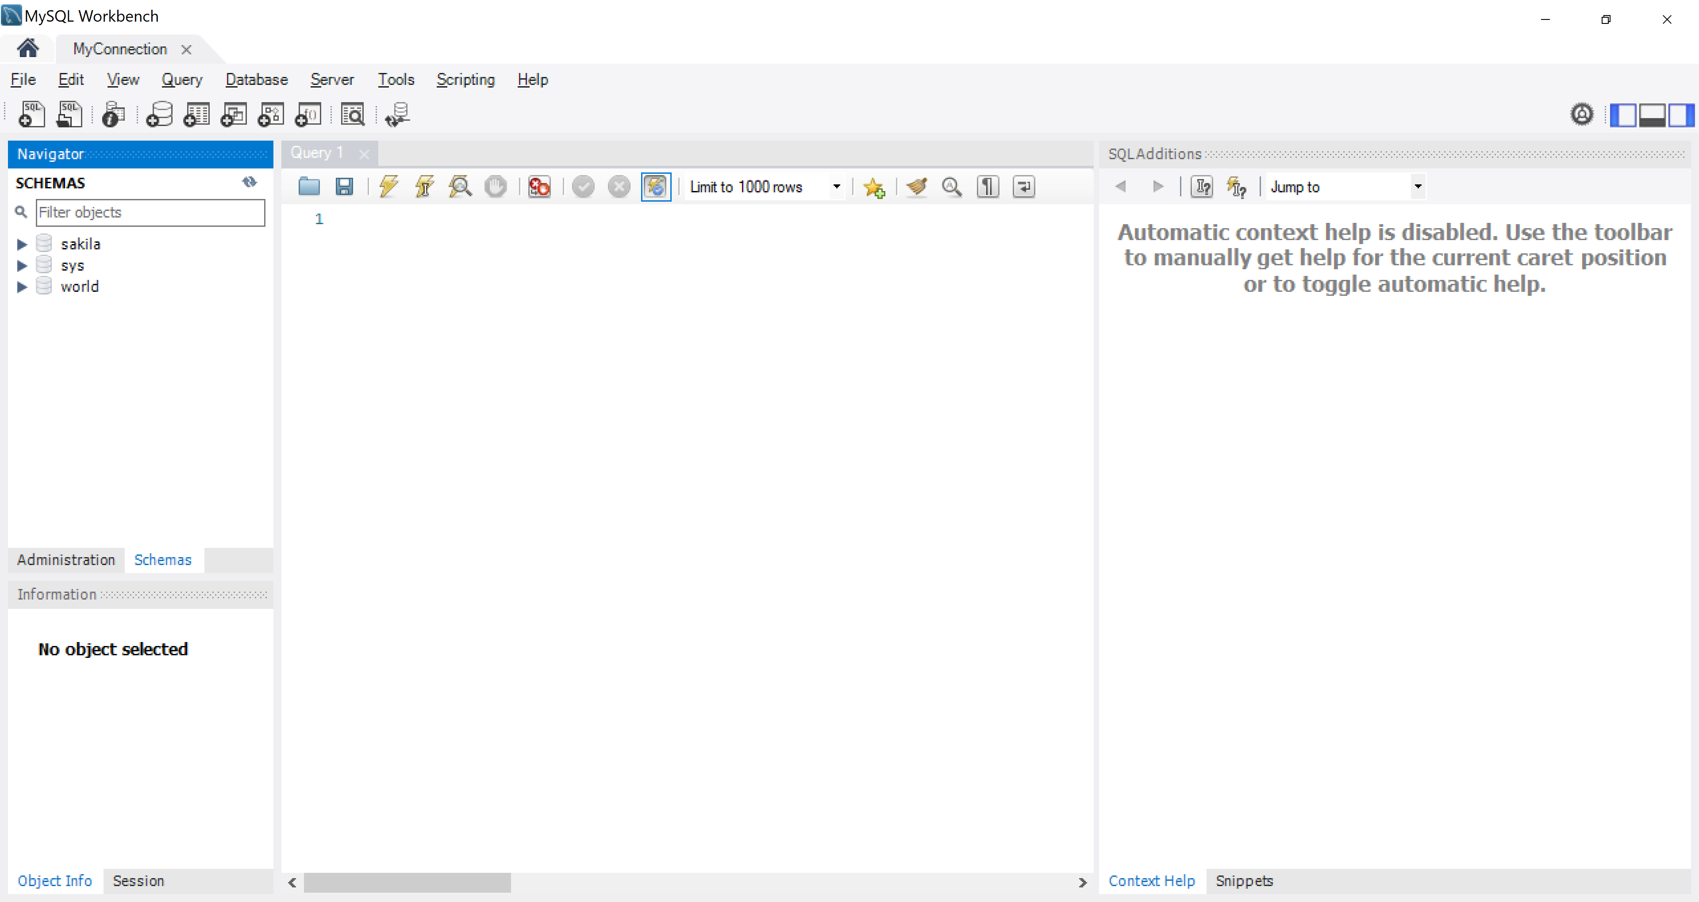
Sử dụng MySQL Workbench

Slide 36
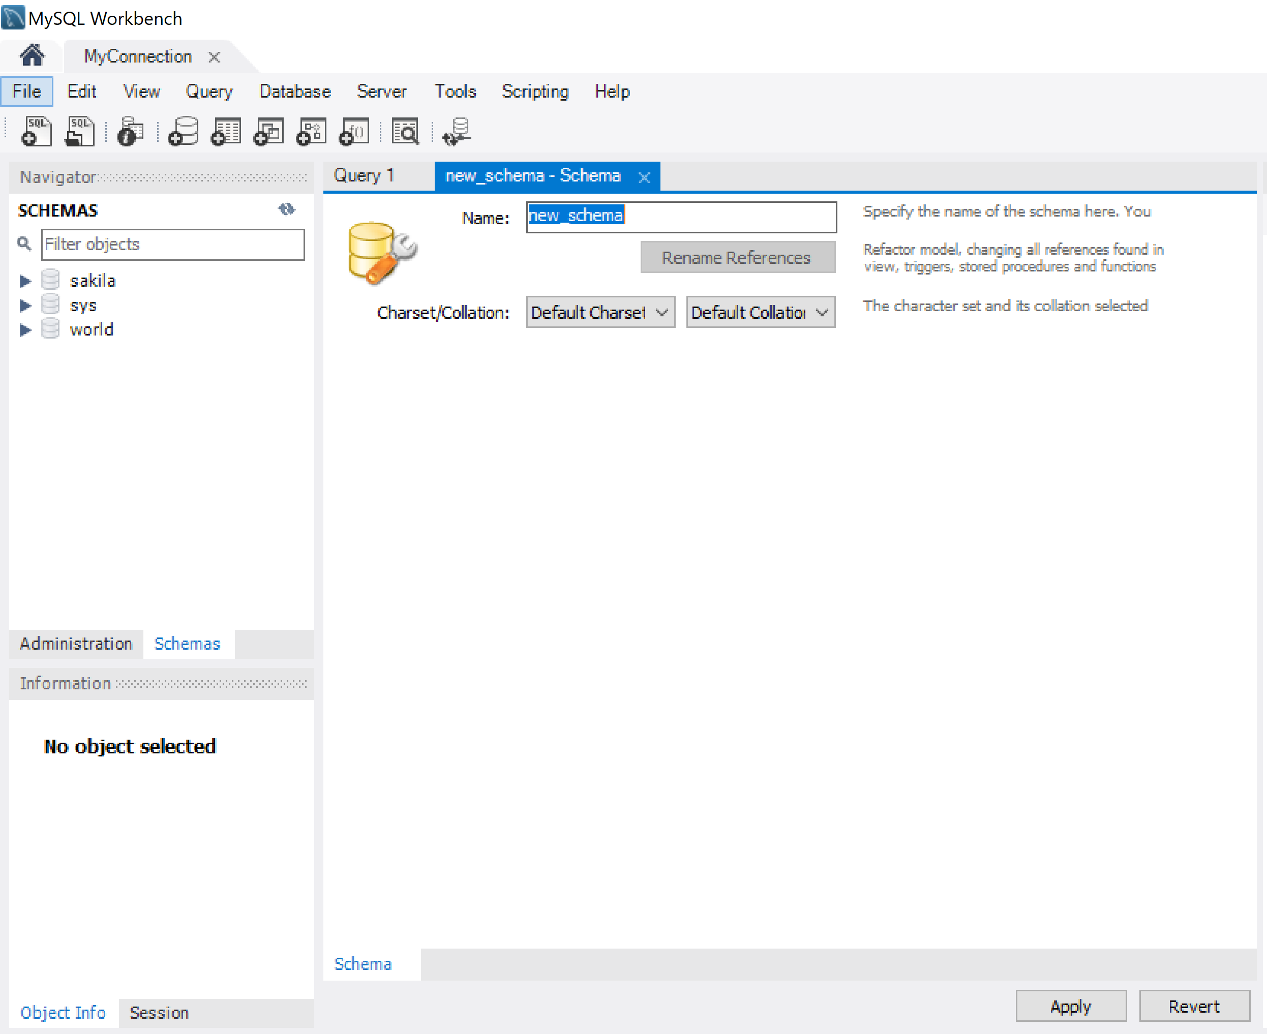
Sử dụng MySQL Workbench
New Schema

Slide 37
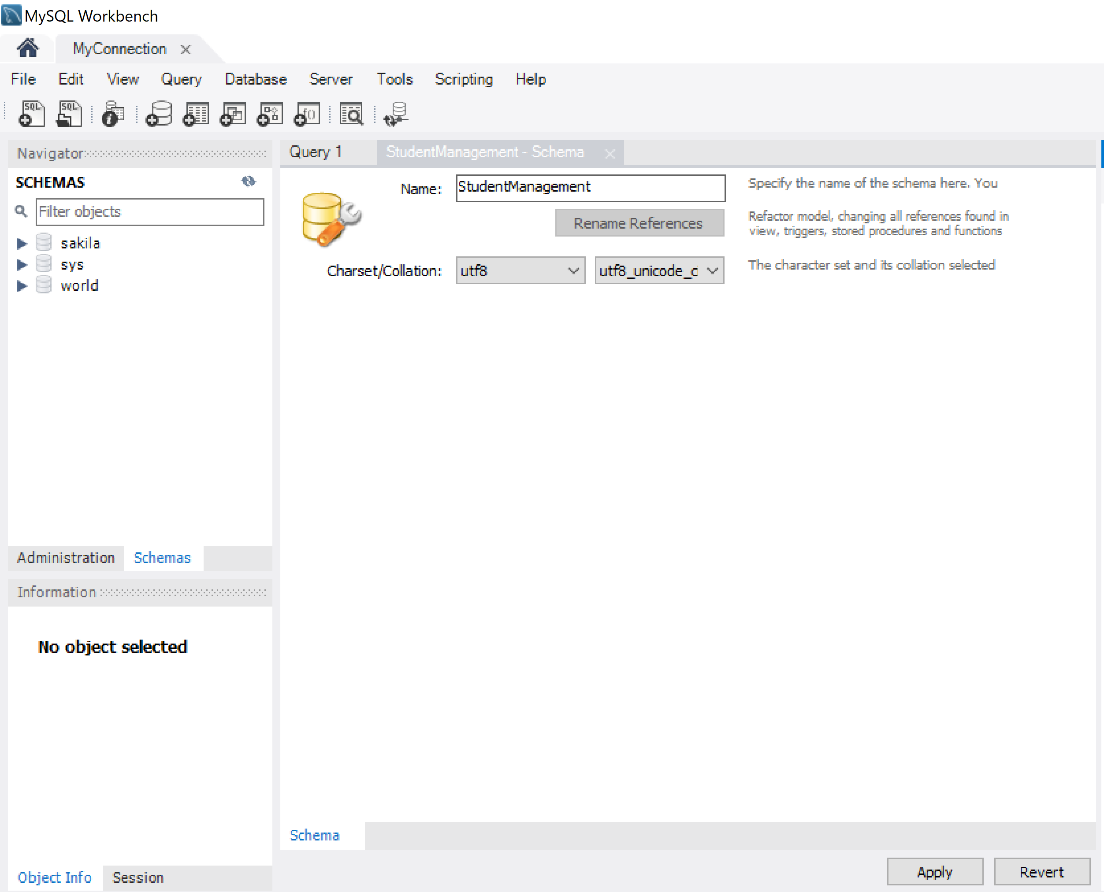
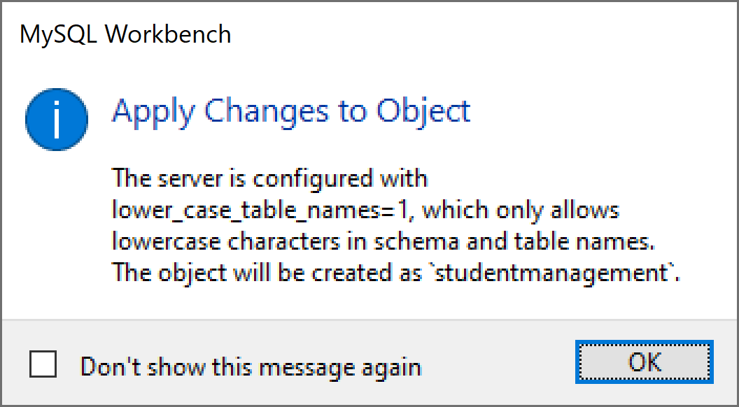
Sử dụng MySQL Workbench

Slide 38
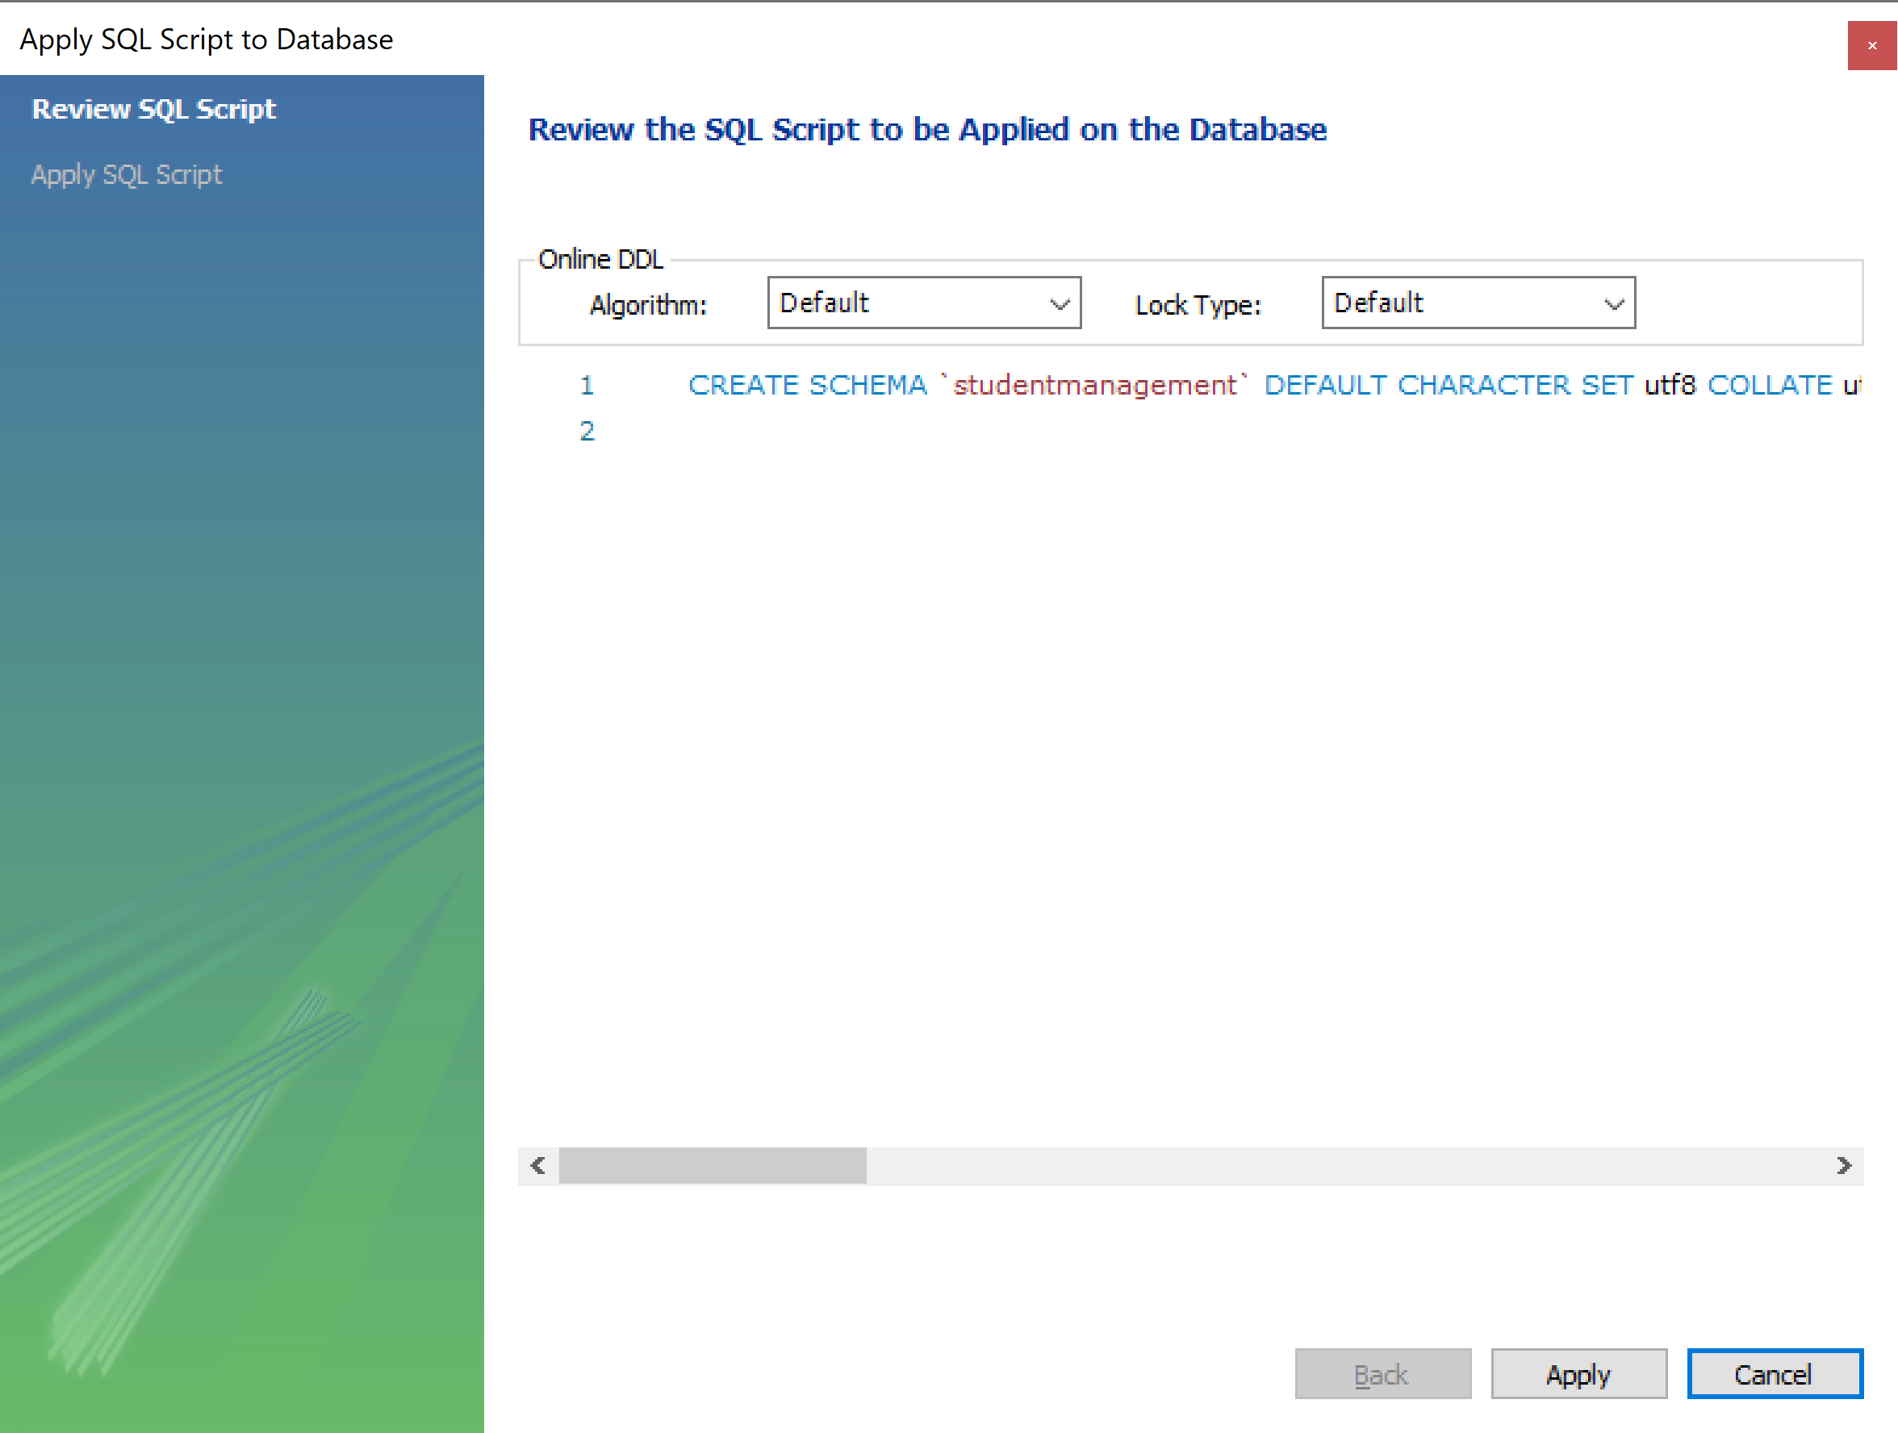
Sử dụng MySQL Workbench

Slide 39
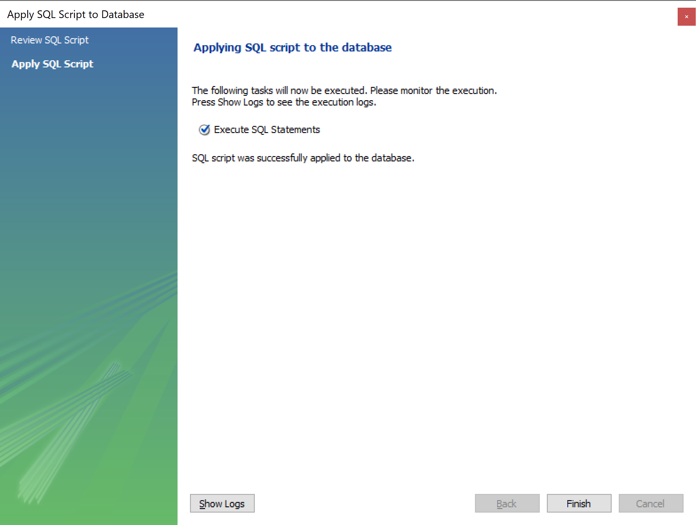
Sử dụng MySQL Workbench

Slide 40
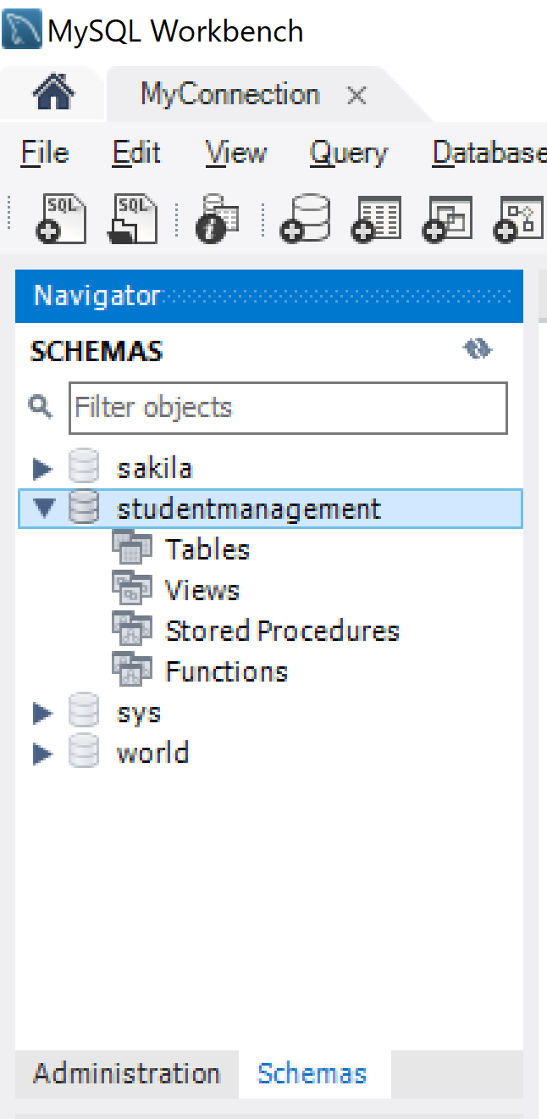
Sử dụng MySQL Workbench

Slide 41
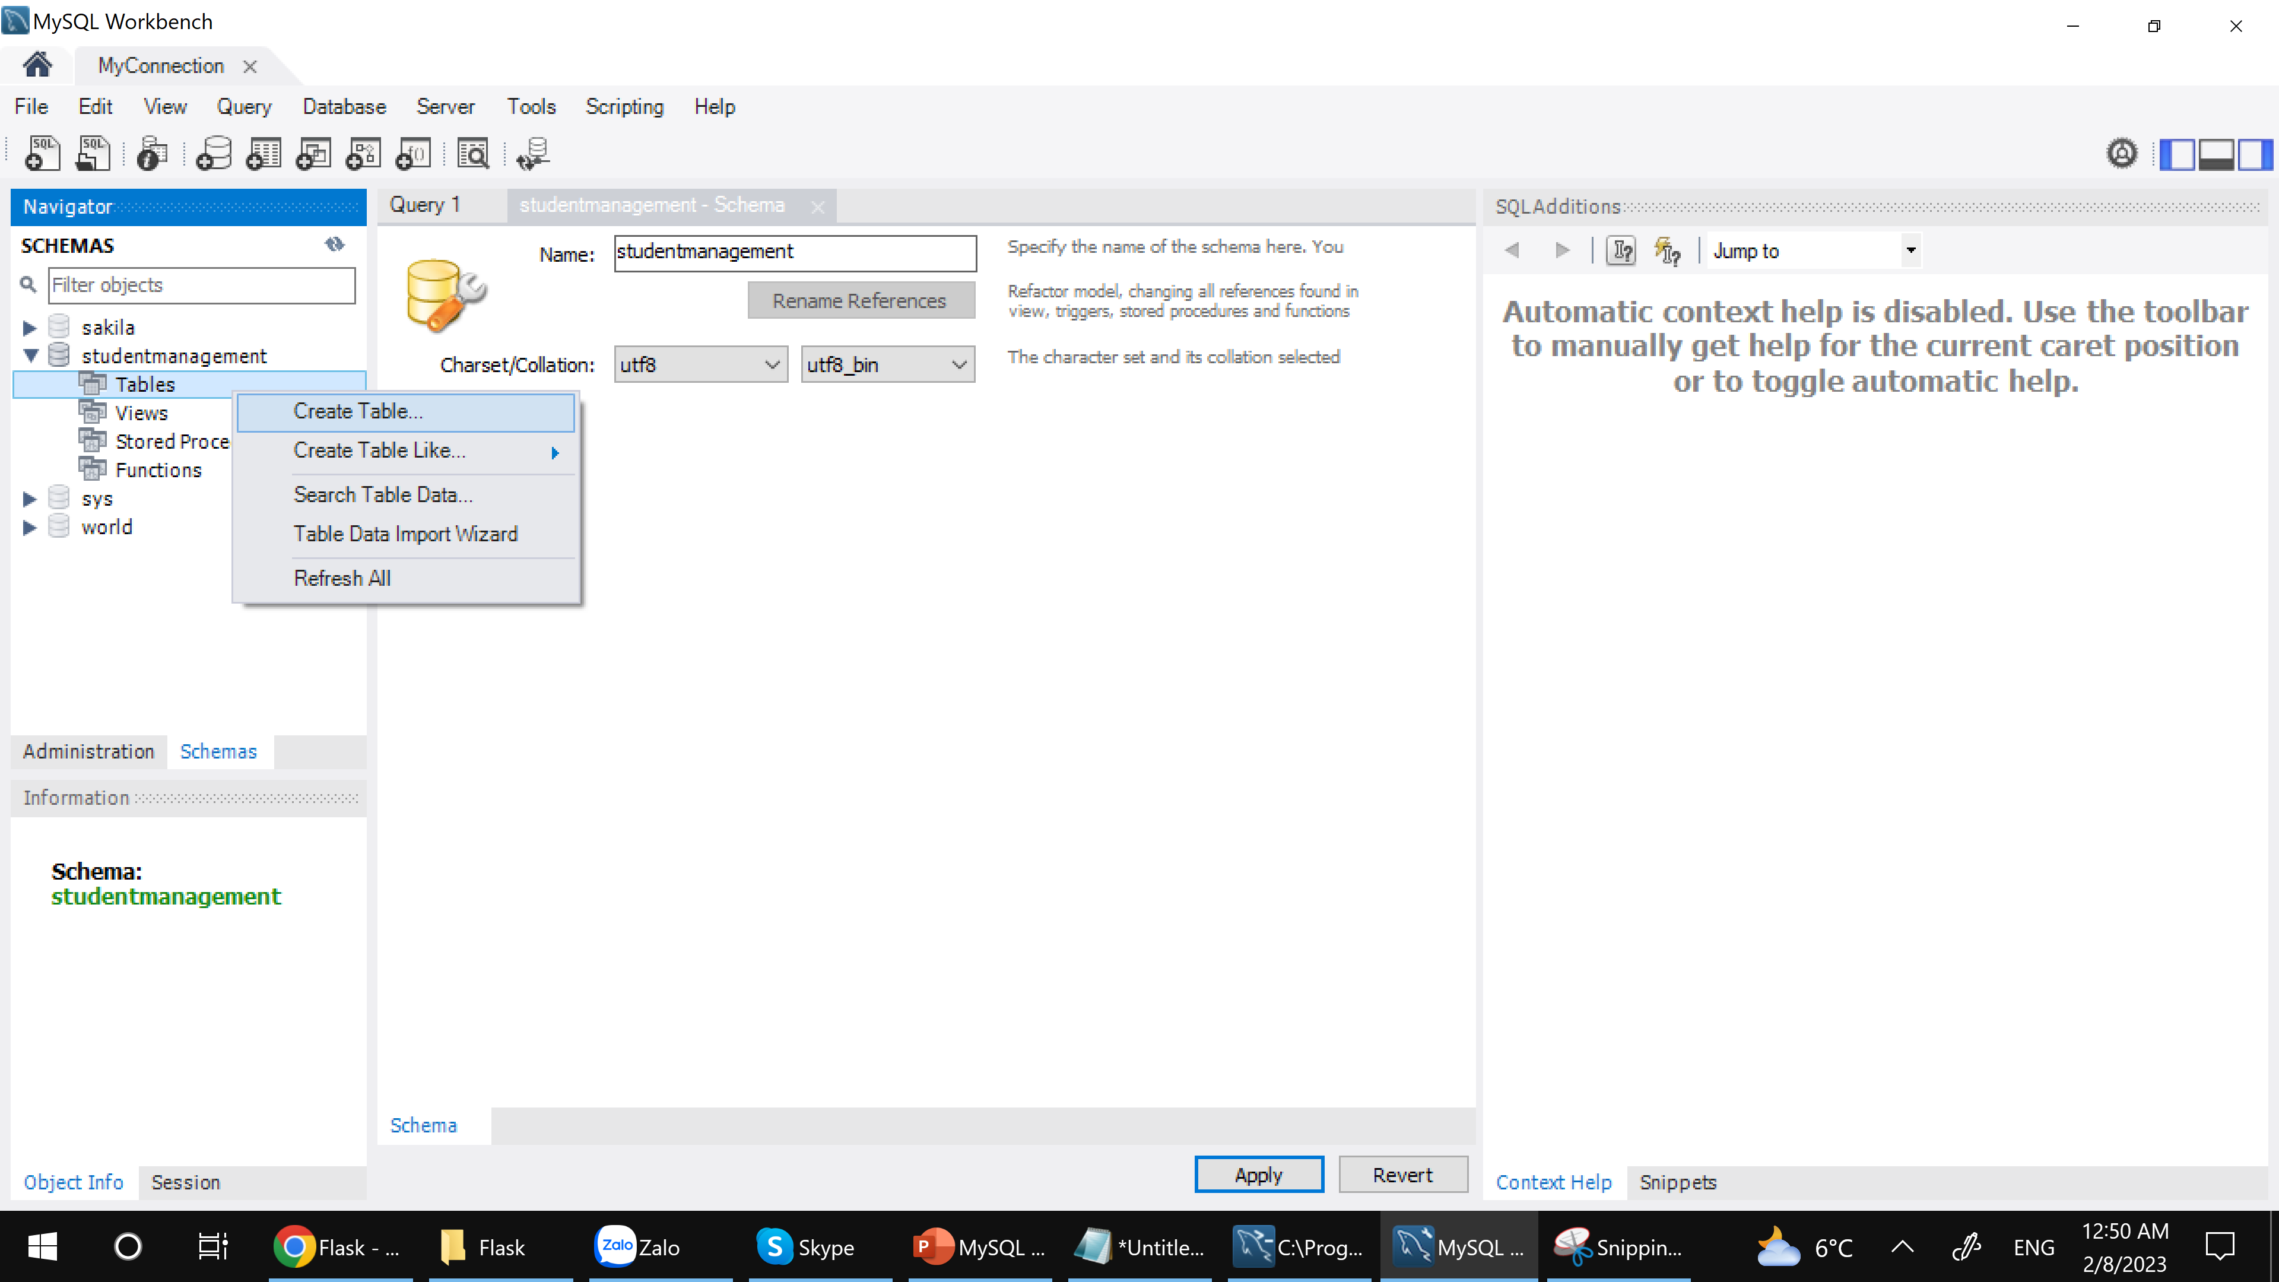
Sử dụng MySQL Workbench

Slide 42
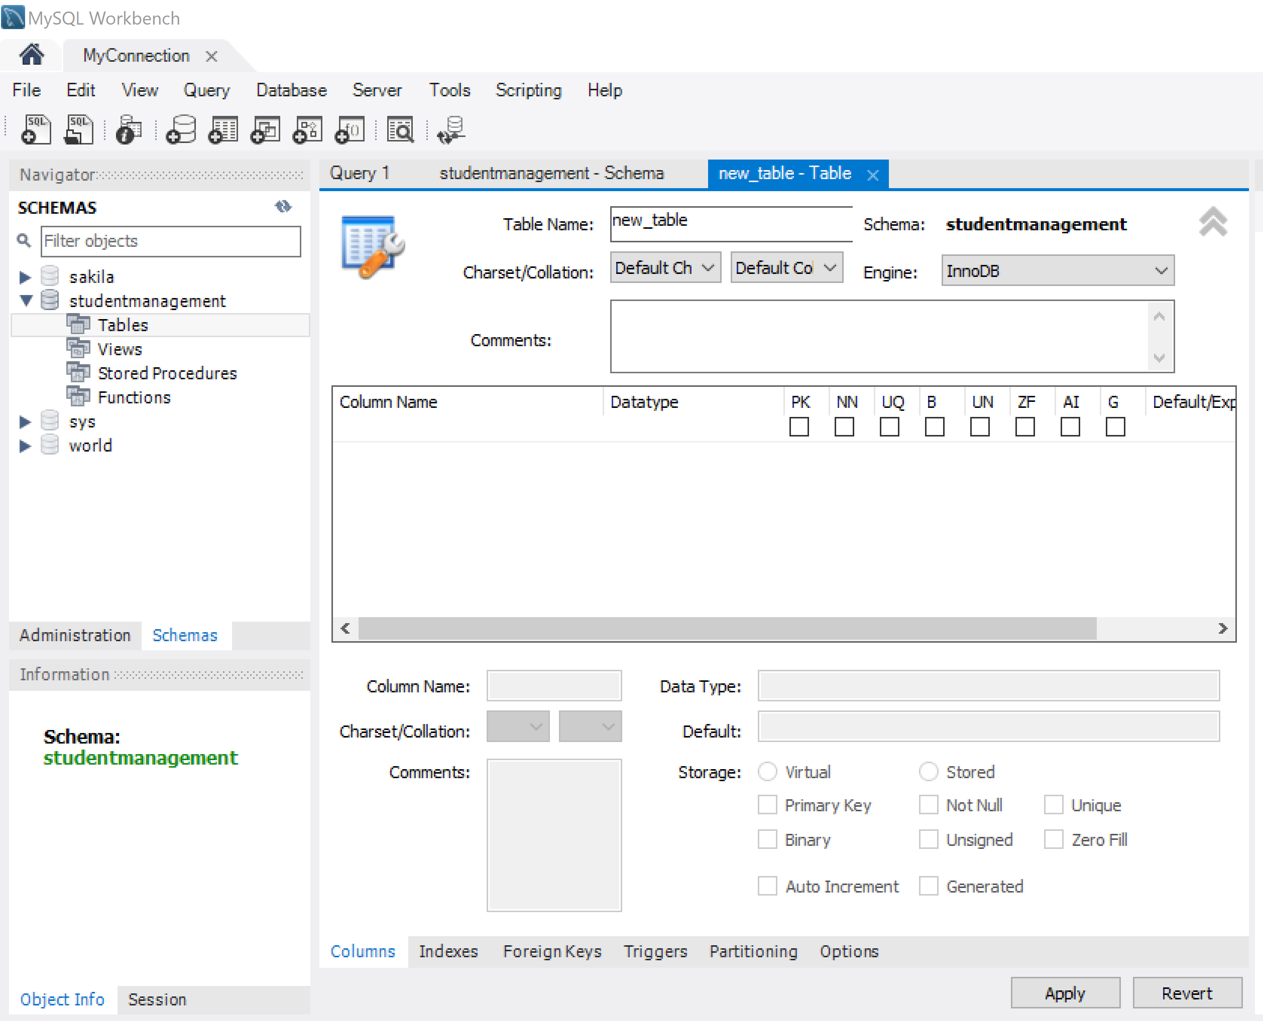
Sử dụng MySQL Workbench

Slide 43
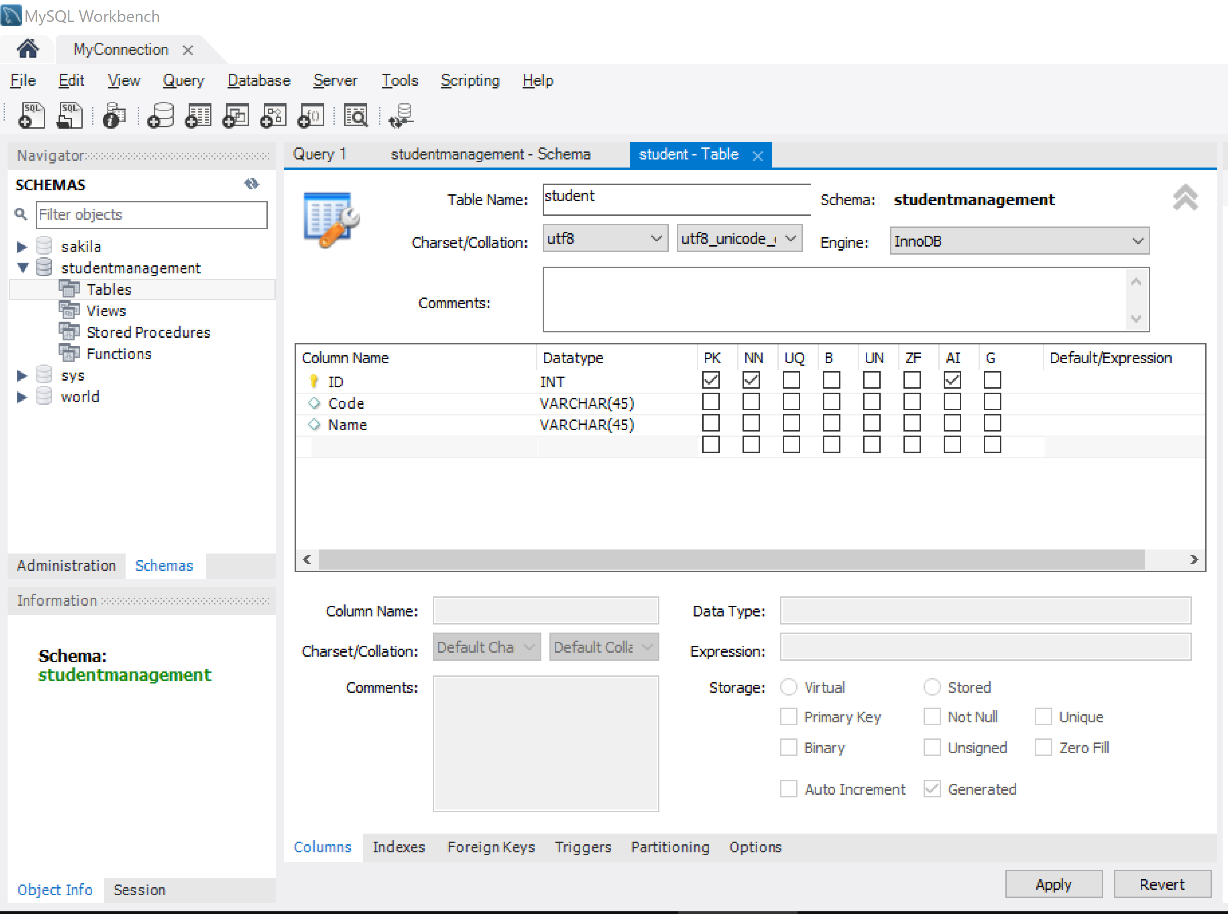
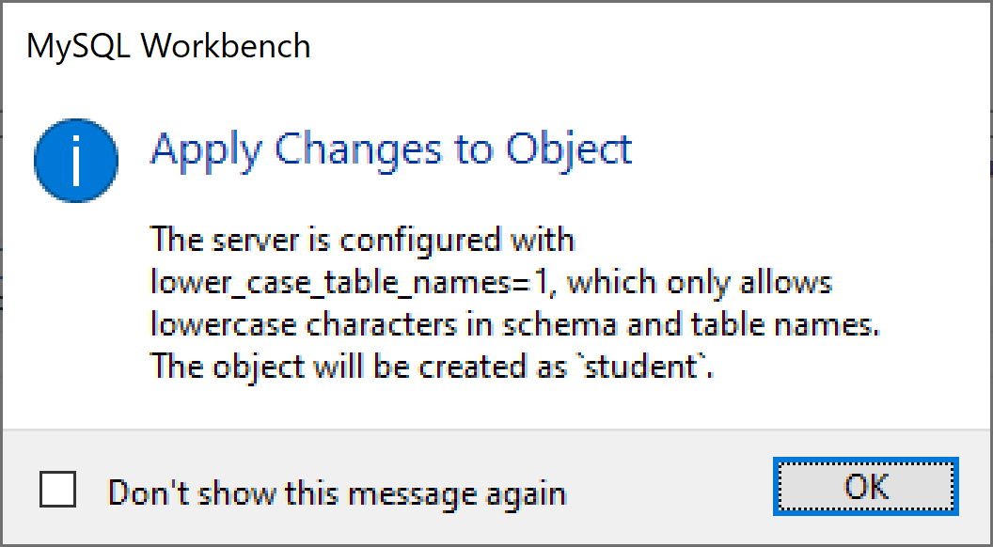
Sử dụng MySQL Workbench

Slide 44
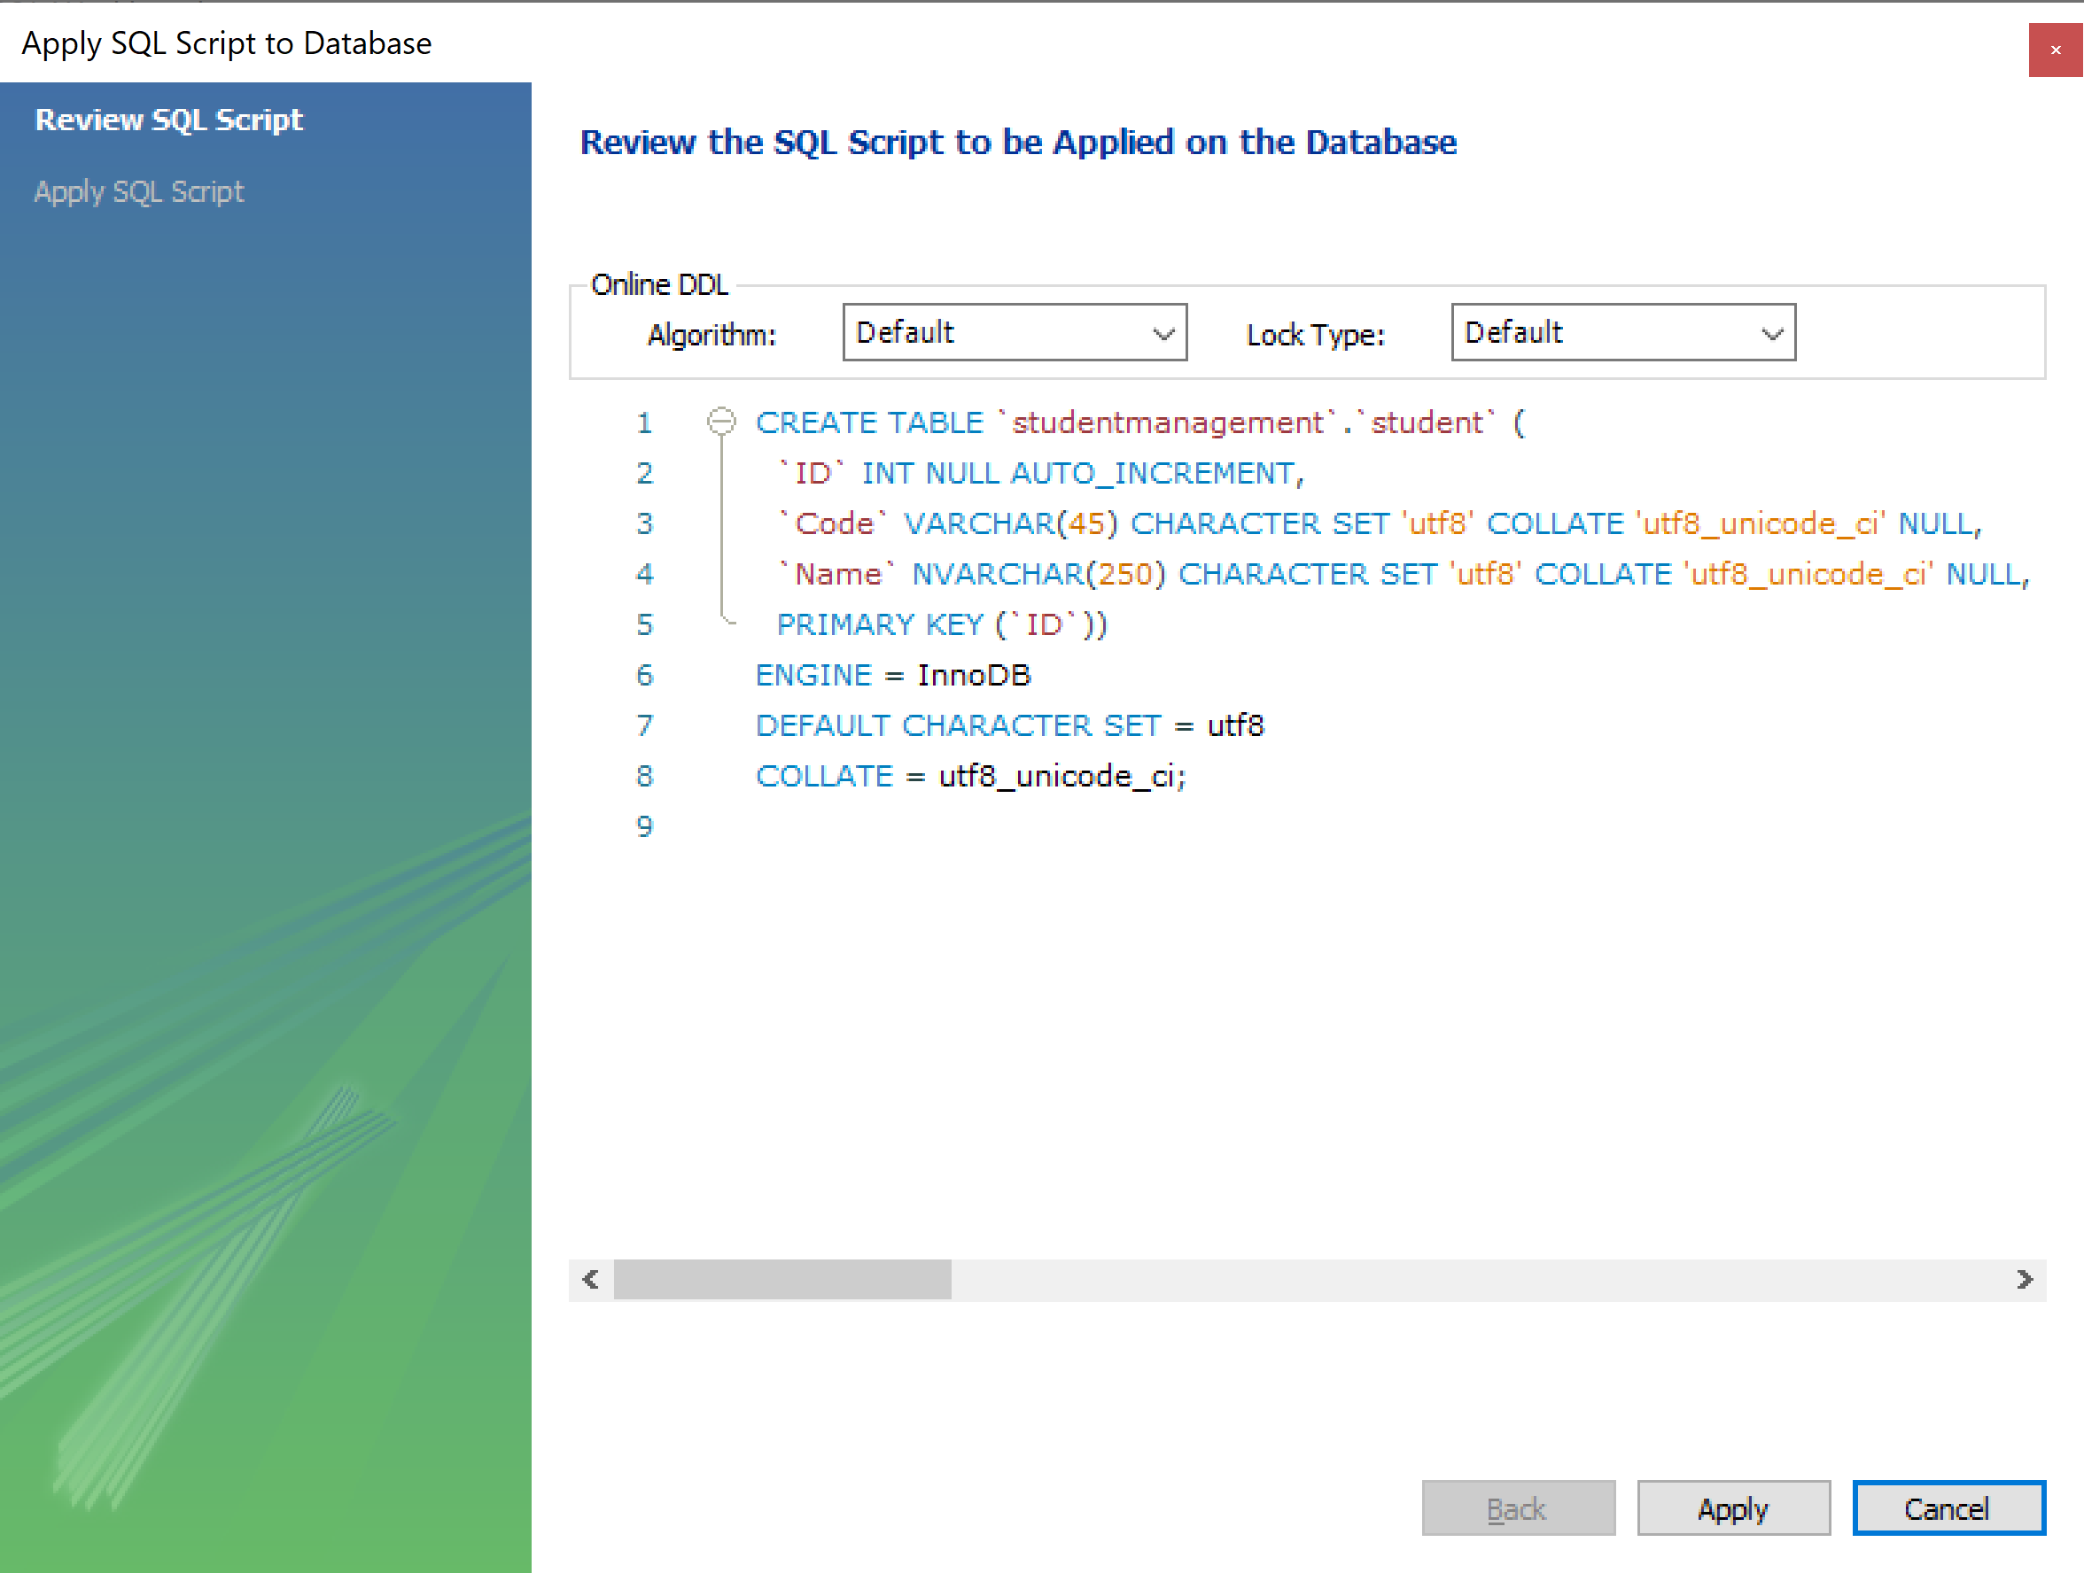
Sử dụng MySQL Workbench

Slide 45
Sử dụng MySQL Workbench

Slide 46
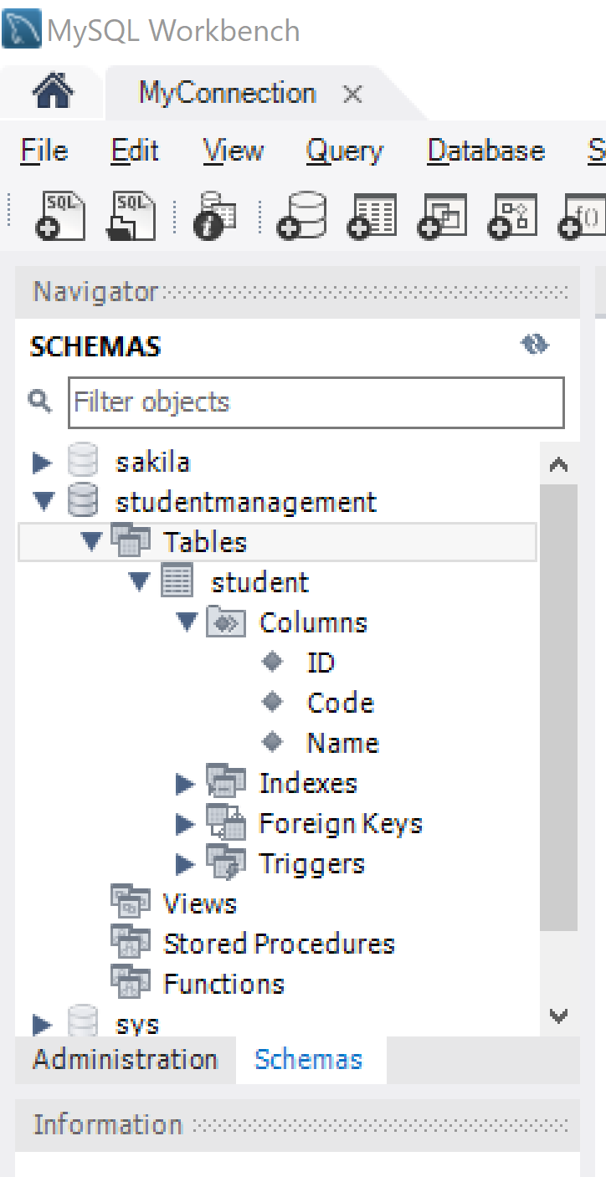
Sử dụng MySQL Workbench

Slide 47
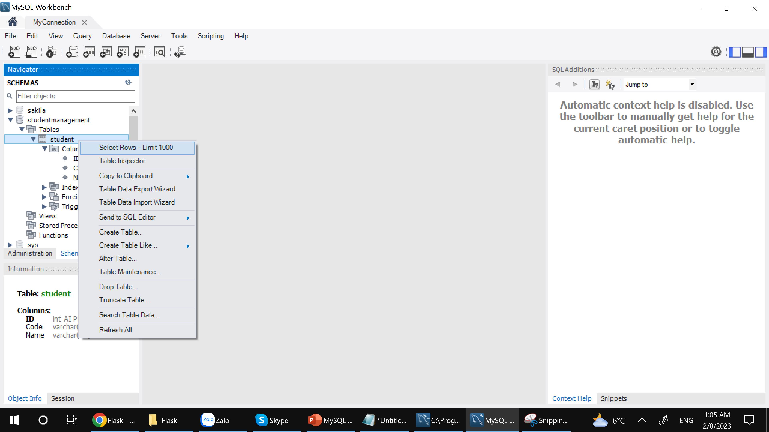
Sử dụng MySQL Workbench

Slide 48
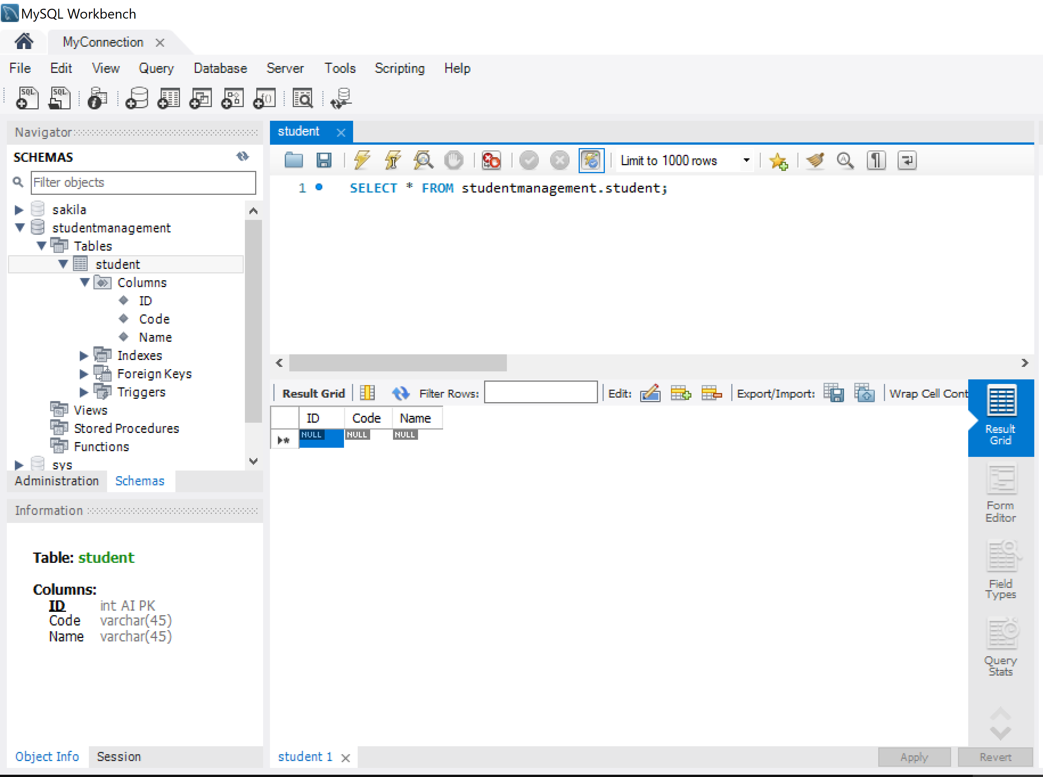
Sử dụng MySQL Workbench

Slide 49
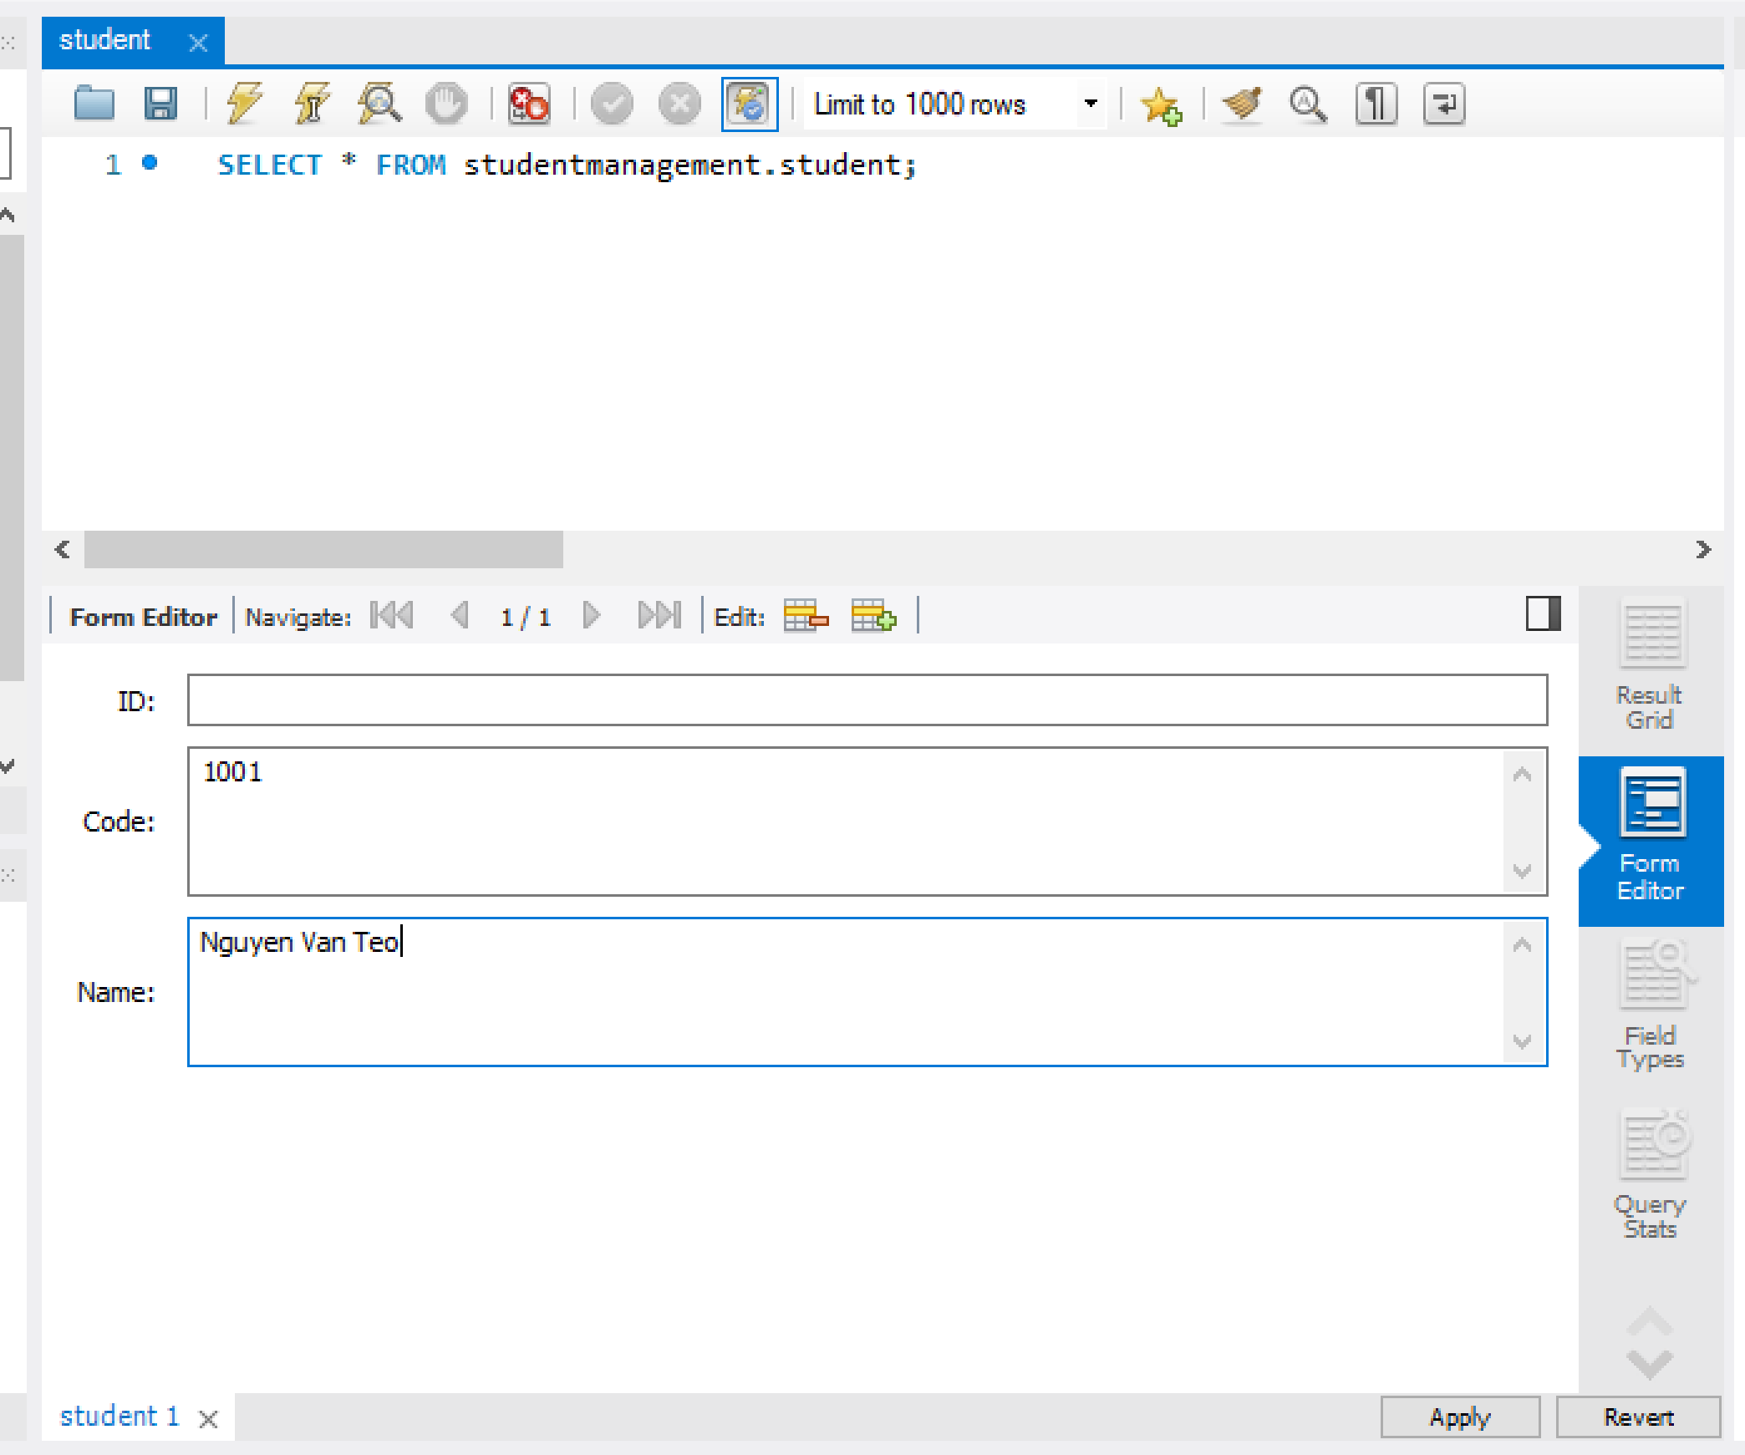
Sử dụng MySQL Workbench

Slide 50
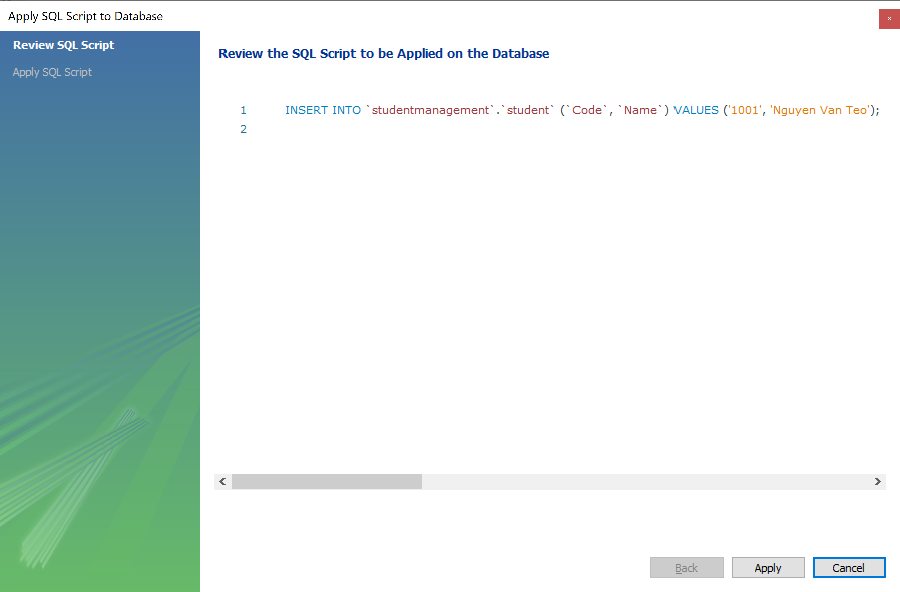
Sử dụng MySQL Workbench

Slide 51
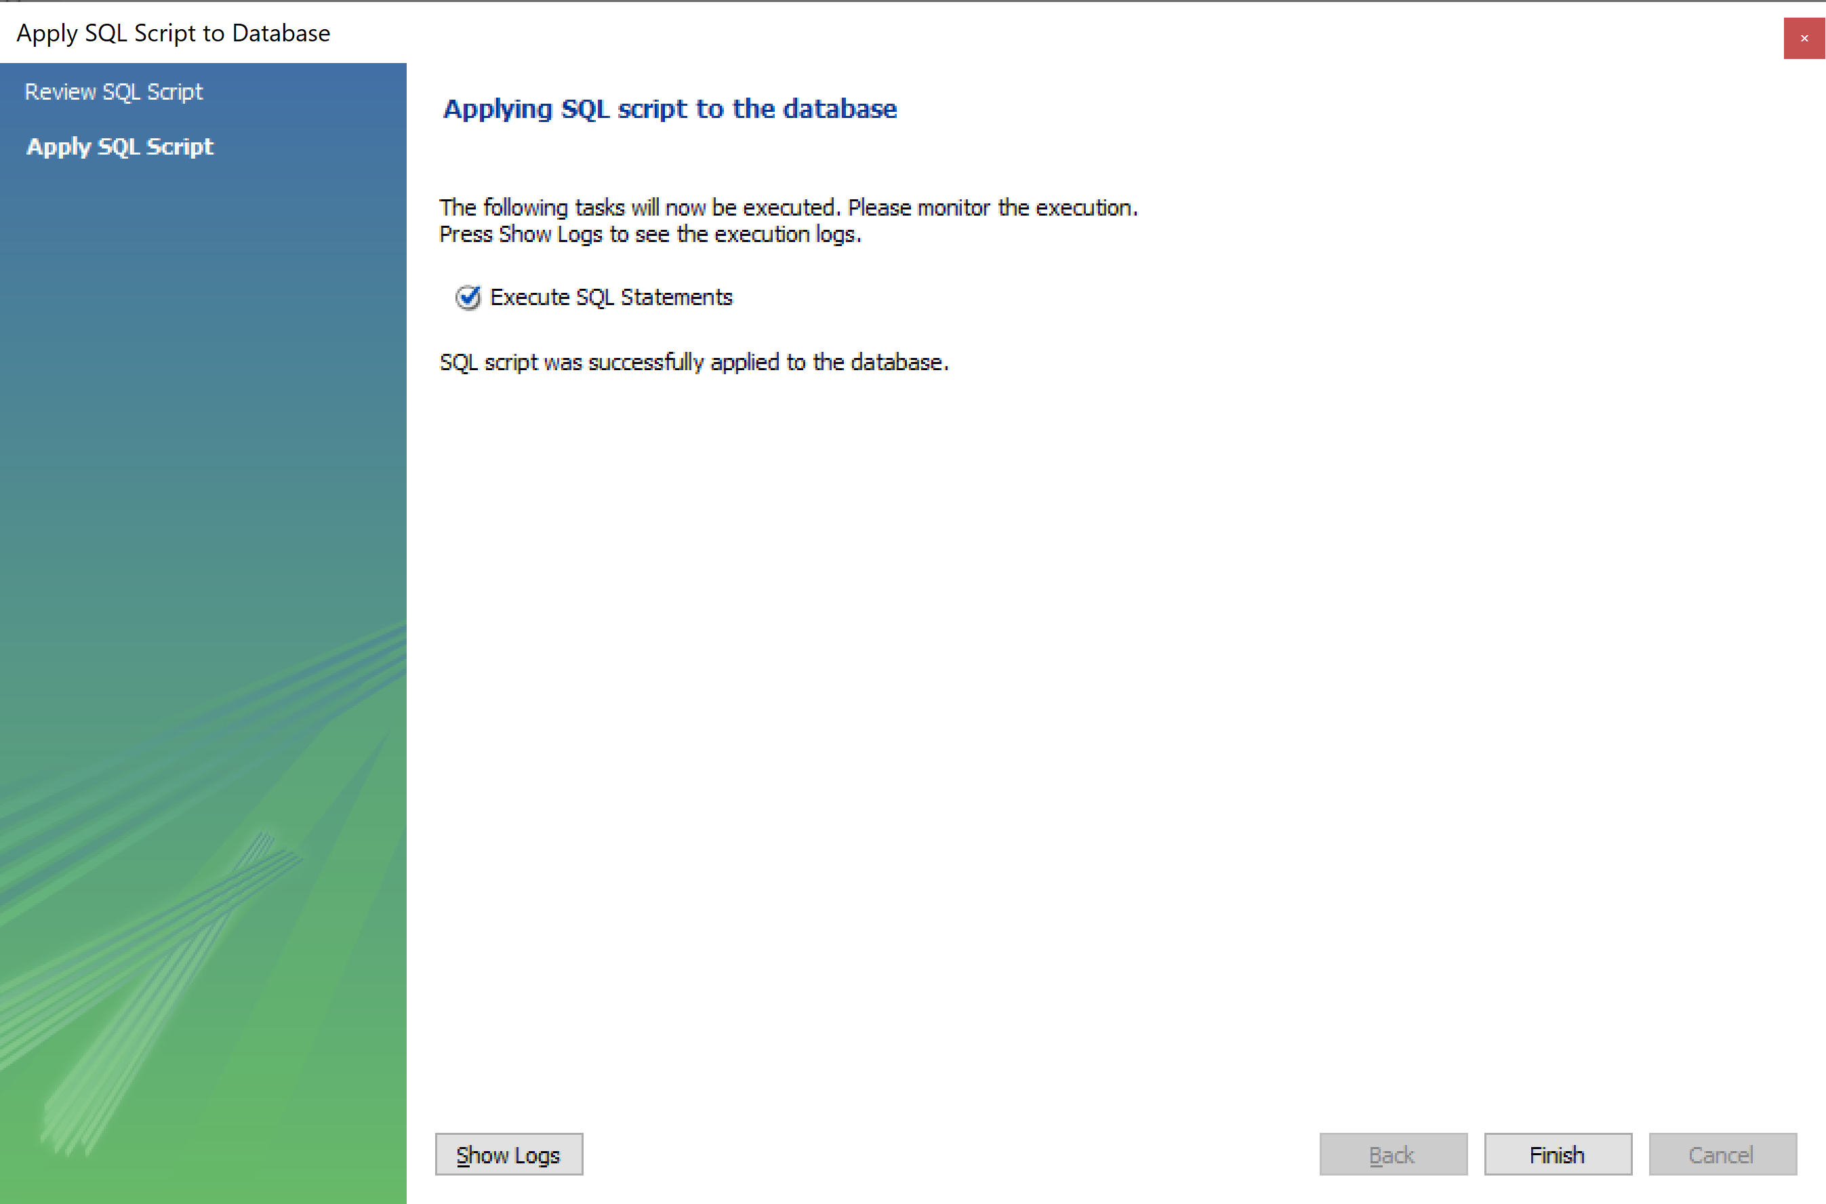
Sử dụng MySQL Workbench

Slide 52
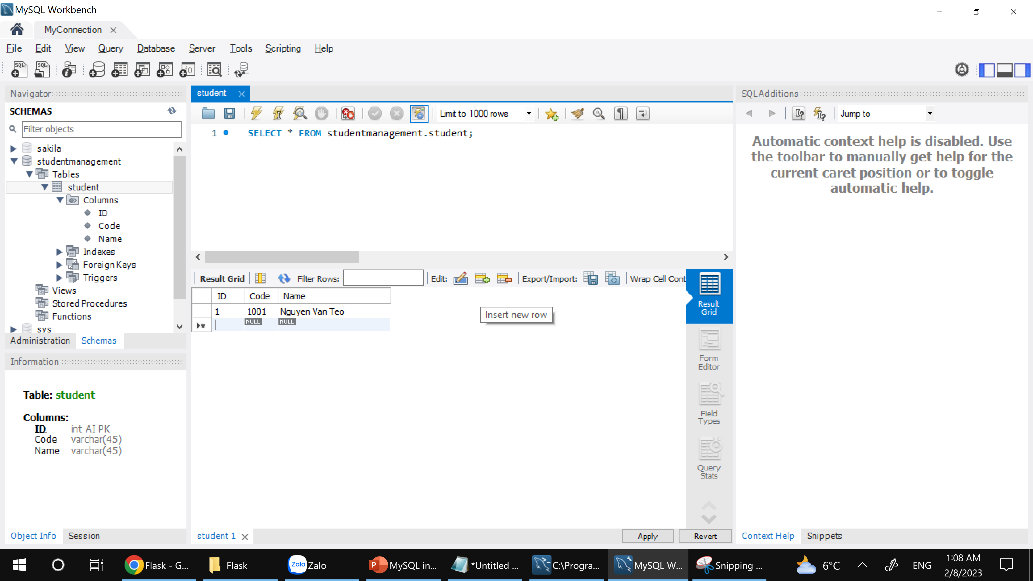
Sử dụng MySQL Workbench

Slide 53
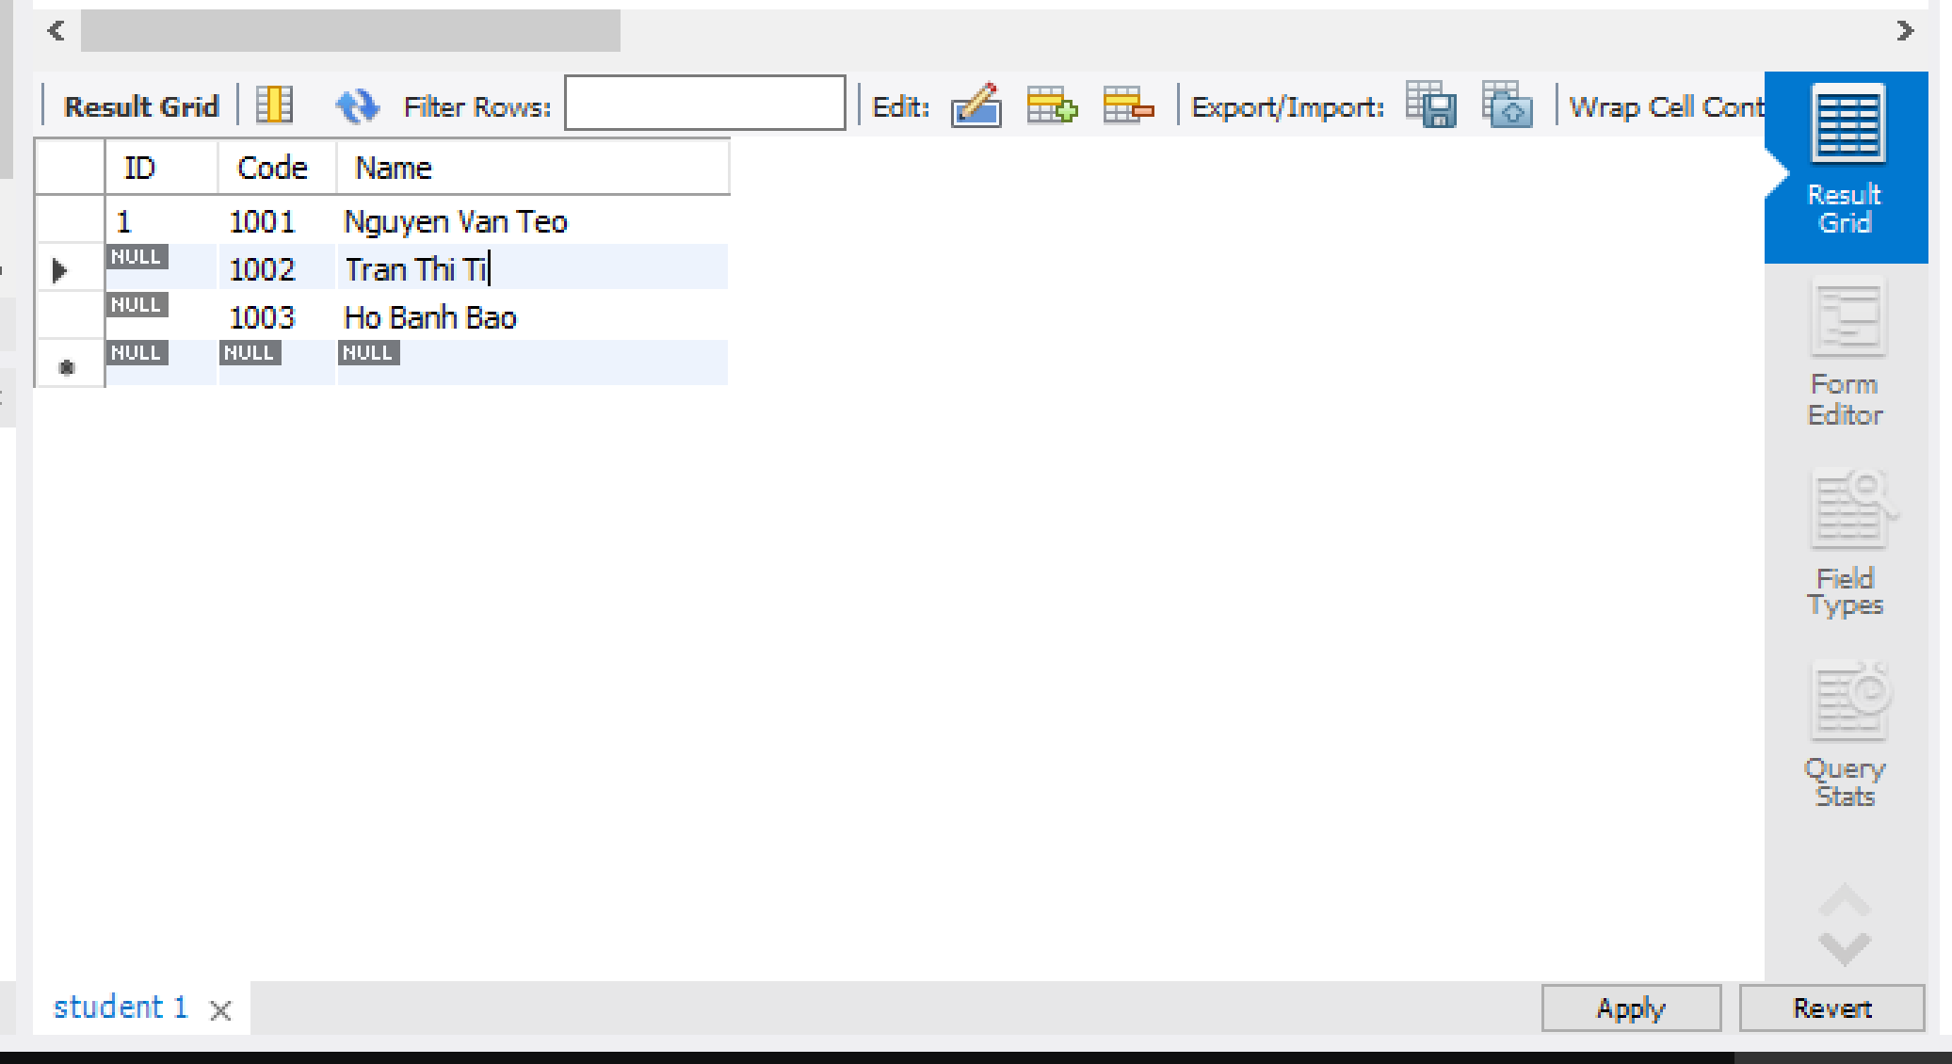
Sử dụng MySQL Workbench

Slide 54

Sử dụng MySQL Workbench

Slide 55

Sử dụng MySQL Workbench

Slide 56
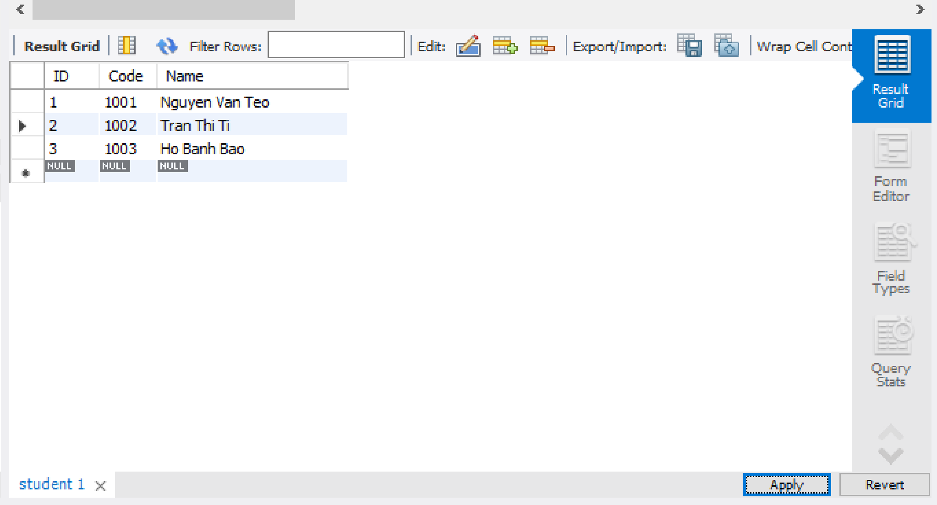
Sử dụng MySQL Workbench

Slide 57
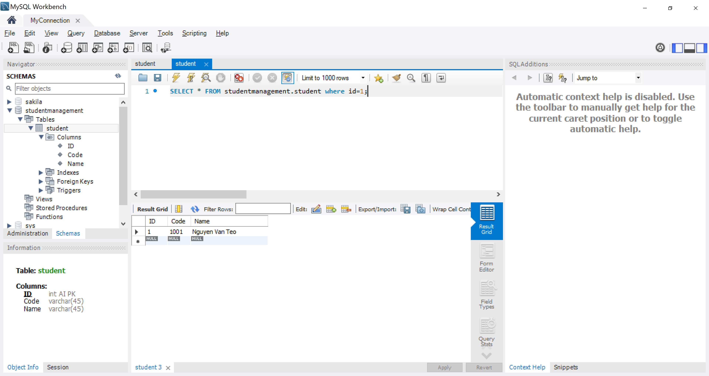
Sử dụng MySQL Workbench

Slide 58
Lập trình Python với MySQL
CRUD:
Select
Insert
Update
Delete
pip install flask
pip install flask-mysql
pip install markupsafe==2.0.1
from flask import Flask, render_template
from flaskext.mysql import MySQL

Slide 59
Lập trình Python với MySQL
from flask import Flask, render_template from flaskext.mysql import MySQL app = Flask(__name__) try: mysql=MySQL() # MySQL configurations app.config['MYSQL_DATABASE_USER'] = 'root' app.config['MYSQL_DATABASE_PASSWORD'] = '@Obama123' app.config['MYSQL_DATABASE_DB'] = 'studentmanagement' app.config['MYSQL_DATABASE_HOST'] = 'localhost' mysql.init_app(app) conn = mysql.connect() print("connection is successful!") cursor = conn.cursor() cursor.execute("select * from student") data = cursor.fetchall() print("ID\tCode\tName") for item in data: print(item[0],"\t",item[1],"\t",item[2]) except mysql.connector.Error as e: print("Error = ",e) finally: conn.close() cursor.close() print("Mysql is closed")
Select Student

Slide 60
Lập trình Python với MySQL
from flask import Flask, render_template from flaskext.mysql import MySQL app = Flask(__name__) try: mysql=MySQL() # MySQL configurations app.config['MYSQL_DATABASE_USER'] = 'root' app.config['MYSQL_DATABASE_PASSWORD'] = '@Obama123' app.config['MYSQL_DATABASE_DB'] = 'studentmanagement' app.config['MYSQL_DATABASE_HOST'] = 'localhost' mysql.init_app(app) conn = mysql.connect() print("connection is successful!") cursor = conn.cursor() cursor.execute("select ID,Code,Name from student") data = cursor.fetchmany(4) print("ID\tCode\tName") for item in data: print(item[0],"\t",item[1],"\t",item[2]) except mysql.connector.Error as e: print("Error = ",e) finally: conn.close() cursor.close() print("Mysql is closed")
Select Many Student

Slide 61
Lập trình Python với MySQL
from flask import Flask, render_template from flaskext.mysql import MySQL app = Flask(__name__) try: mysql=MySQL() # MySQL configurations app.config['MYSQL_DATABASE_USER'] = 'root' app.config['MYSQL_DATABASE_PASSWORD'] = '@Obama123' app.config['MYSQL_DATABASE_DB'] = 'studentmanagement' app.config['MYSQL_DATABASE_HOST'] = 'localhost' mysql.init_app(app) conn = mysql.connect() print("connection is successful!") cursor = conn.cursor() cursor.execute("select * from student") data = cursor.fetchone() print(data) except mysql.connector.Error as e: print("Error = ",e) finally: conn.close() cursor.close() print("Mysql is closed")
Select One Student

Slide 62
Lập trình Python với MySQL
from flask import Flask, render_template from flaskext.mysql import MySQL app = Flask(__name__) try: mysql=MySQL() # MySQL configurations app.config['MYSQL_DATABASE_USER'] = 'root' app.config['MYSQL_DATABASE_PASSWORD'] = '@Obama123' app.config['MYSQL_DATABASE_DB'] = 'studentmanagement' app.config['MYSQL_DATABASE_HOST'] = 'localhost' mysql.init_app(app) conn = mysql.connect() print("connection is successful!") cursor = conn.cursor() cursor.execute("select * from student order by name desc") data = cursor.fetchall() print("ID\tCode\tName") for item in data: print(item[0],"\t",item[1],"\t",item[2]) except mysql.connector.Error as e: print("Error = ",e) finally: conn.close() cursor.close() print("Mysql is closed")
Select Order Student

Slide 63
Lập trình Python với MySQL
from flask import Flask, render_template from flaskext.mysql import MySQL app = Flask(__name__) try: mysql=MySQL() # MySQL configurations app.config['MYSQL_DATABASE_USER'] = 'root' app.config['MYSQL_DATABASE_PASSWORD'] = '@Obama123' app.config['MYSQL_DATABASE_DB'] = 'studentmanagement' app.config['MYSQL_DATABASE_HOST'] = 'localhost' mysql.init_app(app) conn = mysql.connect() print("connection is successful!") cursor = conn.cursor() cursor.execute("select * from student where Code='789'") data = cursor.fetchall() print("ID\tCode\tName") for item in data: print(item[0],"\t",item[1],"\t",item[2]) except mysql.connector.Error as e: print("Error = ",e) finally: conn.close() cursor.close() print("Mysql is closed")
Select Where Student

Slide 64
Lập trình Python với MySQL
from flask import Flask, render_template from flaskext.mysql import MySQL app = Flask(__name__) try: mysql=MySQL() # MySQL configurations app.config['MYSQL_DATABASE_USER'] = 'root' app.config['MYSQL_DATABASE_PASSWORD'] = '@Obama123' app.config['MYSQL_DATABASE_DB'] = 'studentmanagement' app.config['MYSQL_DATABASE_HOST'] = 'localhost' mysql.init_app(app) conn = mysql.connect() print("connection is successful!") cursor = conn.cursor() cursor.execute("SELECT * FROM student LIMIT 4 OFFSET 3") data = cursor.fetchall() print("ID\tCode\tName") for item in data: print(item[0],"\t",item[1],"\t",item[2]) except mysql.connector.Error as e: print("Error = ",e) finally: conn.close() cursor.close() print("Mysql is closed")
Select Paging Student

Slide 65
Lập trình Python với MySQL
from flask import Flask, render_template from flaskext.mysql import MySQL app = Flask(__name__) try: mysql=MySQL() # MySQL configurations app.config['MYSQL_DATABASE_USER'] = 'root' app.config['MYSQL_DATABASE_PASSWORD'] = '@Obama123' app.config['MYSQL_DATABASE_DB'] = 'studentmanagement' app.config['MYSQL_DATABASE_HOST'] = 'localhost' mysql.init_app(app) conn = mysql.connect() print("connection is successful!") cursor = conn.cursor() sql="insert into student (code,name) values (%s,%s)" val=("SV01","Thanh Tran") cursor.execute(sql,val) conn.commit() print(cursor.rowcount," record inserted") except mysql.connector.Error as e: print("Error = ",e) finally: conn.close() cursor.close() print("Mysql is closed")
Insert One Student

Slide 66
Lập trình Python với MySQL
from flask import Flask, render_template from flaskext.mysql import MySQL app = Flask(__name__) try: mysql=MySQL() # MySQL configurations app.config['MYSQL_DATABASE_USER'] = 'root' app.config['MYSQL_DATABASE_PASSWORD'] = '@Obama123' app.config['MYSQL_DATABASE_DB'] = 'studentmanagement' app.config['MYSQL_DATABASE_HOST'] = 'localhost' mysql.init_app(app) conn = mysql.connect() print("connection is successful!") cursor = conn.cursor() sql="insert into student (code,name) values (%s,%s)" val=[("SV03","Pham Dieu"), ("SV04", "Thanh Tran"), ("SV05", "Man Nhi"), ] cursor.executemany(sql,val) conn.commit() print(cursor.rowcount," record inserted") except mysql.connector.Error as e: print("Error = ",e) finally: conn.close() cursor.close() print("Mysql is closed")
Insert Many Student

Slide 67
Lập trình Python với MySQL
from flask import Flask, render_template from flaskext.mysql import MySQL app = Flask(__name__) try: mysql=MySQL() # MySQL configurations app.config['MYSQL_DATABASE_USER'] = 'root' app.config['MYSQL_DATABASE_PASSWORD'] = '@Obama123' app.config['MYSQL_DATABASE_DB'] = 'studentmanagement' app.config['MYSQL_DATABASE_HOST'] = 'localhost' mysql.init_app(app) conn = mysql.connect() print("connection is successful!") cursor = conn.cursor() sql="update student set name='Pham Tang' where Code='456'" cursor.execute(sql) conn.commit() print(cursor.rowcount," record(s) affected") except mysql.connector.Error as e: print("Error = ",e) finally: conn.close() cursor.close() print("Mysql is closed")
Update One Student

Slide 68
Lập trình Python với MySQL
from flask import Flask, render_template from flaskext.mysql import MySQL app = Flask(__name__) try: mysql=MySQL() # MySQL configurations app.config['MYSQL_DATABASE_USER'] = 'root' app.config['MYSQL_DATABASE_PASSWORD'] = '@Obama123' app.config['MYSQL_DATABASE_DB'] = 'studentmanagement' app.config['MYSQL_DATABASE_HOST'] = 'localhost' mysql.init_app(app) conn = mysql.connect() print("connection is successful!") cursor = conn.cursor() sql="update student set name=%s where Code=%s" val=('Pham Tang','789') cursor.execute(sql,val) conn.commit() print(cursor.rowcount," record(s) affected") except mysql.connector.Error as e: print("Error = ",e) finally: conn.close() cursor.close() print("Mysql is closed")
Update SQL Injection Student

Slide 69
Lập trình Python với MySQL
from flask import Flask, render_template from flaskext.mysql import MySQL app = Flask(__name__) try: mysql=MySQL() # MySQL configurations app.config['MYSQL_DATABASE_USER'] = 'root' app.config['MYSQL_DATABASE_PASSWORD'] = '@Obama123' app.config['MYSQL_DATABASE_DB'] = 'studentmanagement' app.config['MYSQL_DATABASE_HOST'] = 'localhost' mysql.init_app(app) conn = mysql.connect() print("connection is successful!") cursor = conn.cursor() sql="DELETE from student where Code='456'" cursor.execute(sql) conn.commit() print(cursor.rowcount," record(s) affected") except mysql.connector.Error as e: print("Error = ",e) finally: conn.close() cursor.close() print("Mysql is closed")
Delete Student

Slide 70
Lập trình Python với MySQL
from flask import Flask, render_template from flaskext.mysql import MySQL app = Flask(__name__) try: mysql=MySQL() # MySQL configurations app.config['MYSQL_DATABASE_USER'] = 'root' app.config['MYSQL_DATABASE_PASSWORD'] = '@Obama123' app.config['MYSQL_DATABASE_DB'] = 'studentmanagement' app.config['MYSQL_DATABASE_HOST'] = 'localhost' mysql.init_app(app) conn = mysql.connect() print("connection is successful!") cursor = conn.cursor() sql="DELETE from student where Code=%s" val=("789") cursor.execute(sql,val) conn.commit() print(cursor.rowcount," record(s) affected") except mysql.connector.Error as e: print("Error = ",e) finally: conn.close() cursor.close() print("Mysql is closed")
Update SQL Injection Student

Slide 71
Lập trình Python với MySQL
Trường hợp Flask cài không được thì có thể cái mysql connector
python -m pip install mysql-connector-python
https://www.w3schools.com/python/python_mysql_getstarted.asp

Slide 72
Lập trình Python với MySQL
from flask import Flask import mysql.connector import pandas as pd import matplotlib.pyplot as plt import seaborn as sns import plotly.express as px from sklearn.cluster import KMeans import numpy as np app = Flask(__name__) import traceback def getConnect(server,port,database,username,password): try: mydb = mysql.connector.connect( host=server, port=port, database=database, user=username, password=password, ) return mydb except: traceback.print_exc() return None

Slide 73
Lập trình Python với MySQL
def closeConnection(conn): if conn!=None: conn.close() def queryDataset(conn,sql): cursor = conn.cursor() cursor.execute(sql) df=pd.DataFrame(cursor.fetchall()) return df conn=getConnect('localhost',3306,'studentmanagement','root','@Obama123') sql1="select * from student" df1=queryDataset(conn,sql1) print(df1)

Slide 74
Bài học tiếp theo
3. Các nhóm giải thuật máy học
3.1. Nhóm giải thuật Linear Regression và ứng dụng
3.2. Nhóm giải thuật Logistic Regression và ứng dụng
3.3. Nhóm giải thuật Classification và ứng dụng

Slide 75
THANK YOU!

